Slide 1
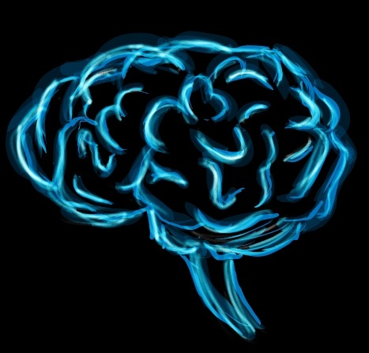
Write down everything you know about the brain.
Day 1
Place Date Here
Write in complete sentences or loss of credit.
Notes:
myelin or myelin sheath

Slide 2
What are nerve cells that provide communication through the body called?
Notes:
Neurons

Slide 3
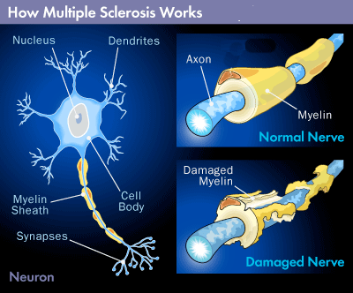
Multiple sclerosis(MS) is a disease in which the immune system mistakenly destroys some of the myelin wrapped around a part of the nerve cell. Which part of the nerve cells are being attacked by this process?
Day 2
Place Date Here
(There is no cure for MS. Some people with MS have trouble walking or talking and destined to a wheel chair, while others have milder symptoms that flare and subside.)
Write in complete sentences or loss of credit.
Notes:
Axon
Multiple sclerosis(MS) is a disease in which the immune system mistakenly destroys some of the myelin wrapped around nerve cell fibers. Which nerve cell fibers are being attacked by this process?

Slide 4
Discuss how today's lesson could be used in the real world.

Slide 5
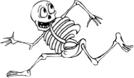
Copy the ENTIRE chart, fill in the blanks and answer the question
Day 3
Place Date Here
The Nervous System
Peripheral Nervous System
Central Nervous System
Autonomic NS
Somatic NS
Brain
Spinal Cord
Sympathetic - prepares the body for action through the “fight-or-flight” syndrome.
Parasympathetic - slows organ & gland activity to conserve the body’s energy & to refuel the body again.
Sympathetic NS
(arousing)
Parasympathetic NS
(calming)
Which part of the Nervous system do you use when you are running for your life?
Notes:
Autonomic - self regulating actions, internal organs, glands
Somatic (controls voluntary movements of skeletal muscles
Sympathetic - prepares the body for fight or fight response. That is it prepares the body to either confront a stressful or dangerous situation or to run away. For example, when a person is suddenly attacked by a large angry dog, the sympathetic nervous system is aroused. It suppresses digestion, increases the heart and respiration rates, and elevates the blood pressure. Ever feel queasy before a test, giving a presentation, a job interview?
Parasympathetic - refuels the body and restores the energy reserves after the stressful situation has occurred. Heart rate and blood pressure are normalized, breathing is slowed, and digestion returns to normal.
mnemonic device- sympathetic = stress, parasympathetic =peace
Answer to Question: Sympathetic Nervous System

Slide 6
Which lobe of the brain do you believe is the most important? Explain your answer.

Slide 7
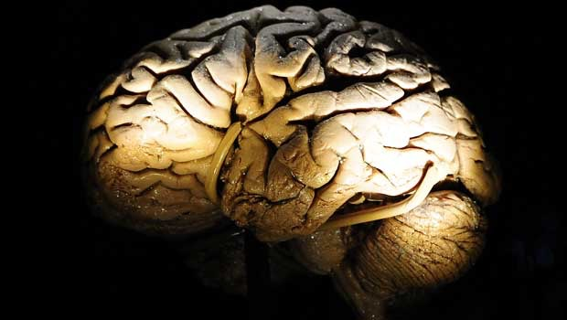
What are three parts of the brain? What part of the brain is the most primitive? What part is the most complex, separating humans from animals?
Day 4
Place Date Here
Write in complete sentences or loss of credit.

Slide 8
What questions do you still have about the brain?

Slide 9
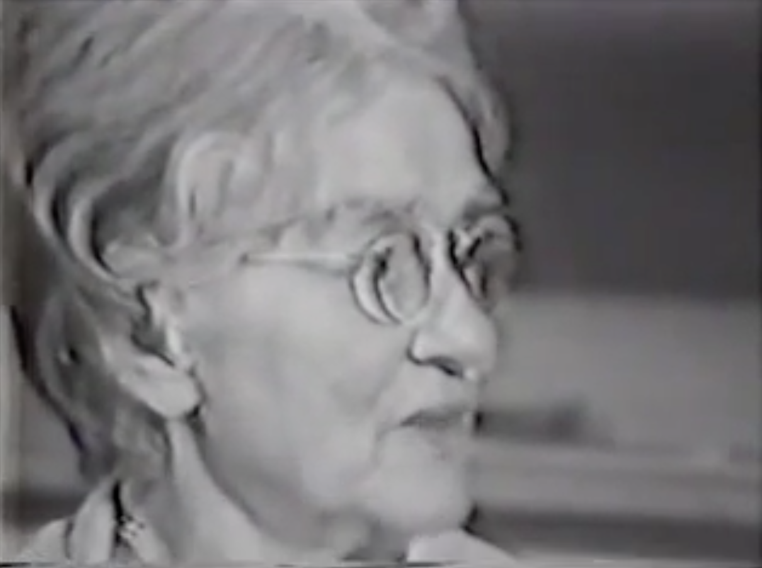
What is the difference between Broca’s Aphasia and Wernicke’s Aphasia?
Day 5
Place Date Here
Write in complete sentences or loss of credit.
Notes:
Wernicke’s Aphasia - disorder caused by damage to Wernicke’s area.
- difficulty understanding speech
- Speech is intelligible- nonsense words
- unaware of their disability
Broca’s Aphasia - understand language, hard to find words
- aware of their problems

Slide 10
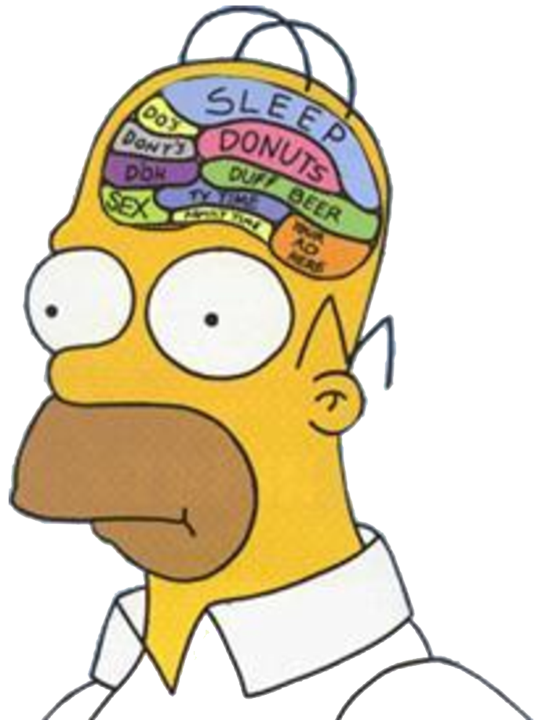
What is the outer layer of the brain called? Why is it important?
Day 5B
Place Date Here
10.8.14
Write in complete sentences
or loss of credit.
Notes:
Cerebral Cortex

Slide 11
Electroencephalograms (EEG) have been used by researchers to diagnose certain kinds of psychological disorders.
What imaging techniques are used to study the brain?
Notes:
PET, CAT or MRIs

Slide 12
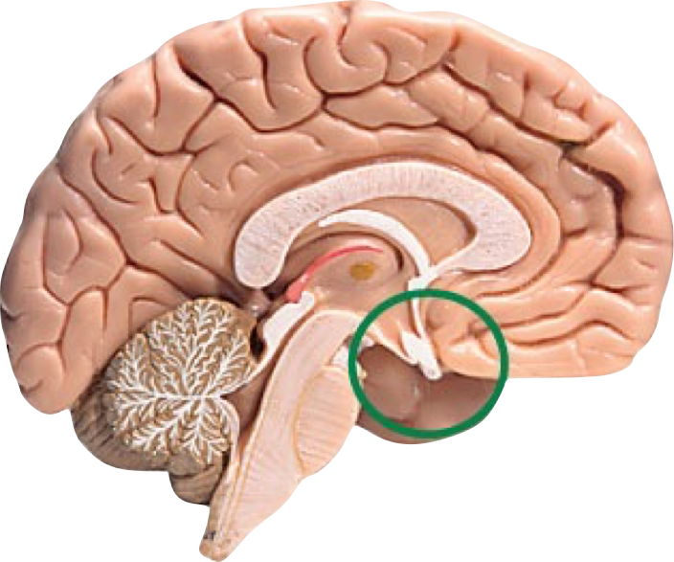
Why is the pituitary gland called the “Master Gland?”
Day 6
Place Date Here
Write in complete sentences or loss of credit.
Notes:
It’s called the “master gland” because its hormones control other parts of the endocrine system, namely the thyroid gland, adrenal glands, ovaries, and testes. However, the pituitary doesn’t entirely run the show.

Slide 13
Name one important thing you learned in class today.

Slide 14
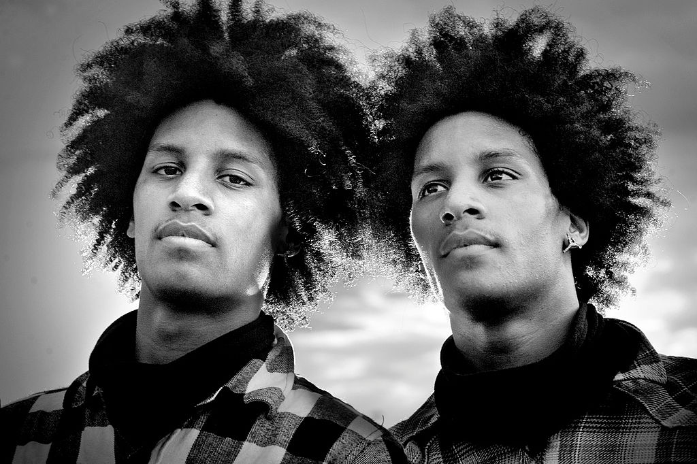
In studies of identical twins reared apart, differences noted would most likely be due to ____________ factors.
Day 7
Place Date Here
Write the entire question down and fill in the blank.
Notes:
Environmental

Slide 15
When, where and how will you study for the psychology exam?
Notes:
Studies show that people are more likely to follow through a course of action if they have it planned.

Slide 16
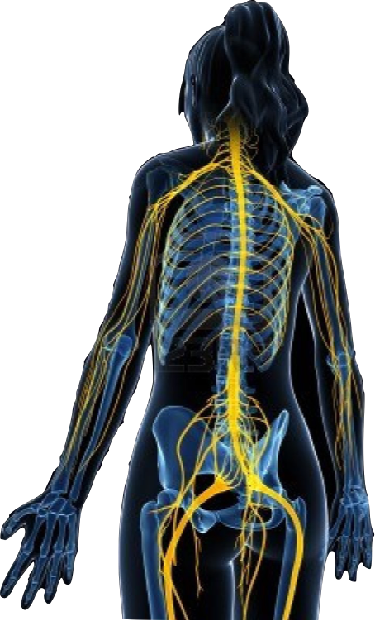
Identify the purpose of the peripheral nervous system and its two main divisions.
Day 8
Place Date Here
Write in complete sentences or loss of credit.
Notes:
The peripheral nervous system transmits messages between the central nervous system and all parts of the body. It is divided into the somatic nervous system, which deals with actions that a person controls,and the autonomic nervous system which deals with actions the people do not control like breathing.

Slide 17
Name three things you could have done to improve your score on this exam on Biology and Behavior.

Slide 18
What part of the brain is the white, fatty substance that insulates axons and enables rapid transmission of neural impulses?
EXTRA
Write in complete sentences or loss of credit.

Slide 19
Michael J. Fox is an actor who has Parkinson’s disease. We know this is comes from the lack of a certain neurotransmitter in the brain. What is the neurotransmitter?
EXTRA
Write in complete sentences or loss of credit.
Notes:
myelin or myelin sheath

Slide 20
What is one quality you inherited from each of your parents? Explain.
EXTRA

Slide 21
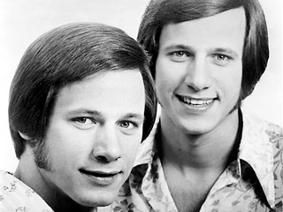
EXTRA
The Minnesota/Jim Twin study suggests that three human characteristics are
largely determined by heredity, rather than environment. What are they?
Write your Answer in complete sentences.
Notes:
personality, intelligence and social attitudes

Slide 22
EXTRA
The “fight-or-flight response to a stressful event is activated by the _____________.
Write the entire bell question down and fill in the blank.
Notes:
sympathetic Nervous System

