Slide 1
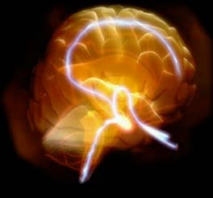
BIOLOGY & BEHAVIOR
II. THE BRAIN

Slide 2
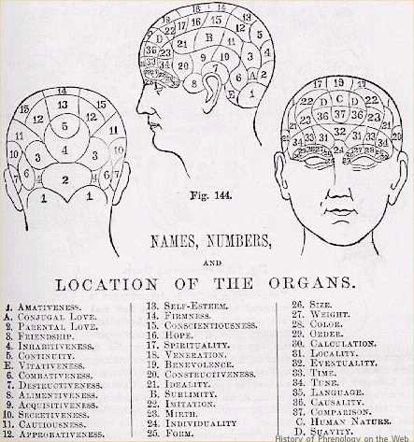
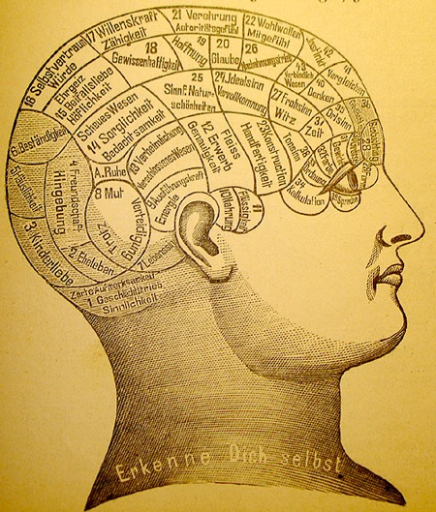
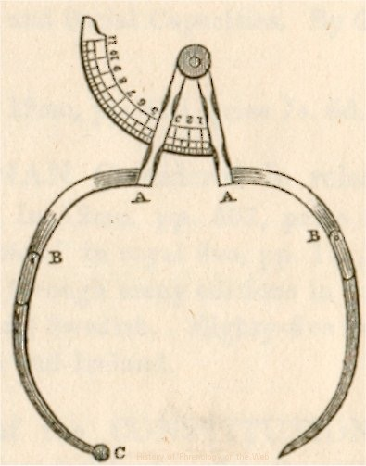
PHRENOLOGY
THE BRAIN
Notes:
A theory which claims to be able to determine character, personality traits, and criminality on the basis of the shape of the head (reading "bumps"). Developed by German physician Franz Joseph Gall around 1800, and very popular in the 19th century, it is now discredited as a pseudoscience. ****Phrenology has however received credit as a protoscience for having contributed to medical science the ideas that the brain is the organ of the mind and that certain brain areas have localized, specific functions.
However, empirical refutation caused most scientists to abandon phrenology as a science by the early 20th century.
Example: cases were observed of clearly aggressive persons displaying a well-developed "benevolent organ". Many other contradictory cases were encountered. Furthermore, with the advent of psychology, many scientists were skeptical of the claim that human character can be determined by simple external measures.

Slide 3
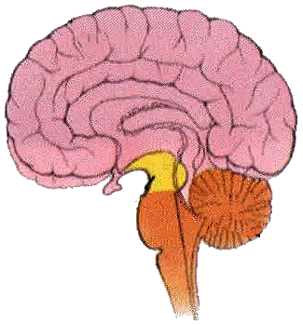
II.THE BRAIN
Divided into Three Sections
I. Hindbrain
II. Midbrain
III.Forebrain
I. HINDBRAIN
Lower portion - vital functions, heart rate, respiration & balance
a. Medulla - vital functions
b. Pons - body movement, attention, sleep
c. Cerebellum - balance & coordination
Fast Fact: An adult human brain weights about 3 pounds where as an adult horse weighs just 1 pound.
Notes:
The brain is divided into three sections: The Hindbrain, Midbrain and the Forebrain.
The Medulla is responsible for vital function such as heart rate, blood pressure, and breathing.
The Pons is located in the front of the Medulla and is involved in regulating body movement, attention, sleep, and alertness.
Cerebellum - This is involved in balance & coordination. A person whose cerebellum is injured may have trouble with coordination. They may walk unevenly & occasionally fall down.

Slide 4
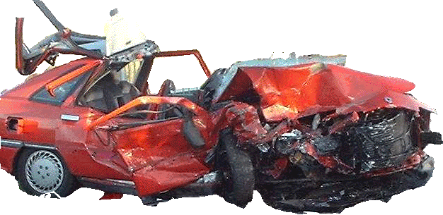
II.THE BRAIN
II. MIDBRAIN
Involved w/ vision, hearing
a. Reticular Activating System - attention, sleep & arousal
III. FOREBRAIN
a. Thalamus
b. Hypothalamus
c. Limbic System
d. Cerebrum
Fast Fact - Alcohol affects the Reticular Activating System to depress our reaction time.
Notes:
The Midbrain is located between the hind brain & the forebrain.
Example: Eye movement is controlled by an area in the midbrain.
Plus the Midbrain contains part of the RETICULAR ACTIVATING SYSTEM. This system is important for attention, sleep & arousal. Stimulation of the reticular activating system makes us alert. (Well. . . some of us anyway) It affects arousal by increasing heart rate & it increases brain activity.
Sudden loud noises stimulate the reticular activating system and can awaken a sleeping person. However, the reticular activating system can screen out some noises. A person who lives in the city may not be awakened by the sounds of traffic roaring by. This same person may, however awaken to sounds that are more out of the ordinary, such as a bird singing.
V Certain parts of the forebrain are very well developed in human beings. The forebrain is the part of the brain that makes it possible for humans to do COMPLEX thinking processes.

Slide 5
II.THE BRAIN
III. FOREBRAIN cont.
a. Thalamus - is a relay station for sensory info.
b. Hypothalamus - Regulates body temp., motivation, & emotion. Also involved in hunger, thirst, & sex behavior.
c. Limbic System - memory, emotion, sex, aggression.
- Hippocampus & Amygdala
d. Cerebrum - Large part of the brain - 70% of vol.
- coordination of voluntary activity in the body.
Fast Fact - The lower brain functions do not require any conscious thought or effort-we are not aware of these activities. Imagine if we were aware of all this information processed by our brain.
Notes:
The Thalamus is very important. The thalamus is to relay sensory and motor (muscles and movement) information that it receives from the brainstem, cerebellum and spinal cord to the lobes of the brain. Most of the messages coming from the sense organs go through the thalamus on the way to the higher levels of the brain(areas responsible for thinking & reasoning). Ex. Lets say you want to move your hand to write, your brain sends a message to the thalamus, which then sends it to the correct place on the motor strip. Otherwise, you’d end up blinking your eye.
Hypothalamus - The hypothalamus is directly located under the thalamus, (Hypo Meaning below). It is very tiny, (size of a pea) but it is extremely important because it is involved in many aspects of behavior and physiological functions. It is responsible for: body temp, various aspects of motivation & emotion. It is involved in Hunger thirst caring for offspring and aggression.
Limbic System - This is involved in learning & memory, emotion, hunger, sex & aggression. If a particular part of the limbic system is damaged, people can recall old memories, but do not create new memories. Ex. a person w/damage to that area may have vivid childhood memories of playing w/their sister, but may not be able to remember that this same sister visited the same day. So researchers believe memories are processed through this area & then sent to other areas for storage. Anterograde Amnesia
Cerebrum. - Only in human beings does the cerebrum make up such a large part of the brain. The cerebrum accounts for about 70% of the weight of the brain. The surface of the cerebrum is wrinkled with ridges and valleys. This surface is the CEREBRAL CORTEX. The cerebrum is involved with coordination of voluntary activity in the body. If you want to move your arm right now, the cerebrum is in part, responsible.

