Slide 1
1920s

Slide 2
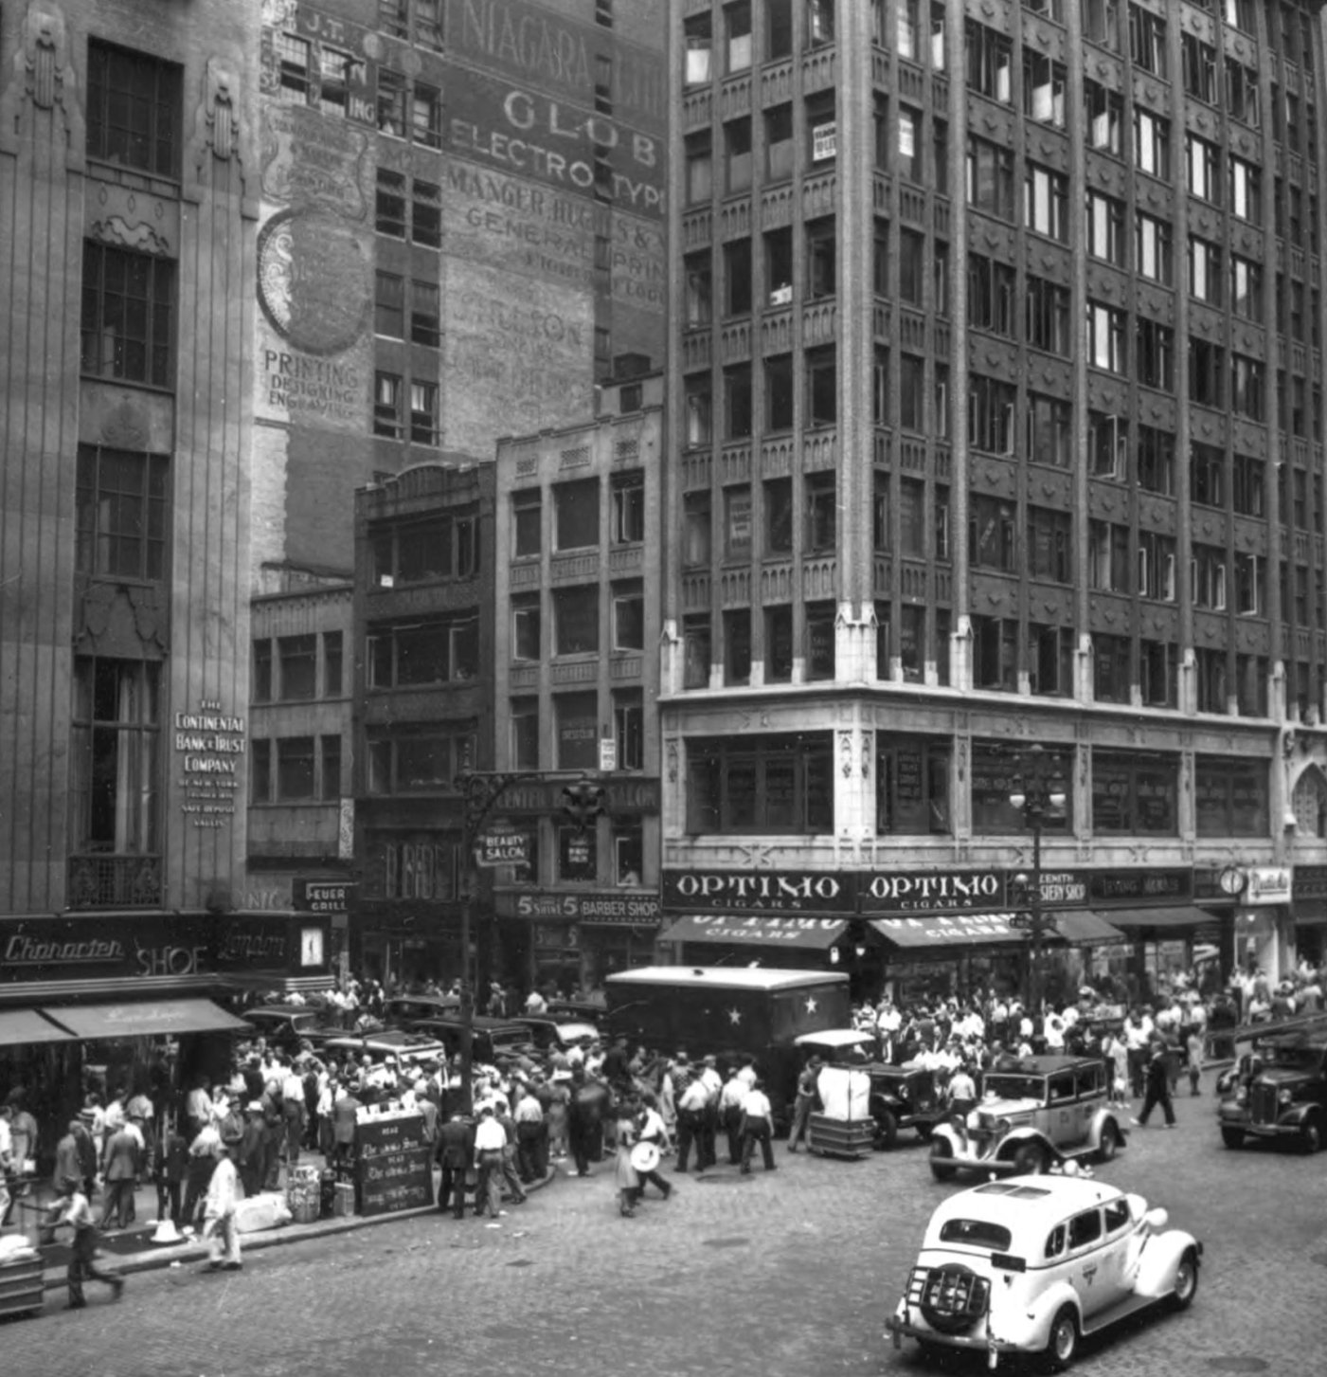
1920s = first decade in which more Americans work in factories than farms
1920s = More Americans live in cities than in rural areas
African Americans migrating to cities from South
Women: city life = eased housework (appliances), store-bought clothes and food

Slide 3
Enjoying Appliances
New consumer goods fed prosperity of 1920s
Provided massive economic stimulus

Slide 4
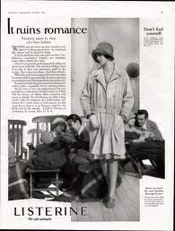
Advertising and Credit
Strengthened the economy
Advertising created a “dream world” that aroused desires for new things
Credit > retailers began offering credit plans for big-ticket items (cars, furniture)

Slide 5
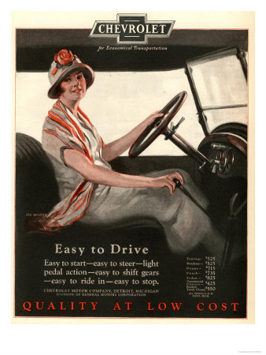
Automobile changed everything
Traffic jams, parking problems, highway facilities
Family vacations
Eroded family cohesion and parental authority
Women gain sense of independence

Slide 6
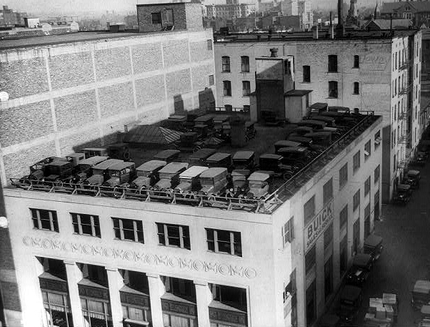
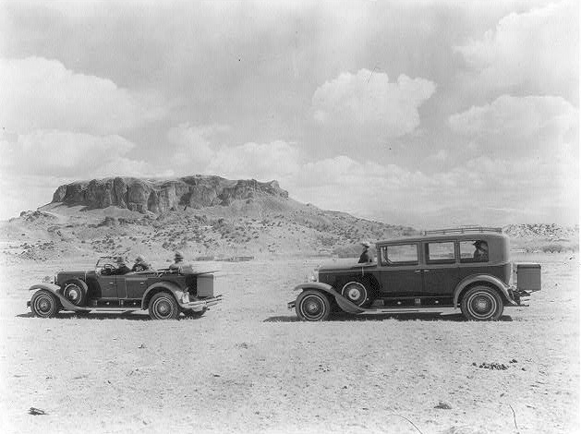

Slide 7
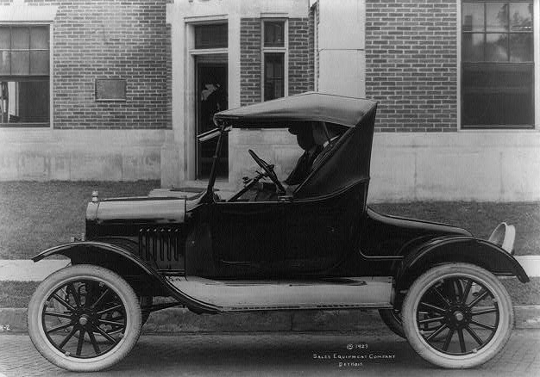
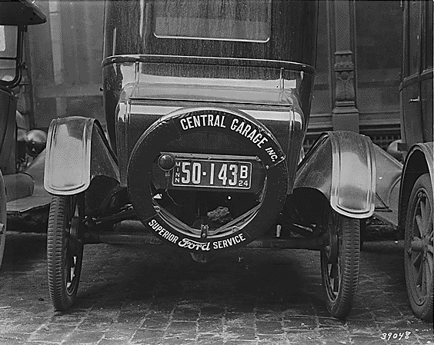
Henry Ford and the Model T
Assembly line techniques
Caused price of cars to decrease
Stimulated rubber, gasoline, motor oil, advertising, and highway construction
Lack of job satisfaction with routine labor

Slide 8
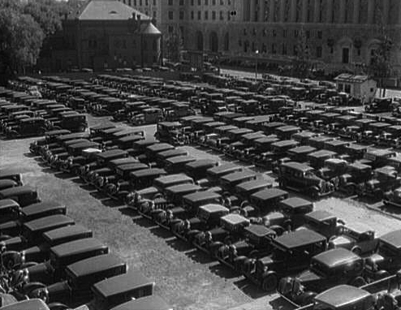
1920s Parking Lot!

Slide 9
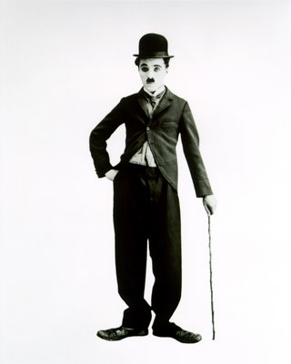
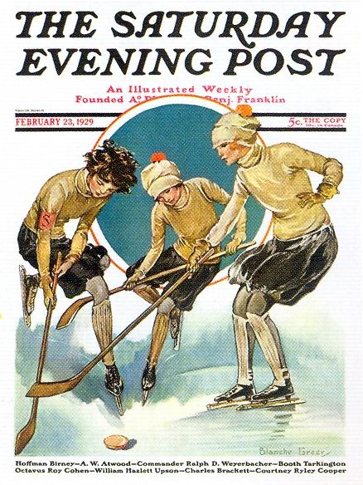
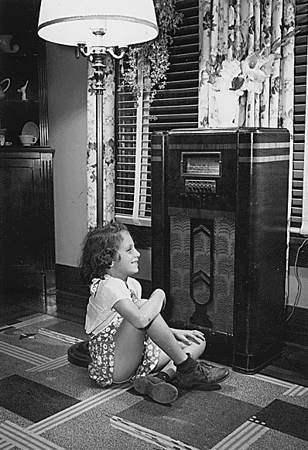
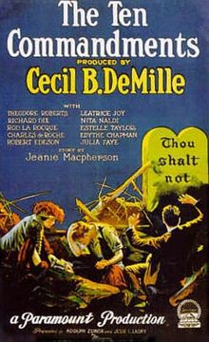
Mass Culture
Mass-culture = unifying effect
Same amusements were available to all parts of country

Slide 10
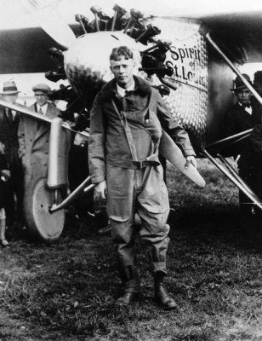
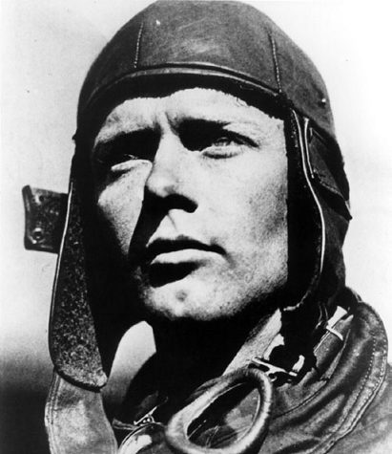
Charles Lindbergh
Solo flight across Atlantic
Embodied American traditional values in new industrial society
His success incorporated elements of technology and individualism

Slide 11
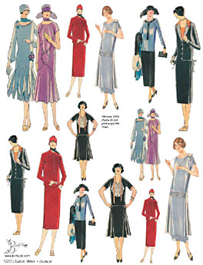
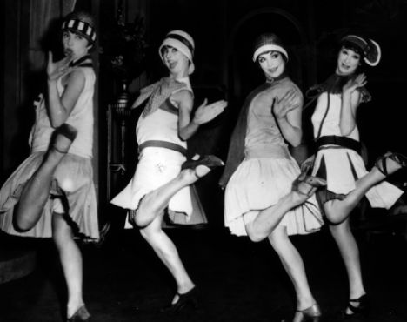
Flappers
Challenged traditional American attitudes about women by supporting greater freedom in manner of dress and moral behavior

Slide 12
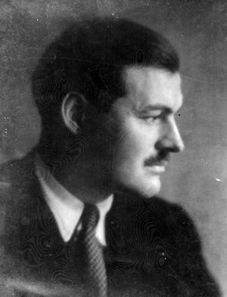
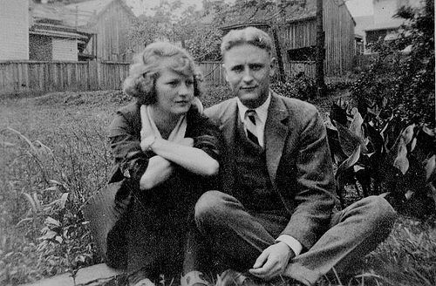
“lost generation”
Ernest Hemingway, F. Scott Fitzgerald,
Term represents a sense of moral loss or aimlessness of the public since WWI
Disillusioned with course of American life

Slide 13
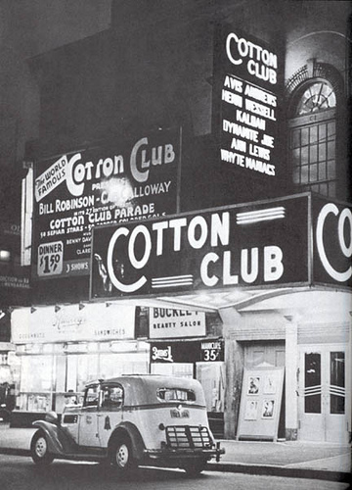
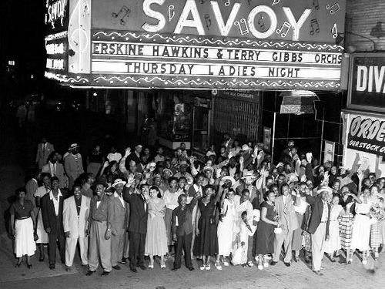
Harlem Renaissance
Flourished in 1920s
Consisted of period of dramatic African American intellectual and artistic creativity

Slide 14
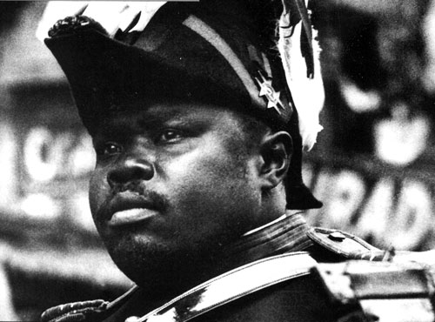
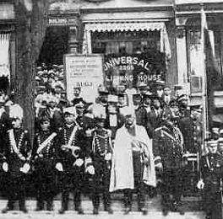
Marcus Garvey
Universal Negro Improvement Association
Glorified all things African American
Encouraged solidarity
“Back to Africa” movement
Return back to “motherland Africa”
NAACP’s middle class, church leaders = upset > saw future in America, not Africa

Slide 15
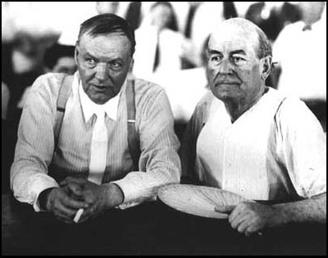
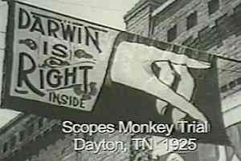
Scopes Trial
Cultural conflict between fundamentalism and modernism
Fundamentalism: insisting that Bible = literal truth, including Genesis account of Creation
Targeted Darwinism as threat to faith > wanted to bar it from public school
John T. Scopes (TN teacher) accepted ACLU offer to challenge law
Clarence Darrow = defense
W.J. Bryan = prosecution
Scopes = convicted (later overturned)

