Slide 1
What is law
Pt 2

Slide 2
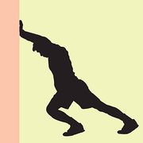
Warm-Up
What is the difference between a right and a responsibility?

Slide 3
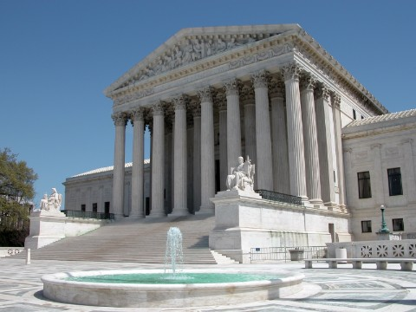
The U.S. has four primary sources of law:
The U.S. Constitution
Statutes passed by the U.S. Congress
Case law created by the U.S. Supreme Court
International treaties

Slide 4
What are the Goals of the American Legal System?
To protect human rights
To promote fairness
To resolve conflicts
To promote order and stability
To promote desirable social and economic behavior
To represent the will of the majority
To protect the rights of the minority

Slide 5
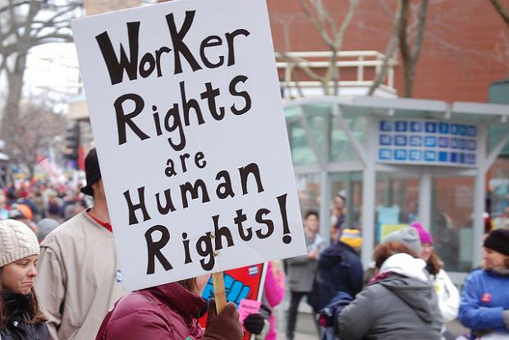
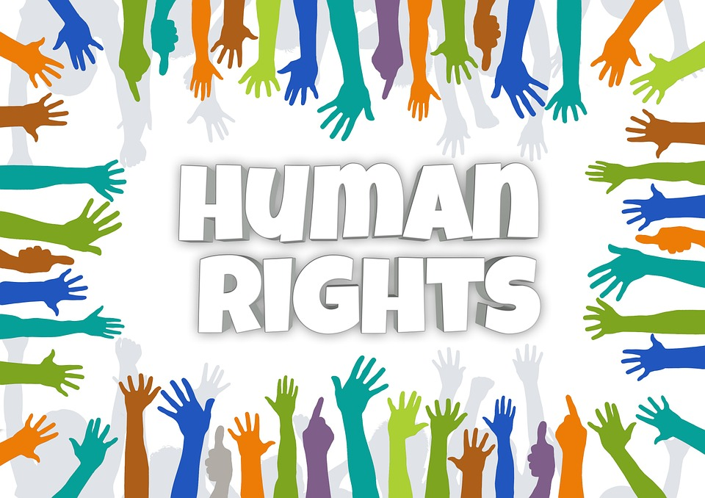
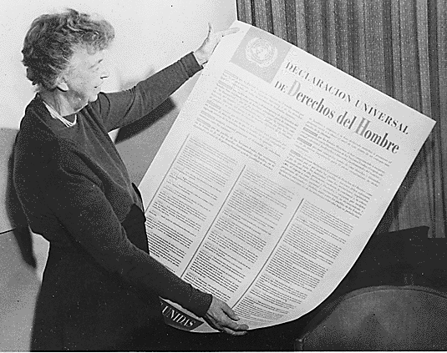

Slide 6
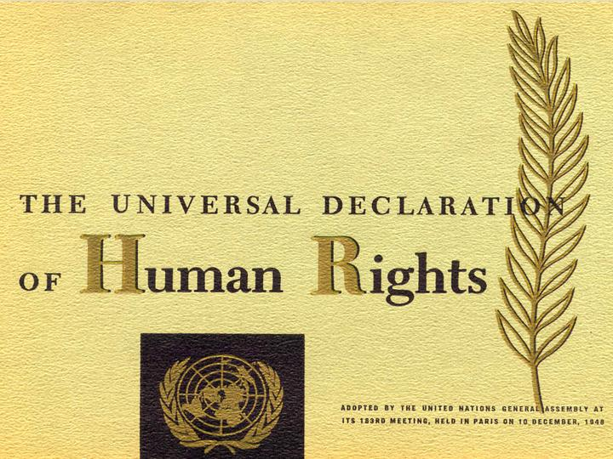
Human Rights
The rights all people have simply because they are humans
The Universal Declaration of Human Rights identifies many rights

Slide 7
Universal Declaration of Human Rights

Slide 8
The Universal Declaration of Human Rights:
Examples include:
life, liberty and security of person
freedom from slavery and servitude
freedom from torture, or cruel, inhuman or degrading treatment or punishment
equality before the law
not being subjected to arbitrary (random) arrest, detention or exile

Slide 9
What is the difference between a right and a responsibility?
Right - a moral or legal entitlement to have or obtain something or to act in a certain way
Responsibility - the state, fact, or position of being accountable to somebody or for something
What is a duty?
An obligation; something that somebody is obliged to do for moral, legal, or religious reasons
Your duties as an American citizen, as a parent
Jury duty is a duty of citizenship

Slide 10
What are the rights, duties and obligations of a citizen?
Citizens owe allegiance to the state and are entitled to civil rights
Citizens are also required to defend the state by joining the military when needed
In the case of U.S. citizenship, loyalty is the most important obligation
This does not mean unyielding devotion to the state, but there must be some form of faith in the system

Slide 11
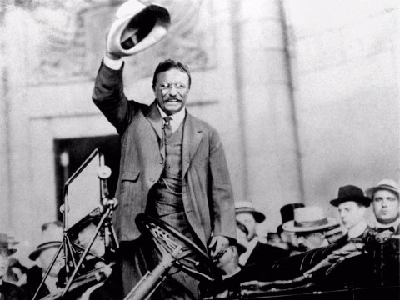
Responsibility
President Theodore Roosevelt proclaimed
“each man must devote a reasonable portion of his time to politics in his community”

Slide 12
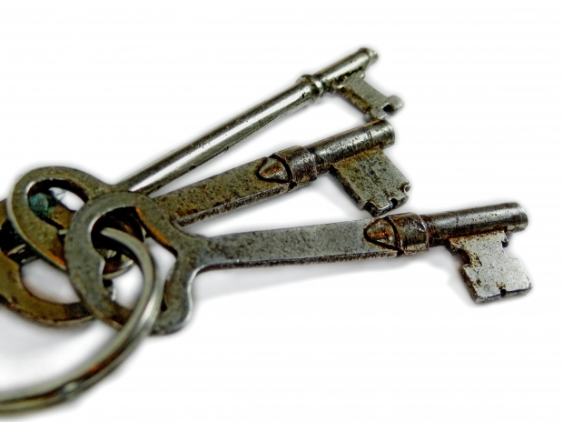
Key Ideas
Rights and freedoms are secured through collaboration between a jury and judge (our court system)
Government, organizations and other individuals cannot suppress the political and civil rights of individuals.
The rights of citizens of the United States are outlined in the Constitution

Slide 13
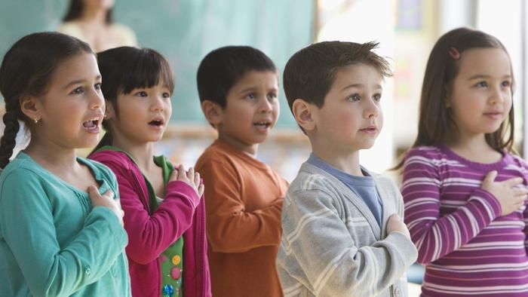

Slide 18
Balancing Rights With Responsibilities
As Americans we enjoy many individual rights
But some people argue that with every right comes a responsibility …
… that these rights should be balanced with social responsibilities
“Just because you have a legal right to do or not to do something, does not mean it is the right thing to do”
Striking the right balance between rights and responsibilities can be difficult

Slide 20
FYI Do non-citizens have rights?
If you're in the United States without proper immigration documents, various sections of the U.S. Constitution apply to you.
An important provision of the Fourteenth Amendment states:
No state shall . . . deprive any person of life, liberty or property, without due process of law; nor deny to any person within its jurisdiction the equal protection of the laws.“
An undocumented immigrant is a "person."
This means that you are afforded procedural rights as a jury trial and the right to defend yourself against the charges if arrested; and if someone sues you over a civil matter, that you have the right to receive notice and to defend yourself in court.

Slide 22
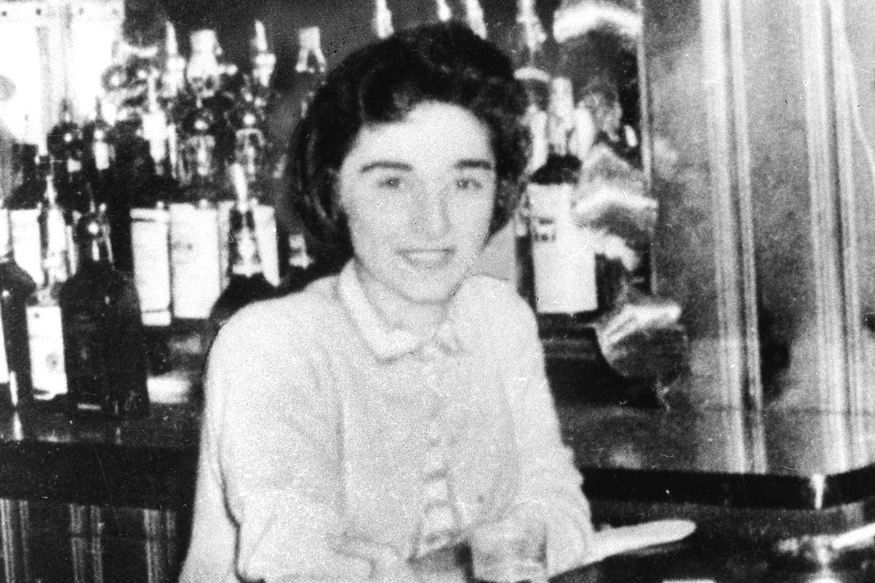

Slide 23
Case of the Apathetic Bystanders Why no action?
Did not care
Selfish
Afraid to get involved
Mistrust of police
Someone else will help (bystander effect)

Slide 24
The Bystander Effect
The more bystanders there are in a situation, the LESS likely any individual bystander will help
People assure themselves that someone else will help
→ The Bystander Effect – No one Cares

Slide 25
A crime?
In general a failure to assist a person in need is not a crime or a tort (civil wrong) unless the relationship gives you a legal duty to act (parents have a legal duty to help children; lifeguard on duty)

Slide 26
Did the bystanders do the right thing?
Most agree that their inactions were morally wrong, but LEGAL at the time
It is immoral to let someone die when it would have taken little effort or risk (phone call) to help save the person.

Slide 27
Should there be a law holding citizens responsible for not helping out in cases such as this one?
Some states have “Good Samaritan” laws
Pros vs. cons (people have different views)

Slide 28
General Laws: Chapter 258C, Section 16
No person who, in good faith, provides or obtains, or attempts to provide or obtain, assistance for a victim of a crime as defined in section one, shall be liable in a civil suit for damages as a result of any acts or omissions in providing or obtaining, or attempting to provide or obtain, such assistance unless such acts or omissions constitute willful, wanton or reckless conduct.

Slide 29
9/19 -- Warm-Up Activity
The Case of Matt and Luther

