Slide 1
Abnormal Psychology
Psychological Disorders
Treatment of Disorders

Slide 2
Psychological Disorders
Defining & Diagnosing Disorders
Approaches to Disorders
Anxiety Disorders
Mood/Affect Disorders
Personality Disorders
Somatoform Disorders
Factitious Disorders
Developmental Disorders
Schizophrenia

Slide 3
Defining Disorders
Distressful/Disturbing
the disorder is distressful or disturbing to the person who suffers from it or others around that person
Deviant/Atypical
statistically, the behavior is not found very often within the population
Maladaptive
the behavior significantly impairs functioning in social, occupational, or other areas of life

Slide 4
Diagnosing Disorders
Diagnosing Disorders
Diagnostic & Statistical Manual of Mental Disorders, Fourth Edition, Text Revision (DSM-IV-TR)
Diagnostic Labeling
Disadvantages
biasing power; self-fulfilling prophecy
Advantages
makes decisions on treatments easier; enables simpler communication about disorders

Slide 5
Diagnosing Disorders
David Rosenhan Study
Pretended to hear voices to get committed
Stopped hearing voices and acted normally
Everything was interpreted as abnormal because of having been labeled already
Sanity vs. Insanity
Not Guilty by Reason of Insanity (NGRI)
Knowing the difference between right & wrong and being able to control actions

Slide 6
Diagnosing Disorders
DSM Multiaxial System
Axis I Clinical Disorders
Axis II Personality Disorders
Mental Retardation
Axis III General Medical Conditions
Axis IV Psychosocial Problems
Environmental Problems
Axis V Global Assessment of Function

Slide 7
Causes of Disorders
Approaches to Disorders
Medical Model
Psychological disorders are like any other sickness; symptoms/syndromes can be medically treated
Biopsychosocial Model
biological, psychological, and social factors all play a role in human functioning in the context of illness
Diathesis-Stress Model
interaction of a vulnerable hereditary predisposition, with precipitating events in the environment may lead to a psychological disorder

Slide 8
Causes of Disorders
Perspectives
Psychoanalytic/Psychodynamic
Unresolved conflicts from childhood and repressed memories can influence behavior negatively
Humanistic
Inability to reach ultimate potential might lead to development of disorder (self-actualization); conditions of worth, negative self-concept
Behavioral
Disorders are developed as a result of learning (Observation, Reinforcement)

Slide 9
Psychological Disorders
Perspectives
Cognitive
Faulty or irrational beliefs may cause someone to develop a psychological disorder
Sociocultural
Disorders are products of the larger culture in which a person develops
Biological
Brain structures and body chemistry influence behavior and development of disorders

Slide 10
Psychological Disorders
Perspectives
Evolutionary
Certain disorders may have been advantageous, or the people who are most reproductively successful have spread these disorders into the gene pool; perhaps mutations have occurred which caused it
Behavior Genetics
A predisposition to develop a particular disorder matched with an environment which facilitates the development of a particular disorder interact to determine whether it is developed or not

Slide 11
Anxiety Disorders
Generalized Anxiety Disorder (GAD)
persistent, unexplained feelings of anxiety
2/3 of sufferers are women
Panic Disorder
have a series of intense episodes of extreme anxiety, known as panic attacks
can be accompanied by agoraphobia

Slide 12
Anxiety Disorders
Obsessive Compulsive Disorder (OCD)
Obsessions: recurrent, unwanted thoughts
Compulsions: repeated actions or rituals which reduce anxiety from obsessions
Post-Traumatic Stress Disorder (PTSD)
reliving traumatic events through thoughts, dreams, or flashbacks

Slide 13
Anxiety Disorders
Phobic Disorder/Phobia
intense, irrational fear
Social Phobia
excessive anxiety in social situations causing considerable distress and impaired function
Specific Phobia
unreasonable or irrational fear related to exposure to specific objects or situations
Agoraphobia
anxiety in environments that are unfamiliar or where they have little control

Slide 14
Mood/Affect Disorders
Major Depressive Disorder
persistent low mood, loss of interest in activities and diminished ability to experience pleasure, feelings of worthlessness
two or more weeks
Dysthymic Disorder
chronic mildly depressed or irritable mood; less severe than depression
Two years or more

Slide 15
Mood/Affect Disorders
Seasonal Affective Disorder (SAD)
sufferers experience normal mental health throughout most of the year, but experience depressive symptoms in the winter
Cyclothymic Disorder
history of hypomanic episodes with periods of depression that do not meet criteria for major depressive episodes
two years or more

Slide 16
Mood/Affect Disorders
Bipolar Disorder
cyclic illness where people periodically exhibit elevated (manic) and depressive episodes
Mania: elevated, expansive, or irritable mood
Depression: persistent low mood, low interest
Type 1
manic episodes (maybe with depression)
Type 2
hypomanic & depressed episodes

Slide 17
Personality Disorders
Anxious/Fearful Type
Avoidant Personality Disorder
hypersensitivity to criticism or rejection
self-imposed social isolation
extreme shyness in social situations
desire close relationships, but don’t think they’ll be accepted

Slide 18
Personality Disorders
Anxious/Fearful Type
Dependent Personality Disorder
dependent on others to meet physical and emotional needs
unwillingness to voice independent opinions, make decisions or initiate activities
intense fear of being alone

Slide 19
Personality Disorders
Anxious/Fearful Type
Obsessive-Compulsive Personality Disorder
Excessive concern with order, rules, schedules and lists
Perfectionism
discomfort with some emotions and relationships

Slide 20
Personality Disorders
Odd/Eccentric Type
Schizoid Personality Disorder
emotional detachment, even from family
extreme introversion
fixation on own thoughts and feelings
fantasizing

Slide 21
Personality Disorders
Odd/Eccentric Type
Schizotypal Personality Disorder
indifference to and withdrawal from others
odd
elaborate style of dressing, speaking and interacting with others
magical thinking

Slide 22
Personality Disorders
Odd/Eccentric Type
Paranoid Personality Disorder
belief that others are lying, cheating, exploiting or trying to harm them
perception of hidden, malicious meaning in benign comments
hostility toward others

Slide 23
Personality Disorders
Dramatic/Impulsive Type
Histrionic Personality Disorder
constant, sudden emotional shifts
attention-grabbing behavior
sensitivity to others’ approval

Slide 24
Personality Disorders
Dramatic/Impulsive Type
Narcissistic Personality Disorder
preoccupation with self-importance
unable to empathize with others
angered at criticism

Slide 25
Personality Disorders
Dramatic/Impulsive Type
Borderline Personality Disorders
inability to control emotions or impulses
fear of abandonment
self-destructive behaviors
unstable relationships with others

Slide 26
Personality Disorders
Dramatic/Impulsive Type
Antisocial Personality Disorder
persistent lying
no regard for law or others’ rights
no remorse
aggressive or violent
often charming

Slide 27
Dissociative Disorders
Dissociative Amnesia
Memory loss that's more extensive than normal forgetfulness and can't be explained by a physical condition
response to traumatic event
Dissociative Fugue
dissociate by putting real distance between themselves and identity; forget who they are
often move to new place and adopt new identity

Slide 28
Dissociative Disorders
Depersonalization Disorder
characterized by a sudden sense of being outside yourself, observing your actions from a distance as though watching a movie
Dissociative Identity Disorder (DID)
formerly known as Multiple Personality Disorder
characterized by "switching" to alternate identities when under stress
identities may have own name, history

Slide 29
Somatoform Disorders
Somatization Disorder
history of physical complaints which occur over a period of years
significant impairment in functioning
no physical causes for symptoms
Pain Disorder
pain which causes significant distress or impairment in functioning which cannot be fully explained by a physician

Slide 30
Somatoform Disorders
Conversion Disorder
deficits in voluntary motor or sensory functions that cannot be fully explained by a physician
Hypochondriasis
preoccupation with fears of having a serious disease based upon a misinterpretation of bodily sensations

Slide 31
Somatoform Disorders
Body Dysmorphic Disorder
preoccupation with a specific body part and the belief that this body part is deformed or defective
preoccupation is significantly excessive and causes distress or significant impairment in functioning

Slide 32
Factitious Disorders
Munchausen Syndrome
sufferers knowingly fake symptoms, but do so for psychological reasons not for monetary or other discrete objectives as in the case of Malingering
Munchausen Syndrome by Proxy
getting attention by purposely making another individual sick
many times their children

Slide 33
Developmental Disorders
Attention-Deficit Hyperactivity Disorder (ADHD)
unable to focus attention and easily distracted
often act impulsively
Autism
lack of responsiveness to other people
impairment in verbal and nonverbal communication
limited activities and interests

Slide 34
Schizophrenia
A group of severe disorders characterized by disorganized and delusional thinking; disturbed perceptions, and inappropriate emotions and actions
Hallucinations: false perceptions
Delusions: false beliefs that have no basis in reality
Affects 1-2% of population

Slide 35
Schizophrenia
Acute vs. Chronic Forms
Acute
Typically happens once, but can happen anytime
Usually in response to some emotional trauma
Doesn’t respond well to anti-psychotic meds
Chronic
Runs in families
Develops during late adolescence
Episodes get longer and more severe with age
Responds well to anti-psychotic meds

Slide 36
Schizophrenia
Types of Delusions
Grandeur
belief of being important or famous
may believe they have special powers or abilities
Persecution
belief of being pursued, spied on, conspired against
Sin/Guilt
belief in being responsible for committing a crime for which they are not guilty
belief in being responsible for a disaster they could have no connection to

Slide 37
Schizophrenia
Types of Delusions
Control/Influence
belief in being controlled by external forces
thought-broadcasting
thought withdrawal
thought insertion
Reference
belief that events are referring to or are meant specifically for the individual

Slide 38
Schizophrenia
Subtypes of Schizophrenia
Catatonic
disturbances of movement
people with catatonic schizophrenia may keep themselves completely immobile or move all over the place
Paranoid
delusions and auditory hallucinations
relatively normal intellectual functioning and expression of affect

Slide 39
Schizophrenia
Subtypes of Schizophrenia
Disorganized
speech and behavior that are disorganized or difficult to understand
flattening or inappropriate emotions
Undifferentiated
characterized by some symptoms seen in all of the other types but not enough of any one of them to define it as another particular type of schizophrenia

Slide 40
Schizophrenia
Subtypes of Schizophrenia
Residual
past history of at least one episode of schizophrenia
person currently has no positive symptoms
may represent a transition between a full-blown episode and complete remission, or it may continue for years without any further psychotic episodes

Slide 41
Schizophrenia
Classification of Symptoms
Positive Symptoms
easy-to-spot behaviors not seen in healthy people
include hallucinations, delusions, thought disorder, and disorders of movement
Negative Symptoms
refers to reductions in normal emotional and behavioral states
include flat affect, apathy, infrequent speech, and social withdrawal

Slide 42
Schizophrenia
Emotional Abnormalities
Flat Affect: no emotion
Blunted Affect: little emotion
Inappropriate Affect: inappropriate emotions for situations

Slide 43
Schizophrenia
Language & Thinking Abnormalities
Loose Word Associations
ideas jump from one track to another
Neologisms
Rare appearance of new words in speech
Clanging
Pairing of words that have no relation to each other beyond that they rhyme or sound alike
Word Salad
Words and phrases combined in a completely disorganized fashion

Slide 44
Schizophrenia
Possible Causes of Schizophrenia
Dopamine Hypothesis
theory that unusual behavior and experiences associated with schizophrenia can be fully or largely explained by changes in dopamine function in the brain
Brain Structure
ventricles in brain are larger than in normal individuals
Diathesis-Stress
genetic predisposition mixed with stressful lifestyle

Slide 45
Schizophrenia
Possible Causes of Schizophrenia
Chromosomal abnormalities or genetic mutations
Double Binds
contradictory patterns of interaction in the family

Slide 46
Treatment of Disorders
History of Treatment
Prevention of Disorders
Types of Psychotherapy
Biomedical Therapies
Alternative Therapies

Slide 47
History of Treatment
Trephination (Early Humans)
hole is drilled or scraped into the skull to allow evil spirits to escape
Philippe Pinel (18th Century)
Dorothea Dix (19th Century)
Deinstitutionalization (1950s and 60s)
the movement out of institutions and into the community of people with psychological disorders; facilitated by the mainstream use of drug therapy

Slide 48
Prevention of Disorders
Primary Prevention
avoids development of a disorder in general
Secondary Prevention
early disease detection; increases opportunity for interventions to prevent progression of the disease and emergence of symptoms
Tertiary Prevention
reduces the negative impact of an already established disease; restores function and reduces disease-related complications

Slide 49
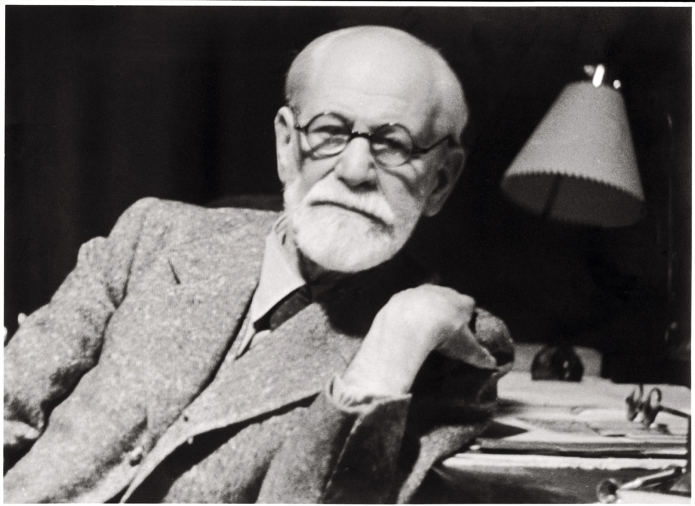
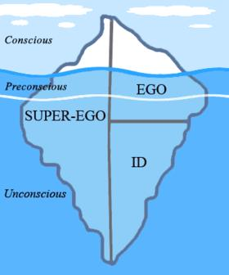
Types of Psychotherapy
Psychoanalysis
Developed by Sigmund Freud
Goal is to confront repressed material

Slide 50
Types of Psychotherapy
Methods of Psychoanalysis
Hypnosis
subjects hypnotized to learn about crucial and repressed memories or thoughts
Free Association
relate anything which comes to mind, regardless of how unimportant or embarrassing the memory is
Dream Analysis
analyze dreams for messages from the unconscious
Manifest Content: surface content of dream
Latent Content: hidden meaning behind dream

Slide 51
Types of Psychotherapy
Methods of Psychoanalysis
Resistance
because of the pain associated with repressed content, the patient again and again rejects it
Interpretation
Analyst noting significant aspects of dreams, resistances, and events to provide patient insight
Transference
unconscious redirection of feelings for one person to the psychoanalyst

Slide 52
Types of Psychotherapy
Methods of Psychoanalysis
Psychodynamic Therapy
Briefer, less intensive
Face-to-face, rather than laying on couch
Focus on themes across important relationships to understand current symptoms

Slide 53
Types of Psychotherapy
Humanistic Therapy
Aim is to help people grow in self-awareness and self-acceptance
Focus on present and future more than the past
Focus on conscious thoughts
Treat “clients,” not “patients”

Slide 54
Types of Psychotherapy
Humanistic Therapy
Self-Actualization: the instinctual need of humans to make the most of their abilities and to strive to be the best they can
Determinism: a belief that nothing about human behavior occurs by accident or chance
Psychodynamic & Psychoanalytic, Behavioral therapies are deterministic, while humanistic therapy assumes that humans have free will

Slide 55
Types of Psychotherapy
Humanistic Therapy
Client-Centered Therapy
Developed by Carl Rogers
Therapists should exhibit genuineness, acceptance, and empathy
Unconditional Positive Regard: therapists accept the client where they are at the moment; diagnosis and treatment planning to be much less important than being supportive to the client

Slide 56
Types of Psychotherapy
Humanistic Therapy
Client-Centered Therapy
Non-Directive
client directs him- or herself toward solving his or her own problems, and thus the therapist avoids directing the therapeutic process
Active Listening
Paraphrasing
Clarifying
Reflecting Feelings

Slide 57
Types of Psychotherapy
Behavioral Therapy
Counterconditioning
Triggered stimulus is associated with a new response
uses classical conditioning techniques
Aversive Conditioning
Trains people to associate physical or psychological discomfort with behaviors, thoughts, or situations he/she wants to avoid
Exposure Therapies
Expose people to what they would normally avoid

Slide 58
Types of Psychotherapy
Behavioral Therapy
Exposure Therapies
Systematic Desensitization
Technique used to treat phobias and other extreme fears
Progressive Relaxation: enables a person to recreate the relaxed sensation intentionally in a variety of situations
Anxiety Hierarchy: catalogue of anxiety-provoking situations or stimuli arranged in order from least to most distressing
Flooding
Client repeatedly confronts anxiety-provoking stimulus until the fear is extinguished

Slide 59
Types of Psychotherapy
Behavioral Therapy
Token Economy
reinforcing positive behavior by awarding "tokens" for meeting positive behavioral goals
tokens are accumulated and "spent" in order to obtain a reinforcer
uses operant conditioning techniques

Slide 60
Types of Psychotherapy
Behavioral Therapy
Social Skills Training
Modeling: allowing an individual to observe another person performing the appropriate behavior
Client practices appropriate social behaviors through role-playing
Therapist then shapes behavior by giving positive reinforcement and corrective feedback
Uses operant conditioning and observational learning techniques

Slide 61
Types of Psychotherapy
Cognitive Therapy
Developed by Aaron Beck after seeing a theme of loss, rejection, and abandonment while using Freudian techniques to analyze dreams of depressed individuals
Aim is to reveal irrational thinking and help the client think differently

Slide 62
Types of Psychotherapy
Cognitive Therapy
Attributional Style
how people explain to themselves why they experience a particular event (positive or negative)
Internal-External (Personal)
Stable-Unstable (Permanent)
Global-Specific (Pervasive)
Cognitive Triad
triad of negative thought types seen in depression
Self
World
Future

Slide 63
Types of Psychotherapy
Cognitive Therapy
Cognitive-Behavior Therapy
Aims to alter the way people think and also the way they act
Rational Emotive Behavior therapy (REBT)
focuses on uncovering irrational beliefs which may lead to unhealthy negative emotions and replacing them with more productive rational alternatives
Activating Event
Beliefs about that event
Consequences of those beliefs
Developed by Albert Ellis

Slide 64
Types of Psychotherapy
Group Therapy
Family Therapy
Assumes that we live and grow in relation others, especially our families
Aim to heal relationships and mobilize family resources
Self-Help Groups
Led by group members, not a psychotherapist
Provide an outlet to share personal experiences and find other people who are have similar problems

Slide 65
Biomedical Therapies
Drug Therapy
Anti-anxiety Drugs (anxiolytics)
tranquilizers (benzodiazepines) like Valium, Xanax
Anti-depressant Drugs
elevate mood; include MAOIs and SSRIs like Prozac, Paxil, Zoloft
Stimulants
treat Narcolepsy or ADHD

Slide 66
Biomedical Therapies
Drug Therapy
Anti-psychotic Drugs (neuroleptics)
block dopamine receptors; include Thorazine
side effects include tardive dyskinesia
Mood stabilizers
Lithium carbonate used to treat bipolar disorder

Slide 67
Biomedical Therapy
Brain Stimulation
Electroconvulsive Therapy (ECT)
Last resort for severely depressed individuals
Momentary electric shock
Side effects include memory loss
Repetitive Transcranial Magnetic Stimulation (rTMS)
Application of repeated pulses of magnetic energy to the brain
No seizures, memory loss, other side effects

Slide 68
Biomedical Therapy
Psychosurgery
Lobotomy
procedure basically involves severing the frontal lobes from the rest of the brain
used in the past to treat a wide range of severe mental illnesses, including schizophrenia, clinical depression, and various anxiety disorders
caused lethargy, immaturity, and lack of creativity
Corpus Callosotomy
disconnects the cerebral hemispheres, resulting in a condition called split-brain

Slide 69
Treatment of Disorders
Alternative Therapy
Eye Movement Desensitization and Reprocessing (EMDR)
People imagine traumatic scenes while the therapist triggers their eye movements
Light Exposure Therapy
exposure to daylight or to specific wavelengths of light using lasers, LEDs, fluorescent lamps, or very bright, full-spectrum light, for a prescribed amount of time
effective for seasonal affective disorder

