Slide 1
Day 2
AP Psychology
T. Cummings
Keefe Tech

Slide 2
Recap Day #1 – Debriefing/Content “The Newspaper Article”
How do we meaningfully test any claim?
What is the evidence?
Amazing Randi v. Uri Geller on The Tonight Show

Slide 3
“People’s desire to believe in the paranormal is stronger than all the evidence that it does not exist.”
-Susan Blackmore, PhD

Slide 4
Recap Day #1 – Debriefing/Content
How do we meaningfully test any claim?
What is the evidence?
Amazing Randi v. Uri Geller on The Tonight Show
Concepts: hypothesis, controlled experiments, experimenter bias, replication, IV/DV, use of confederates, confirmation bias, perhaps more!

Slide 5
Recap Day #1 Demonstrations of alleged ‘parapsychological phenomena’
What’s the evidence?
Can it be replicated?
How do we test a hypothesis?
Who set up the conditions?
Once you believe, do you attend only to evidence that confirms your belief?
Confirmation Bias

Slide 6
Research Methods and Statistics 8-10% AP Exam
Unit 1
Graphic Organizer
Quiz Friday
(Open Note)
Assignment Reading Pages #1-20

Slide 7
Warm-Up:
Watch the commercial for Belsomra.
What is the claim?
What is the population (n=)?
Who is in the experimental group?
Who is in the control group?

Slide 8
The Independent Variable & The Dependent Variable
“They’re testing the effect
of __________
on __________”

Slide 9
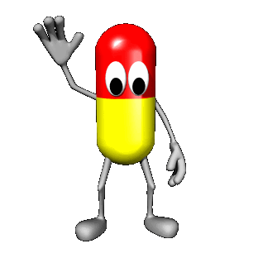
Independent Variable
Whatever is being manipulated in the experiment.
Hopefully the independent variable brings about change.
If there is a drug in an experiment, the drug is almost always the independent variable.

Slide 10
Dependent Variable
Whatever is being measured in the experiment.
It is dependent on the independent variable.
The dependent variable would be the effect of the drug.

Slide 11
The Independent Variable & The Dependent Variable
“They’re testing the effect
of __________
on __________”

Slide 12
Legless Rats…
“The number of legs a rat has will impact its speed in a maze”

Slide 14
“They’re testing the effect
of __________
on __________”

Slide 15
Legless Rat Experiment
IV:
DV:
Control Group:
Experimental Group:

Slide 16
The null hypothesis
“The independent variable will have no effect on the dependent variable”
In an experiment, you are not so much trying to “prove” your hypothesis as you are gathering data to see if you can reject the null hypothesis

Slide 17
Confounding variables:
Any variable other than the IV that
could cause a change in the DV
creating differences between your groups

Slide 18
DEMO: RANDOM ASSIGNMENT
(Names in a hat)

Slide 19
Random Assignment
Each subject has an equal chance of being assigned to the control or experimental group

Slide 20
Why random assignment?
Balance/equalize group characteristics
Eliminates participant confounding variables
It is not a true experiment without it

Slide 21
Placebos and the Placebo Effect (Expectancy)
White sugar pill will give you a placebo, if you want a stronger effect go to a smaller blue pill with a letter stamped on it. Stronger yet, a gel capsule and of course anything intravenous will give you an even more powerful placebo effect. Also note the nocebo effect- getting side effects from the placebo
Make sure to mention sham surgeries here.
Also, NPR 5/11/2016 using a Nike putter vs. no name putter creates a sports equipment type of placebo.

Slide 22
A double blind control for possible experimenter bias
Neither the participants nor the researcher
or data gatherer know the hypothesis or
who has been assigned to what group

Slide 23
APA Ethical Guidelines:
* Volunteers only!
* Researchers must obtain informed consent
* Researchers must insure a minimum amount of deception
* Researchers must induce a minimum of harm or stress
* Researchers must maintain the confidentiality of the volunteers
* Volunteers have the right to discontinue at any time
* Researchers have an obligation to debrief after the research is ended

Slide 24
Institutional Review Board (IRB)

Slide 25
Ethics in social science research:
*1920: John B. Watson and “Little Albert”
*1963: Stanley Milgram’s
“electric shock” study
*1932-72: The Tuskegee Syphilis Study
*1968: Blue Eyes, Brown Eyes.

Slide 26
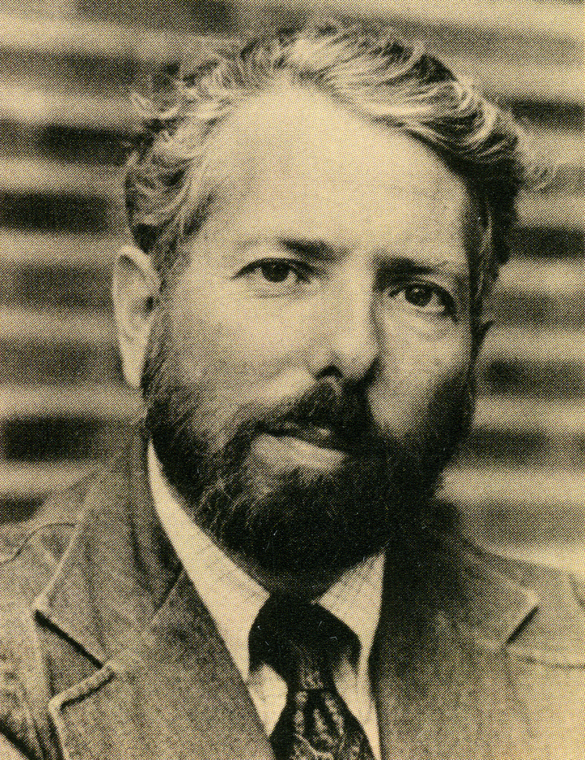
Stanley Milgram
Yale- 1963

Slide 27
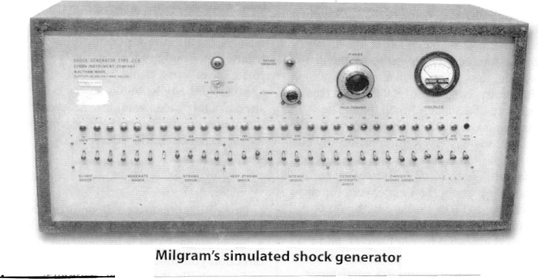

Slide 28
Milgram video with original footage
https://drive.google.com/open?id=1j_piWh_Tpt5CZvs8jwv7TsnlxixqvRgW

Slide 29
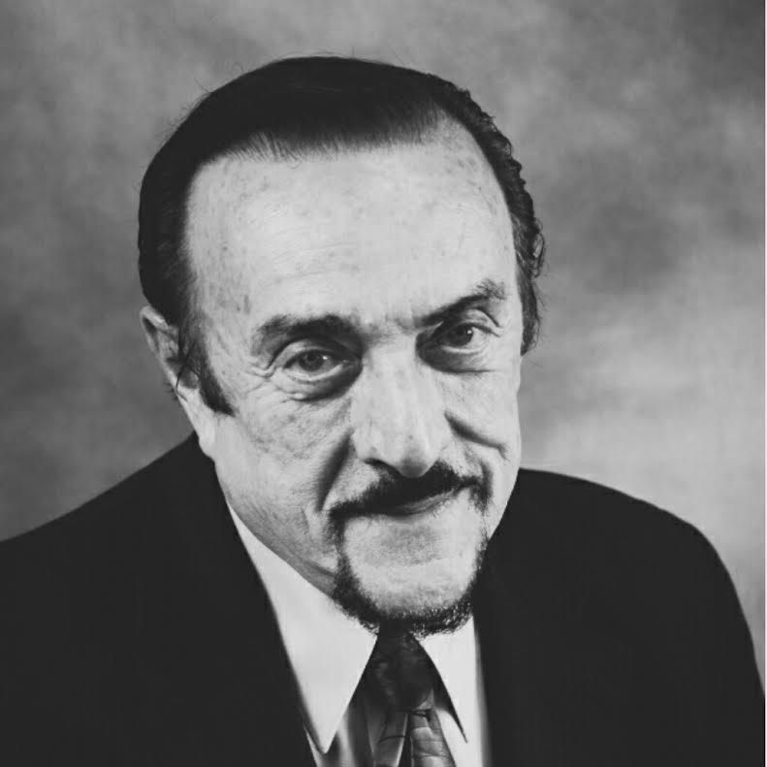
Recall Zimbardo’s “Mock Prison” study at Stanford (1971)

Slide 30
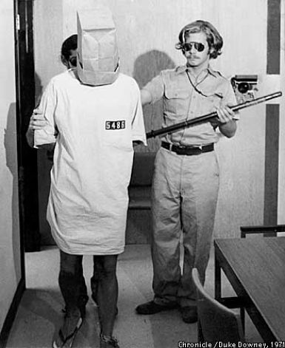
Stanford Prison Experiment (1971)

Slide 31
The AP Exam
AP Psychology Exam – Thursday May 9th, 2019 – Afternoon
100 MC → 70 mins (2/3 Grade)
2 FRQ → 50 mins (1/3 Grade) –BLUE OR BLACK INK
FRQ #1
FRQ #2

