Slide 1
Pros and Cons of experimental methodology?
Causal Relationships!

Slide 2
What methods are there
to test claims and beliefs?
Experimentation to explore possible cause and effect
Surveys

Slide 3
Survey Methodology

Slide 4
PROS AND CONS OF SURVEY METHODOLOGY
Surveys that you have taken?

Slide 5
Surveys cont…
A quick DEMO
(take out blank sheet of paper)

Slide 6
1. Is the Mississippi River longer or shorter than 500 miles?
2. How many miles long is it?

Slide 7
3. Does the average college textbook cost more or less than $50?
4. How much does the average textbook cost?

Slide 9
1. Is the Mississippi River longer or shorter than 3000 miles?
2. How many miles long is it?

Slide 10
3. Does the average college textbook cost more or less than $300?
4. How much does the average college textbook cost?

Slide 11
RESULTS?

Slide 12
Survey of 1255 people
77% interested in the study of plants and trees
39% interested in botany

Slide 13
Stats from recent CNN research:
What % of men surveyed report they wash
their hands after using a public restroom?
95%
What % of male subjects in a naturalistic
observation wash their hands after
using a public restroom
65%

Slide 14
2000 National Survey
75% of men occasionally
think about killing someone
60% of women report the same
33% of the men surveyed said they
frequently think of killing someone
15% of women

Slide 15
Some jobs require daily contact
with people, while others require almost
none at all. If you had your choice of
any occupation, how much regular
contact with others would you prefer?
1- none at all
2- a little bit
3- some
4- quite a bit
5- constant
Notes:
15

Slide 16
Possible problems in survey methodology:
You don’t have a representative sample
of the population you’re studying

Slide 17
Case Study of Survey Methodology:
The 1936 Presidential Election
Prediction: Landon Wins 57% to 43%
Actual: FDR 62%, Landon 38%
What went wrong?
Notes:
17
Poll done by Literary Digest which had been accurately predicting elections since 1916. Very reputable. Largest and most expensive poll done to date at that point. 2.4 million respondents
They collected names/address of 10 million people only 2.4 million respond REALLY hammer that having more #s does not increase accuracy
PROB= the names came from telephone books, magazine subscriptions, and auto registry→ these are the affluent in society during the worst economic crisis in US History
Gallup accurately predicted with a sample of 50,000

Slide 18
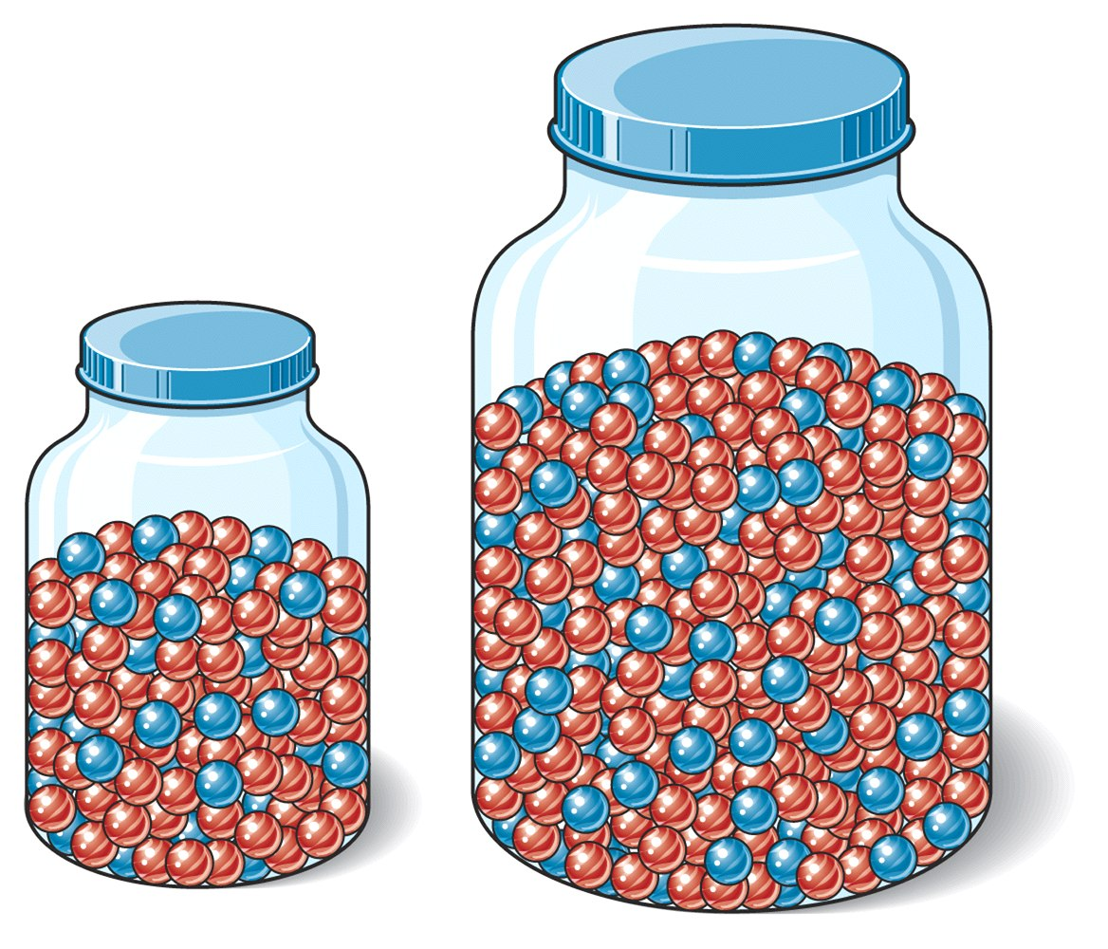
The population you are studying
The representative sample
of that population

Slide 19
Possible problems in survey methodology:
You don’t have a representative sample
of the population you’re studying
Social Desirability Bias
Demand Characteristic
Be careful how you frame the questions

Slide 20
What methods are there
to test claims and beliefs?
Experimentation to explore possible cause and effect
Surveys
Naturalistic observations

Slide 21
Naturalistic Observations
Two key elements:
*A clear, measurable “operational
definition” of what you’re observing
* Remaining unobtrusive!
Notes:
21

Slide 22
What methods are there
to test claims and beliefs?
Experimentation to explore possible cause and effect
Surveys
Naturalistic observations
Correlational research

Slide 23
Correlational Research
Note: correlation coefficients

Slide 24
(Schaeffer, 1988)
Statistically, in barrooms there is a correlation
between music tempo and
drinking rates
What would you predict (positive or negative)?
Notes:
There is a negative correlation

Slide 25
The correlation between
S.A.T. scores and freshman
college G.P.A.
r = + .61
Notes:
.5 is considered a strong correlation by many texts

Slide 26
Correlations: positive,
negative or zero?
1- # of bananas imported into the U.S. and divorce rates
2- Weight in pounds and hours of TV viewing
3- Educational level and income
4- Typing practice and typing errors
5- SAT scores and IQ scores
6- Happiness and income

Slide 27
Correlations (continued)
6- SAT scores and college GPA
7- Levels of overall happiness and altruistic behavior
8- Number of plants in your home and number of times you brush your teeth daily
9- Educational level and levels of obedience to authority
10- Age and hours of sleep per night
11- Test anxiety and test performance

Slide 28
Correlations (continued)
12- Hours of exercise and weight of exerciser
13- High School GPA and hours spent watching TV per week
14- Musical preference and frequency of sex
15- Time spent playing violent video games and aggressive behavior
Notes:
28

Slide 29
A Quick “Check-In”
Which of the following represents the strongest correlation?
+.57
-.78
-.25
+.71
+1.25
Notes:
.5 is considered a strong correlation by many texts

Slide 30
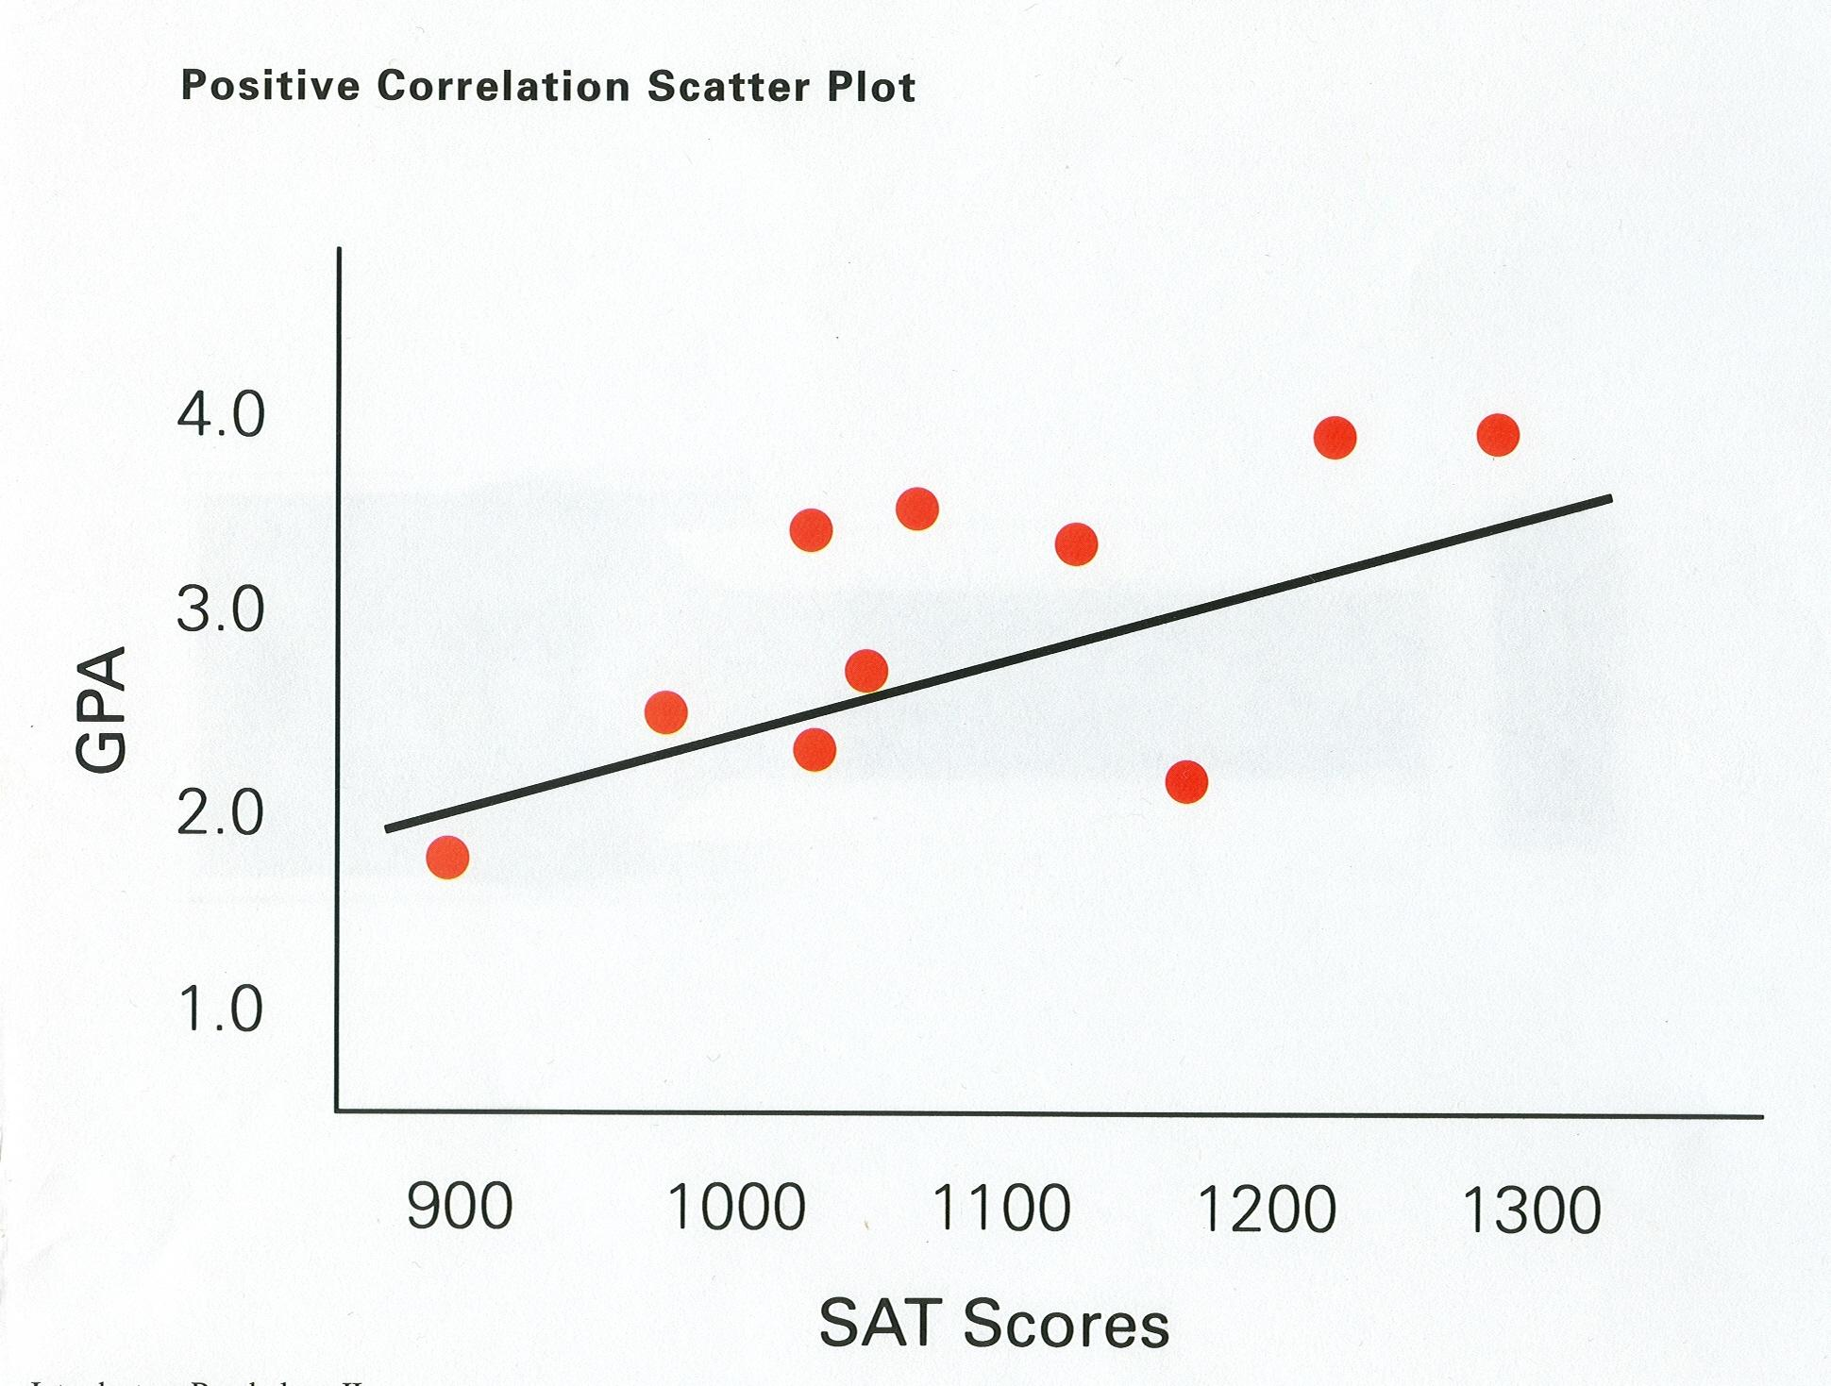
Notes:
30

Slide 31
CORRELATIONAL STUDIES
DO NOT infer causation from mere correlation
Also, be aware of the 3rd Variable Issue
Notes:
Any violent crime is positively correlated with the sale of Ice Cream
Churches and crime rates are highly correlated- 3rd variable is population

Slide 32
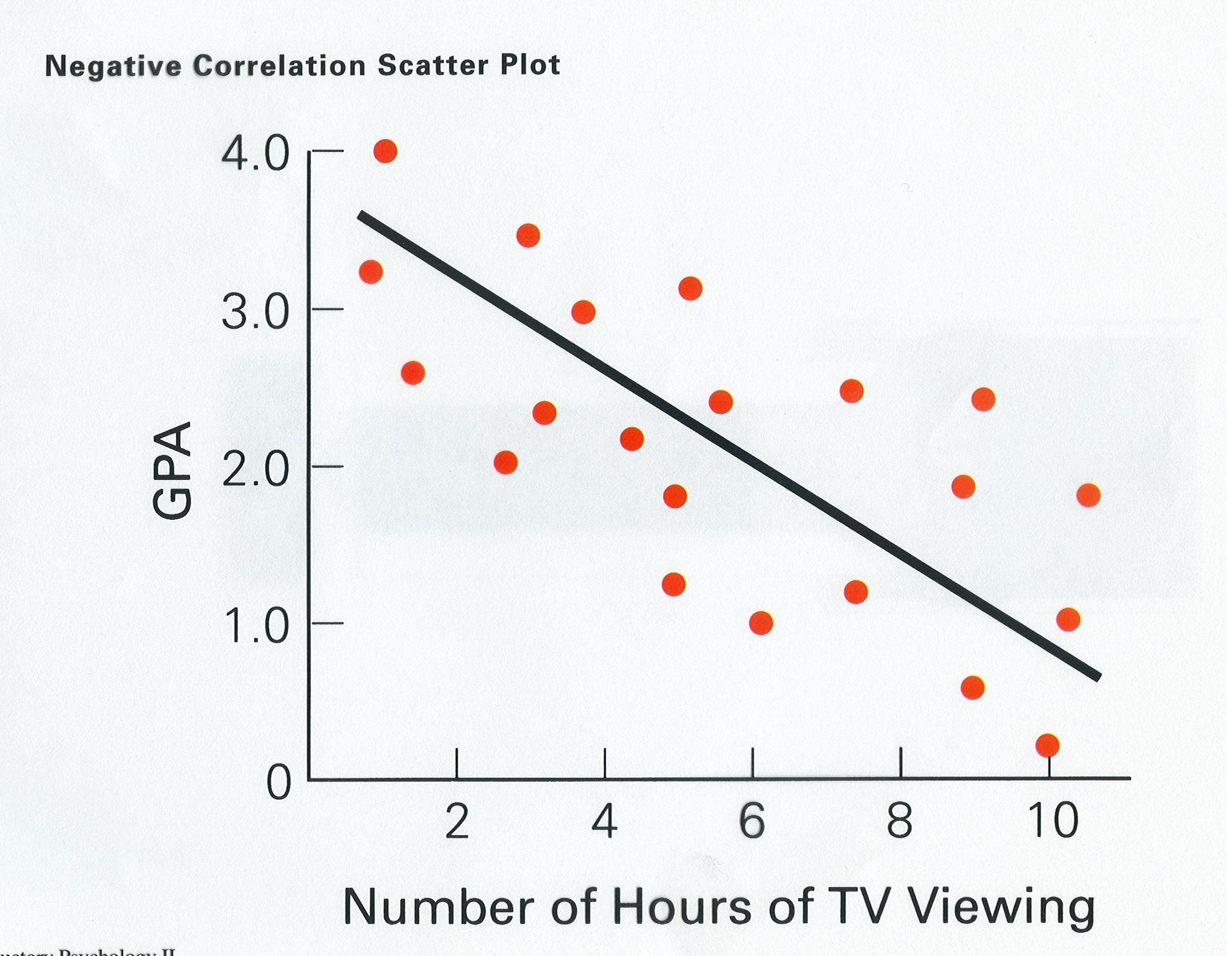
Directionality
Issue
Notes:
32

Slide 36
A useful website? Spurious Correlations

Slide 37
Case Study Methodology: A way to start each of your units?

Slide 38
Case Study methodology
Examining an event that has
already occurred for the lessons
we can derive from that event
Some examples:
* The Genovese Stabbing Case
* The Big Dan’s Rape Case

Slide 39
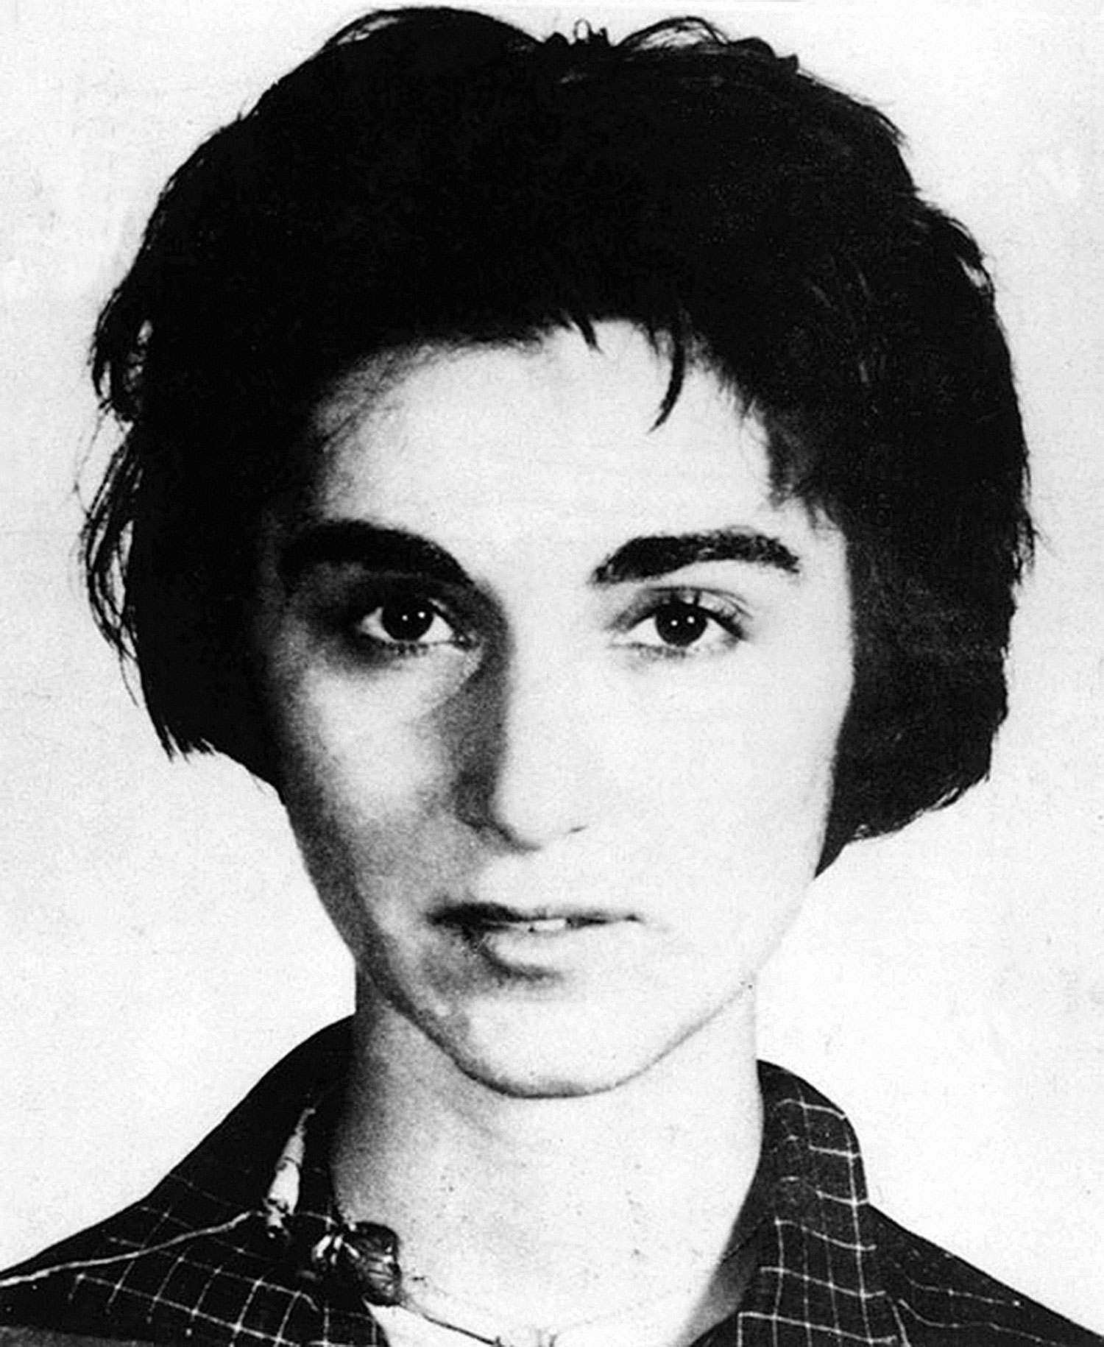
Kitty Genovese
1964

Slide 40
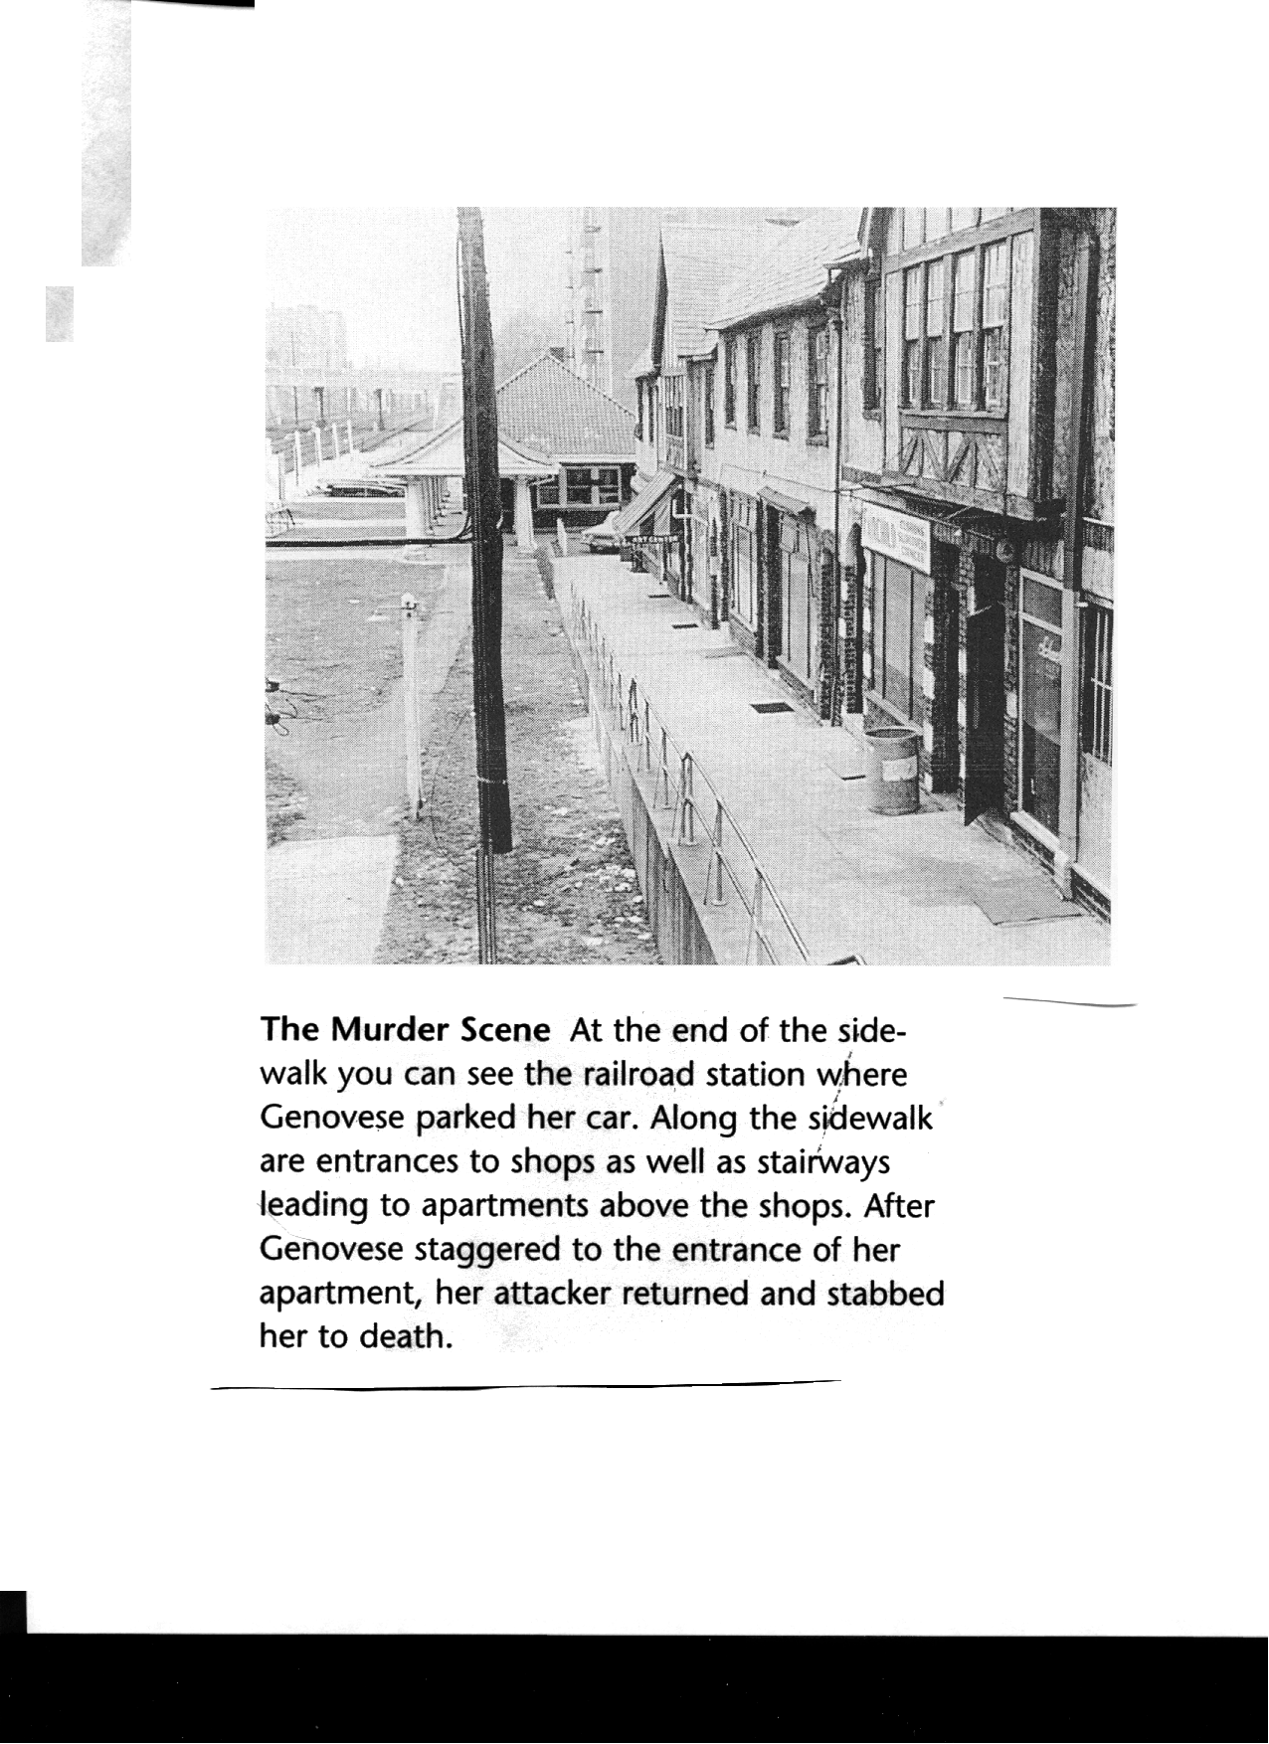

Slide 41
Big Dan’s Tavern- 1983 New Bedford Mass.

Slide 42
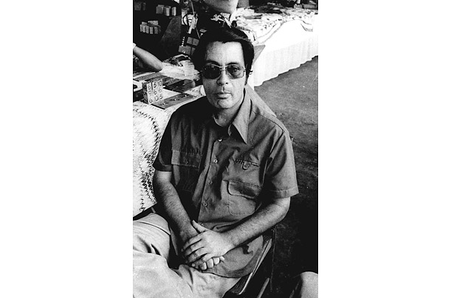
Jonestown 1978

Slide 43
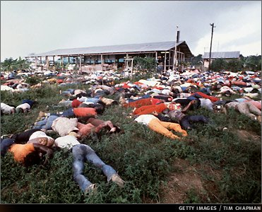
909 victims

Slide 44
STATISTICS
Notes:
There are only a few stats they really need to know. Importantly, they can’t use a calculator on the test so they will not be asked to calculations that aren’t basic mental math.

Slide 45
STATISTICS
Descriptive
Inferential
Measures of central tendency
Measures of variability
Statistical Significance

Slide 46
Statistical Significance
Is the outcome really a result of what
you’ve manipulated, or could it be
merely a chance occurrence?
It’s like establishing guilt “beyond
a reasonable doubt”
The statistical cut-off
is p < .05, meaning there’s a 95% likelihood
the results are NOT due to chance

Slide 47
Statistical Significance
The results are not due to chance
We are 95% sure the results are not due to chance
There is less than a 5% chance that the results were due to chance
P < .05

Slide 48
If p < .05, you can reject the NULL Hypothesis

Slide 49
Standard Deviation: the “typical” difference between each score and the mean

Slide 51
“Eyeball” this pro basketball
player salaries list:
MEAN: $5.1 million
MEDIAN: $3.35 million
$23.6 million $3.0 million
$12.4 million $1.5 million
$5.3 million $1.0 million
$4.6 million $1.0 million
$3.9 million $0.8 million
$3.7 million $0.4 million
MODE: $1 million
S.D.: $6.39 million
What would be highest: mean, median or mode?
What would be lowest?
A high or low S.D.?

Slide 52
Central Tendency 1968 TOPPS Baseball Cards
Nolan Ryan $1500
Billy Williams $8
Luis Aparicio $5
Harmon Killebrew $5
Orlando Cepeda $3.50
Maury Wills $3.50
Jim Bunning $3
Tony Conigliaro $3
Tony Oliva $3
Lou Pinella $3
Mickey Lolich $2.50
Elston Howard $2.25
Jim Bouton $2
Rocky Colavito $2
Boog Powell $2
Luis Tiant $2
Tim McCarver $1.75
Tug McGraw $1.75
Joe Torre $1.5
Rusty Staub $1.25
Curt Flood $1
With Ryan:
Median=$2.50
Mean=$74.14
Without Ryan:
Median=$2.38
Mean=$2.85

Slide 53
Two sets of data, with the same mean but different amounts
of variability… calculating the “standard deviation”
Set A
7
7
8
11
12
12
13
Set B
2
4
8
9
14
16
17
Mean? Median? Mode?

Slide 54
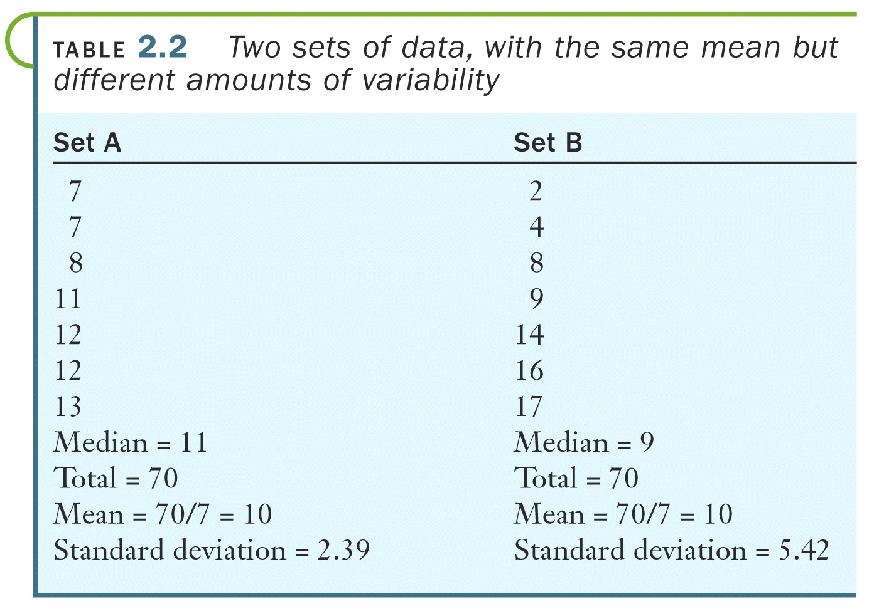

Slide 55
Percentiles?

Slide 56
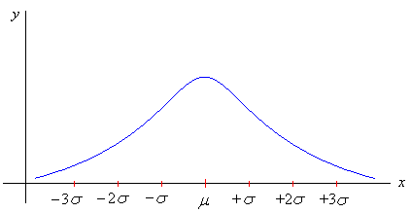
Normal Curve
Approximate percentage of area within given standard deviations
99.7%
95%
68%

Slide 57
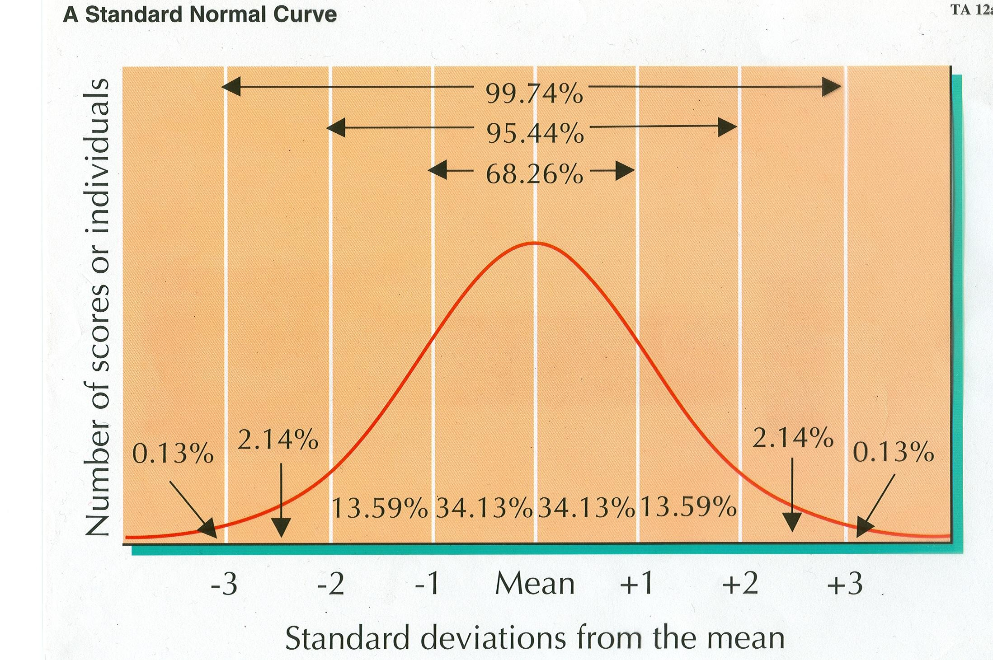

Slide 58
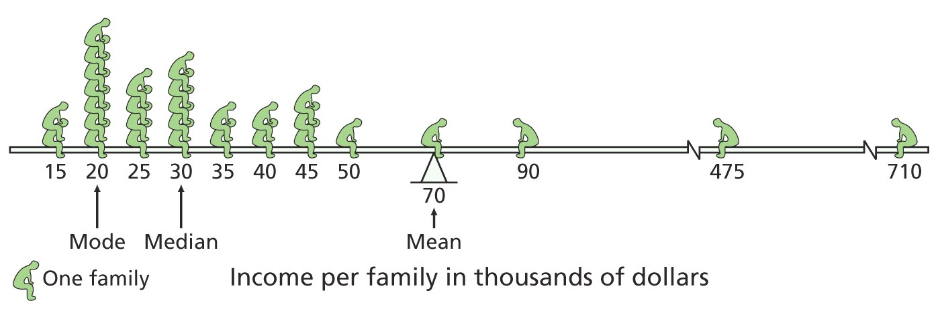

Slide 59
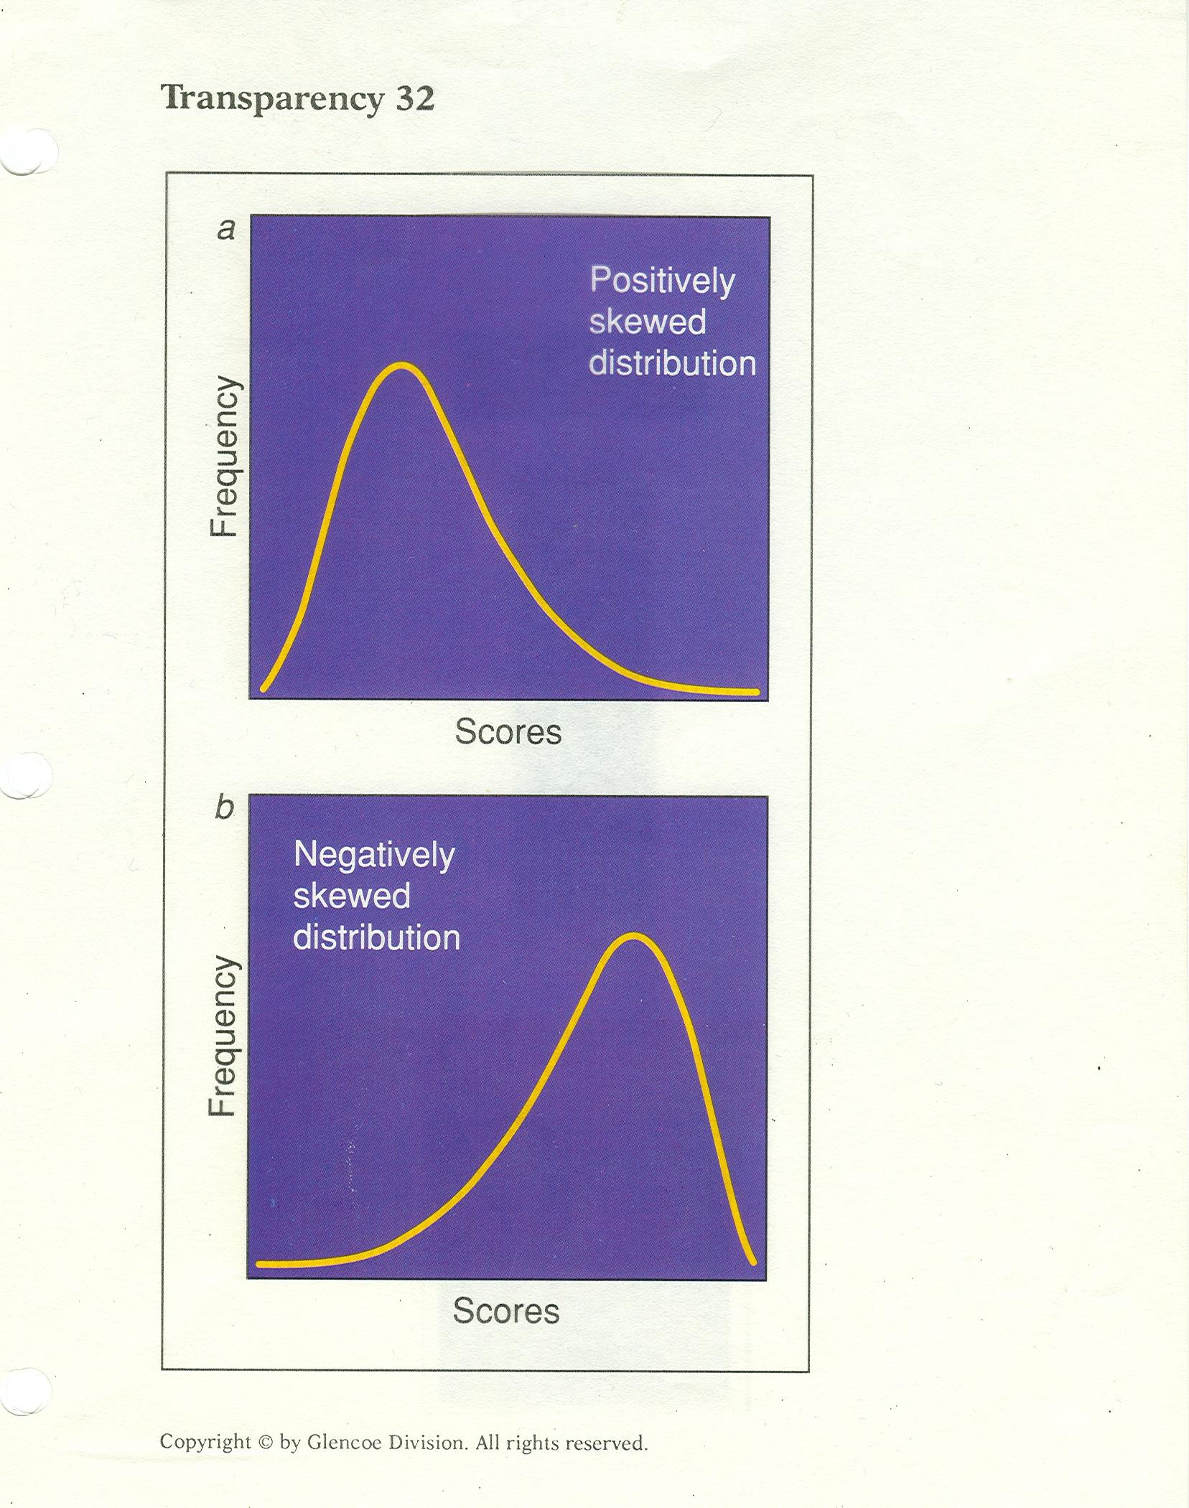

Slide 60
A helpful stats mnemonic?
The skew is the few

Slide 61
End of “Stats and
Research” powerpoint

Slide 62
