Slide 1
Day 5
AP Psychology – Unit 1: Research Methods & Stats
Other Research Methods
T. Cummings
Keefe Tech

Slide 2
Pros and Cons of experimental methodology?
Causal Relationships!

Slide 3
What methods are there
to test claims and beliefs?
Experimentation to explore possible cause and effect
Surveys

Slide 4
Survey Methodology

Slide 5
PROS AND CONS OF SURVEY METHODOLOGY
Surveys that you have taken?

Slide 6
Surveys cont…
A quick DEMO
(take out blank sheet of paper)

Slide 7
1. Is the Mississippi River longer or shorter than 500 miles?
2. How many miles long is it?

Slide 8
3. Does the average college textbook cost more or less than $50?
4. How much does the average textbook cost?

Slide 10
1. Is the Mississippi River longer or shorter than 3000 miles?
2. How many miles long is it?

Slide 11
3. Does the average college textbook cost more or less than $300?
4. How much does the average college textbook cost?

Slide 12
Q #2 -&- Q#4 RESULTS?
Group 1: Group 2:
Mean= Mean=

Slide 13
Framing
…the way questions are FRAMED or worded can dramatically impact the results of the survey. Even the order or words in a question can have subtle effects.
…the exact technique used on questions #2 and #4 was an anchoring heuristic.

Slide 14
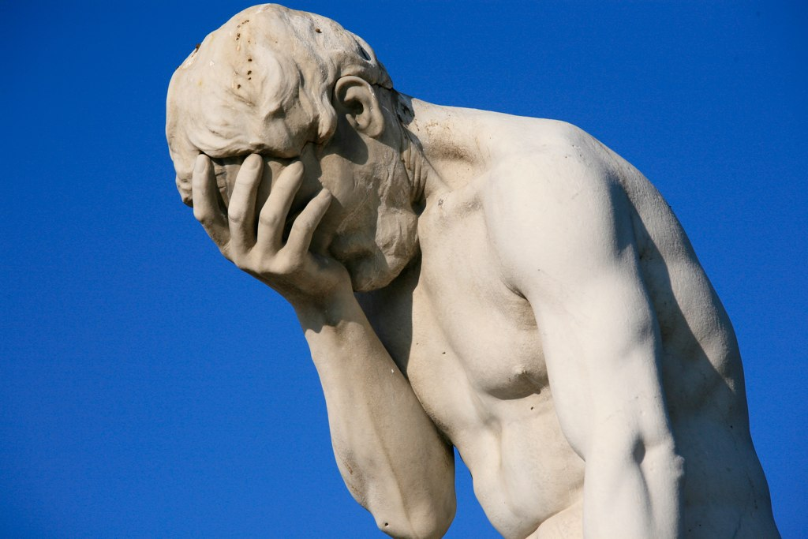
Survey of 1255 people
77% interested in the study of plants and trees
39% interested in botany

Slide 15
Stats from recent CNN research:
What % of men surveyed report they wash
their hands after using a public restroom?
95%
What % of male subjects in a naturalistic
observation wash their hands after
using a public restroom
65%

Slide 16
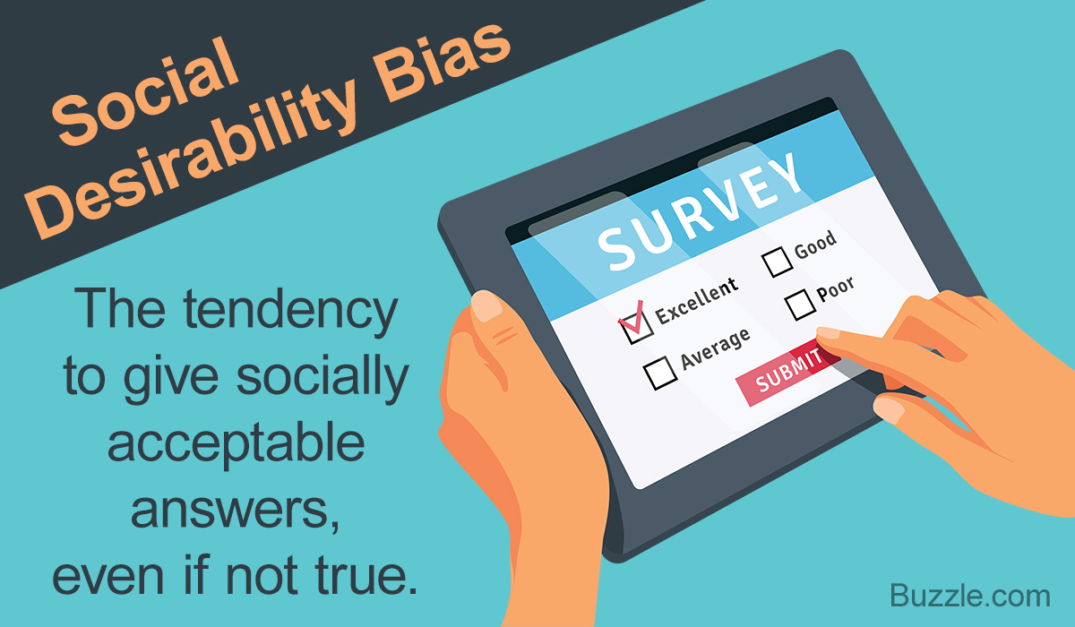
Social Desirability Bias

Slide 17
2000 National Survey
75% of men occasionally
think about killing someone
60% of women report the same
33% of the men surveyed said they
frequently think of killing someone
15% of women

Slide 18
Some jobs require daily contact
with people, while others require almost
none at all. If you had your choice of
any occupation, how much regular
contact with others would you prefer?
1- none at all
2- a little bit
3- some
4- quite a bit
5- constant
Notes:
18

Slide 19
Demand Characteristic
(those who are taking the survey sense what the researcher seem to want of them; then supplying the answers they feel they’re expected to give…)

Slide 20
Possible problems in survey methodology:
You don’t have a representative sample
of the population you’re studying

Slide 21
Case Study of Survey Methodology:
The 1936 Presidential Election
Incumbent Democratic President Franklin D. Roosevelt vs Republican Governor Alf Landon of Kansas
Prediction: Landon Wins 57% to 43%
Actual: FDR 62%, Landon 38%
What went wrong?
Poll done by Literary Digest which had been accurately predicting elections since 1916. Very reputable. Largest and most expensive poll done to date at that point. 2.4 million respondents
They collected names/address of 10 million people only 2.4 million respond….having more #s does not increase accuracy
PROBLEM = the names came from telephone books, magazine subscriptions, and auto registry…WHAT ERA IN US?
→ these are the affluent in society during the worst economic crisis in US History
Gallup, another polling agency, accurately predicted with a sample of 50,000…
Notes:
21
Poll done by Literary Digest which had been accurately predicting elections since 1916. Very reputable. Largest and most expensive poll done to date at that point. 2.4 million respondents
They collected names/address of 10 million people only 2.4 million respond REALLY hammer that having more #s does not increase accuracy
PROB= the names came from telephone books, magazine subscriptions, and auto registry→ these are the affluent in society during the worst economic crisis in US History
Gallup accurately predicted with a sample of 50,000

Slide 22
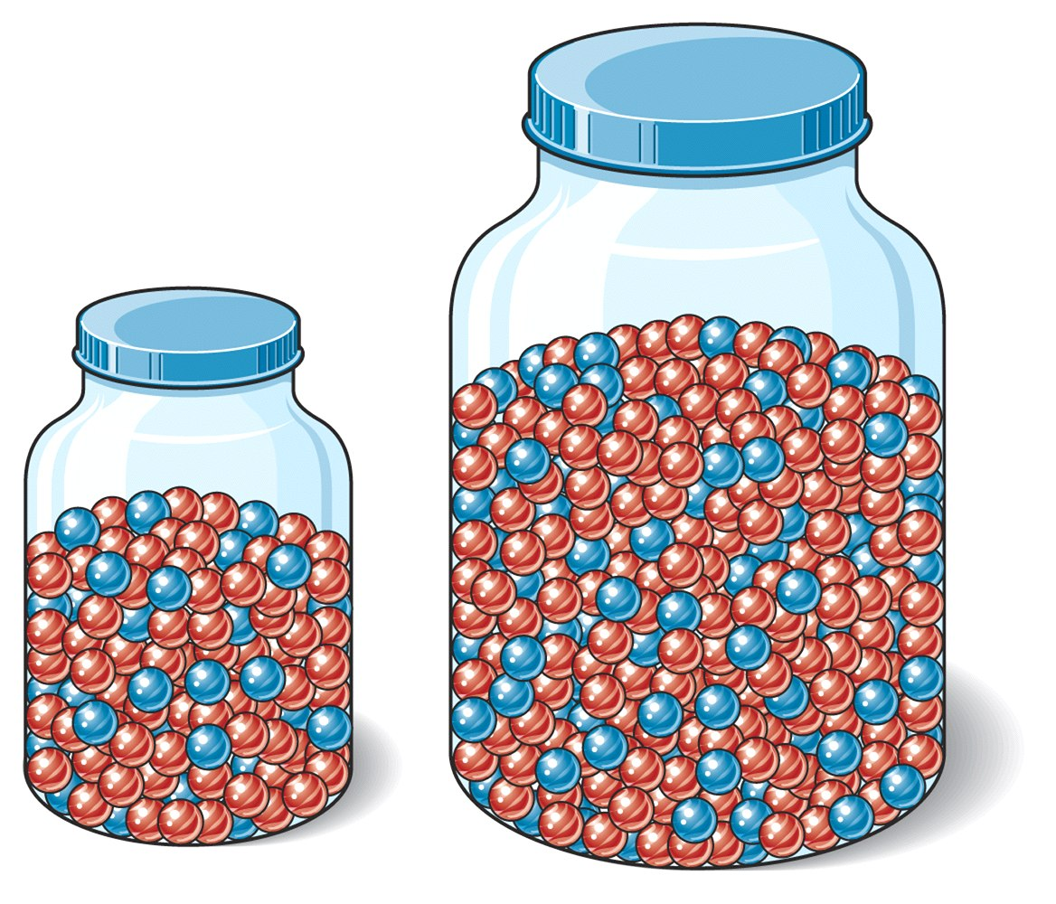
The population you are studying
The representative sample
of that population

Slide 23
Possible problems in survey methodology:
You don’t have a representative sample
of the population you’re studying
Social Desirability Bias
Demand Characteristic
Be careful how you frame the questions

Slide 24
What methods are there
to test claims and beliefs?
Experimentation to explore possible cause and effect
Surveys
Naturalistic observations

Slide 25
Naturalistic Observations
Two key elements:
*A clear, measurable “operational
definition” of what you’re observing
* Remaining unobtrusive!
Notes:
25

Slide 26
What methods are there
to test claims and beliefs?
Experimentation to explore possible cause and effect
Surveys
Naturalistic observations
Correlational research

Slide 27
Correlational Research
Note: correlation coefficients

Slide 28
(Schaeffer, 1988)
Statistically, in barrooms there is a correlation
between music tempo and
drinking rates
What would you predict (positive or negative)?
Notes:
There is a negative correlation

Slide 29
The correlation between
S.A.T. scores and freshman
college G.P.A.
r = + .61
Notes:
.5 is considered a strong correlation by many texts

Slide 30
Correlations: positive,
negative or zero?
1- # of bananas imported into the U.S. and divorce rates
2- Weight in pounds and hours of TV viewing
3- Educational level and income
4- Typing practice and typing errors
5- SAT scores and IQ scores
6- Happiness and income

Slide 31
Correlations (continued)
6- SAT scores and college GPA
7- Levels of overall happiness and altruistic behavior
8- Number of plants in your home and number of times you brush your teeth daily
9- Educational level and levels of obedience to authority
10- Age and hours of sleep per night
11- Test anxiety and test performance

Slide 32
Correlations (continued)
12- Hours of exercise and weight of exerciser
13- High School GPA and hours spent watching TV per week
14- Musical preference and frequency of sex
15- Time spent playing violent video games and aggressive behavior
Notes:
32

Slide 33
A Quick “Check-In”
Which of the following represents the strongest correlation?
+.57
-.78
-.25
+.71
+1.25
Notes:
.5 is considered a strong correlation by many texts

Slide 34
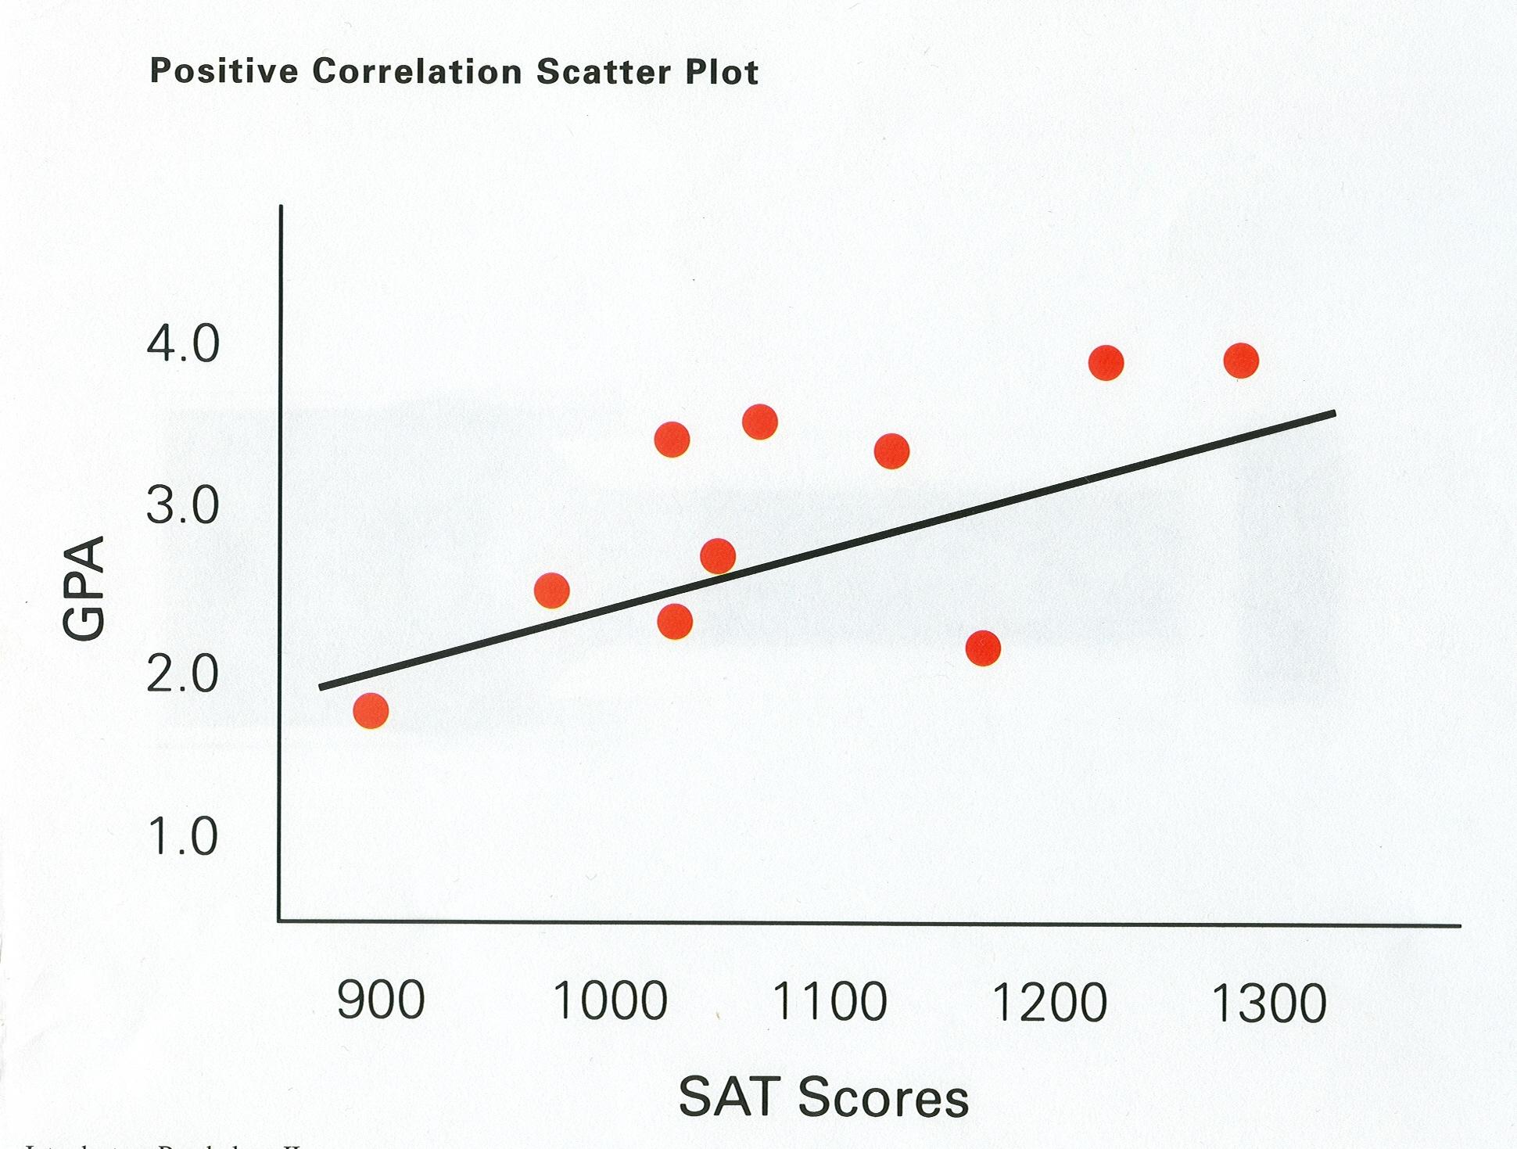
Notes:
34

Slide 35
CORRELATIONAL STUDIES
DO NOT infer causation from mere correlation
Also, be aware of the 3rd Variable Issue
Notes:
Any violent crime is positively correlated with the sale of Ice Cream
Churches and crime rates are highly correlated- 3rd variable is population

Slide 36
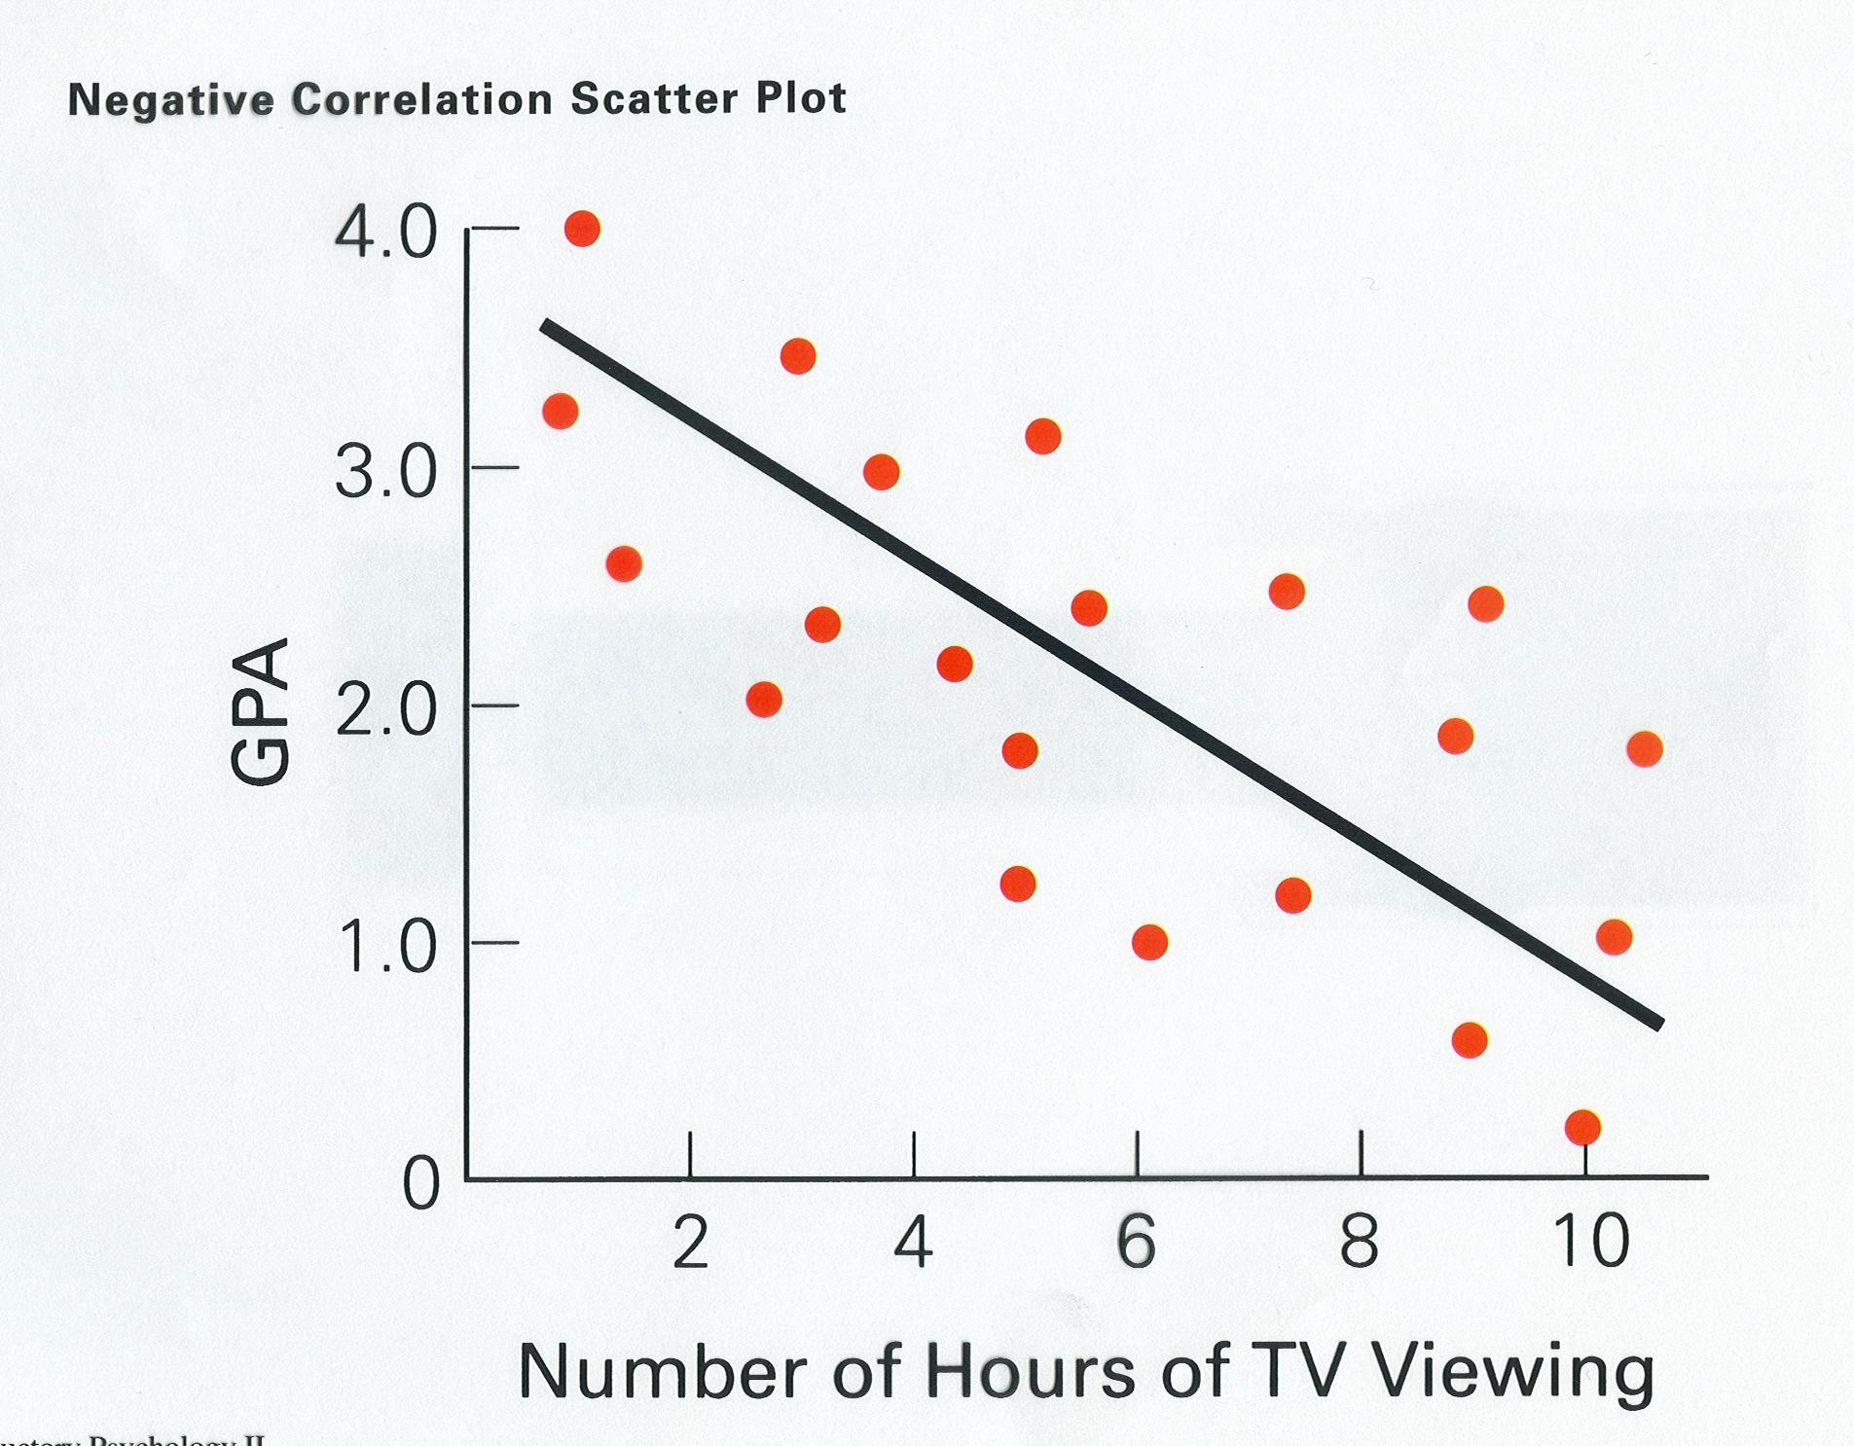
Directionality
Issue
Notes:
36

Slide 40
A useful website? Spurious Correlations

Slide 41
Case Study Methodology: A way to start each of your units?

Slide 42
Case Study methodology
Examining an event that has
already occurred for the lessons
we can derive from that event
Some examples:
* The Genovese Stabbing Case
* The Big Dan’s Rape Case

Slide 43
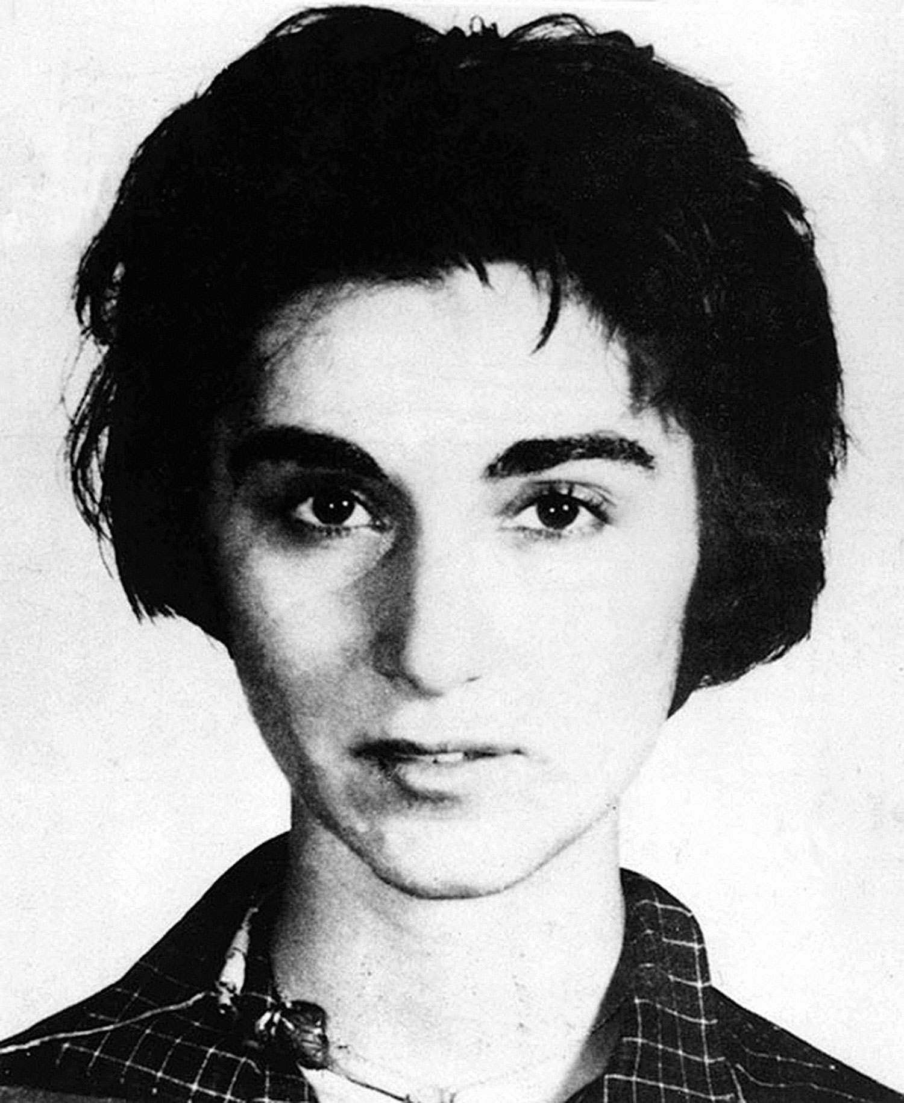
Kitty Genovese
1964

Slide 44
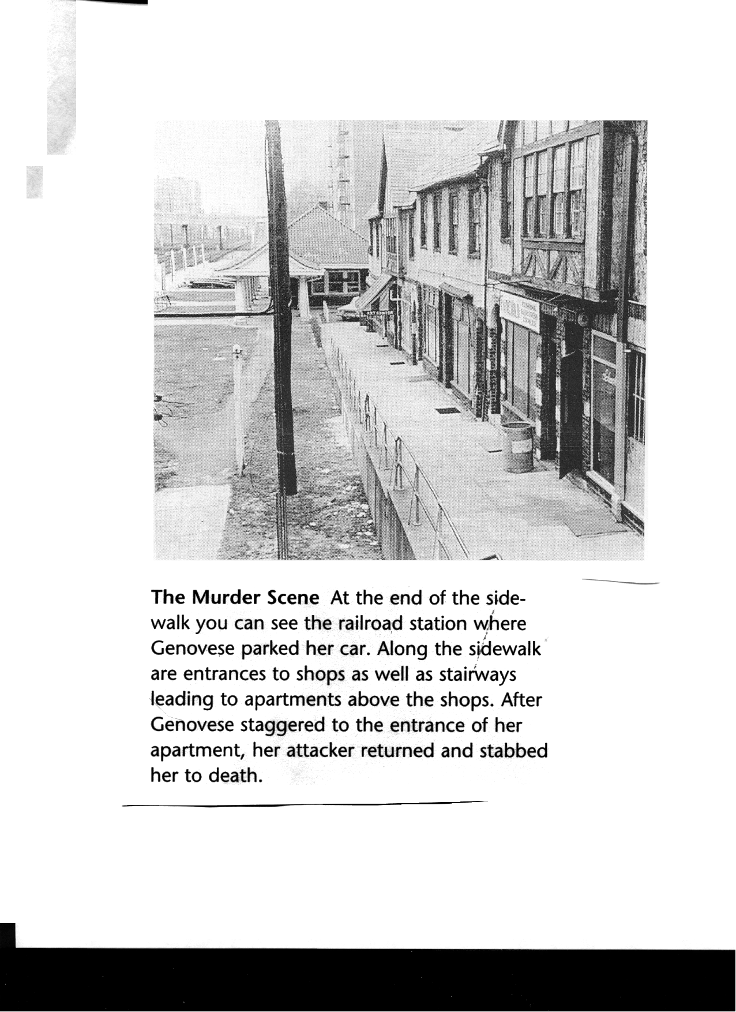

Slide 45
Big Dan’s Tavern- 1983 New Bedford Mass.

Slide 46
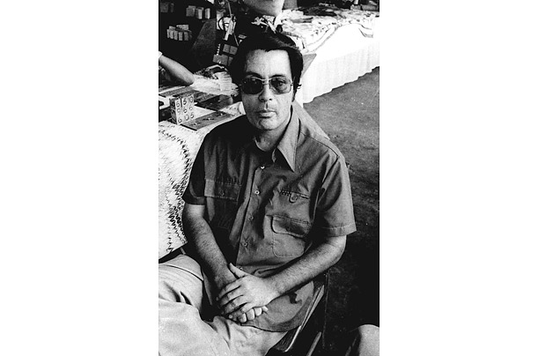
Jonestown 1978

Slide 47
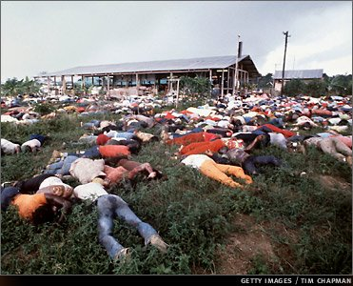
909 victims

Slide 48
STATISTICS
Notes:
There are only a few stats they really need to know. Importantly, they can’t use a calculator on the test so they will not be asked to calculations that aren’t basic mental math.

Slide 49
STATISTICS
Descriptive
Inferential
Measures of central tendency
Measures of variability
Statistical Significance

Slide 50
Statistical Significance
Is the outcome really a result of what
you’ve manipulated, or could it be
merely a chance occurrence?
It’s like establishing guilt “beyond
a reasonable doubt”
The statistical cut-off
is p < .05, meaning there’s a 95% likelihood
the results are NOT due to chance

Slide 51
Statistical Significance
The results are not due to chance
We are 95% sure the results are not due to chance
There is less than a 5% chance that the results were due to chance
P < .05

Slide 52
If p < .05, you can reject the NULL Hypothesis

Slide 53
Standard Deviation: the “typical” difference between each score and the mean

Slide 55
“Eyeball” this pro basketball
player salaries list:
MEAN: $5.1 million
MEDIAN: $3.35 million
$23.6 million $3.0 million
$12.4 million $1.5 million
$5.3 million $1.0 million
$4.6 million $1.0 million
$3.9 million $0.8 million
$3.7 million $0.4 million
MODE: $1 million
S.D.: $6.39 million
What would be highest: mean, median or mode?
What would be lowest?
A high or low S.D.?

Slide 56
Central Tendency 1968 TOPPS Baseball Cards
Nolan Ryan $1500
Billy Williams $8
Luis Aparicio $5
Harmon Killebrew $5
Orlando Cepeda $3.50
Maury Wills $3.50
Jim Bunning $3
Tony Conigliaro $3
Tony Oliva $3
Lou Pinella $3
Mickey Lolich $2.50
Elston Howard $2.25
Jim Bouton $2
Rocky Colavito $2
Boog Powell $2
Luis Tiant $2
Tim McCarver $1.75
Tug McGraw $1.75
Joe Torre $1.5
Rusty Staub $1.25
Curt Flood $1
With Ryan:
Median=$2.50
Mean=$74.14
Without Ryan:
Median=$2.38
Mean=$2.85

Slide 57
Two sets of data, with the same mean but different amounts
of variability… calculating the “standard deviation”
Set A
7
7
8
11
12
12
13
Set B
2
4
8
9
14
16
17
Mean? Median? Mode?

Slide 58
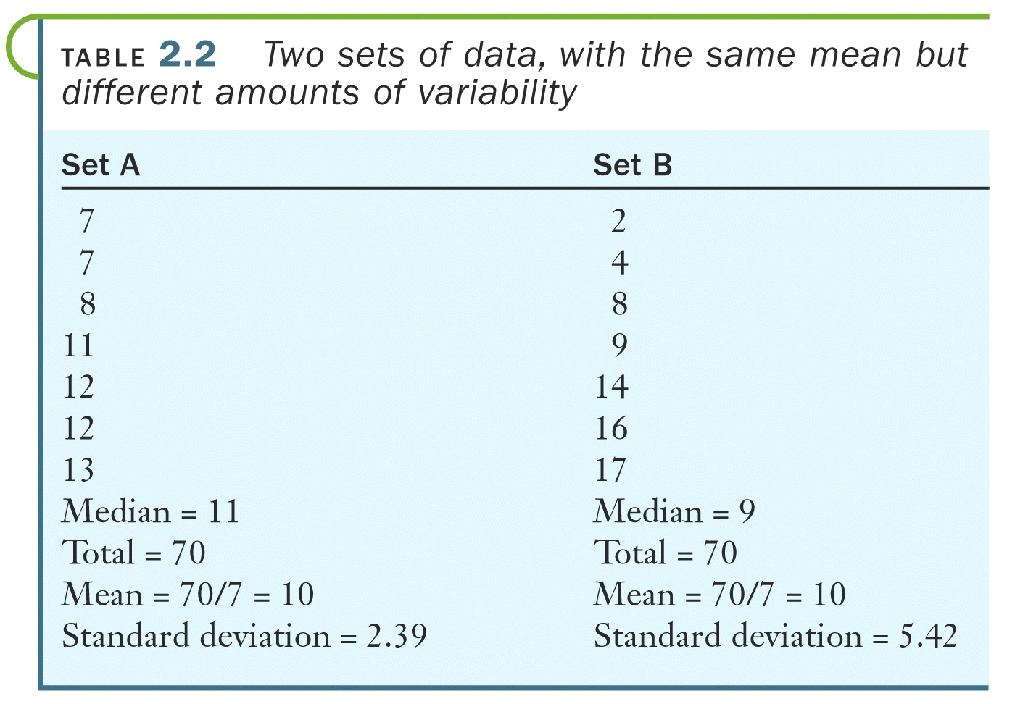

Slide 59
Percentiles?

Slide 60
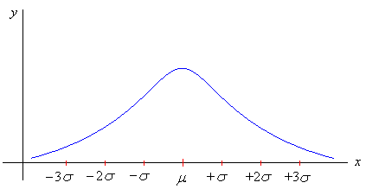
Normal Curve
Approximate percentage of area within given standard deviations
99.7%
95%
68%

Slide 61
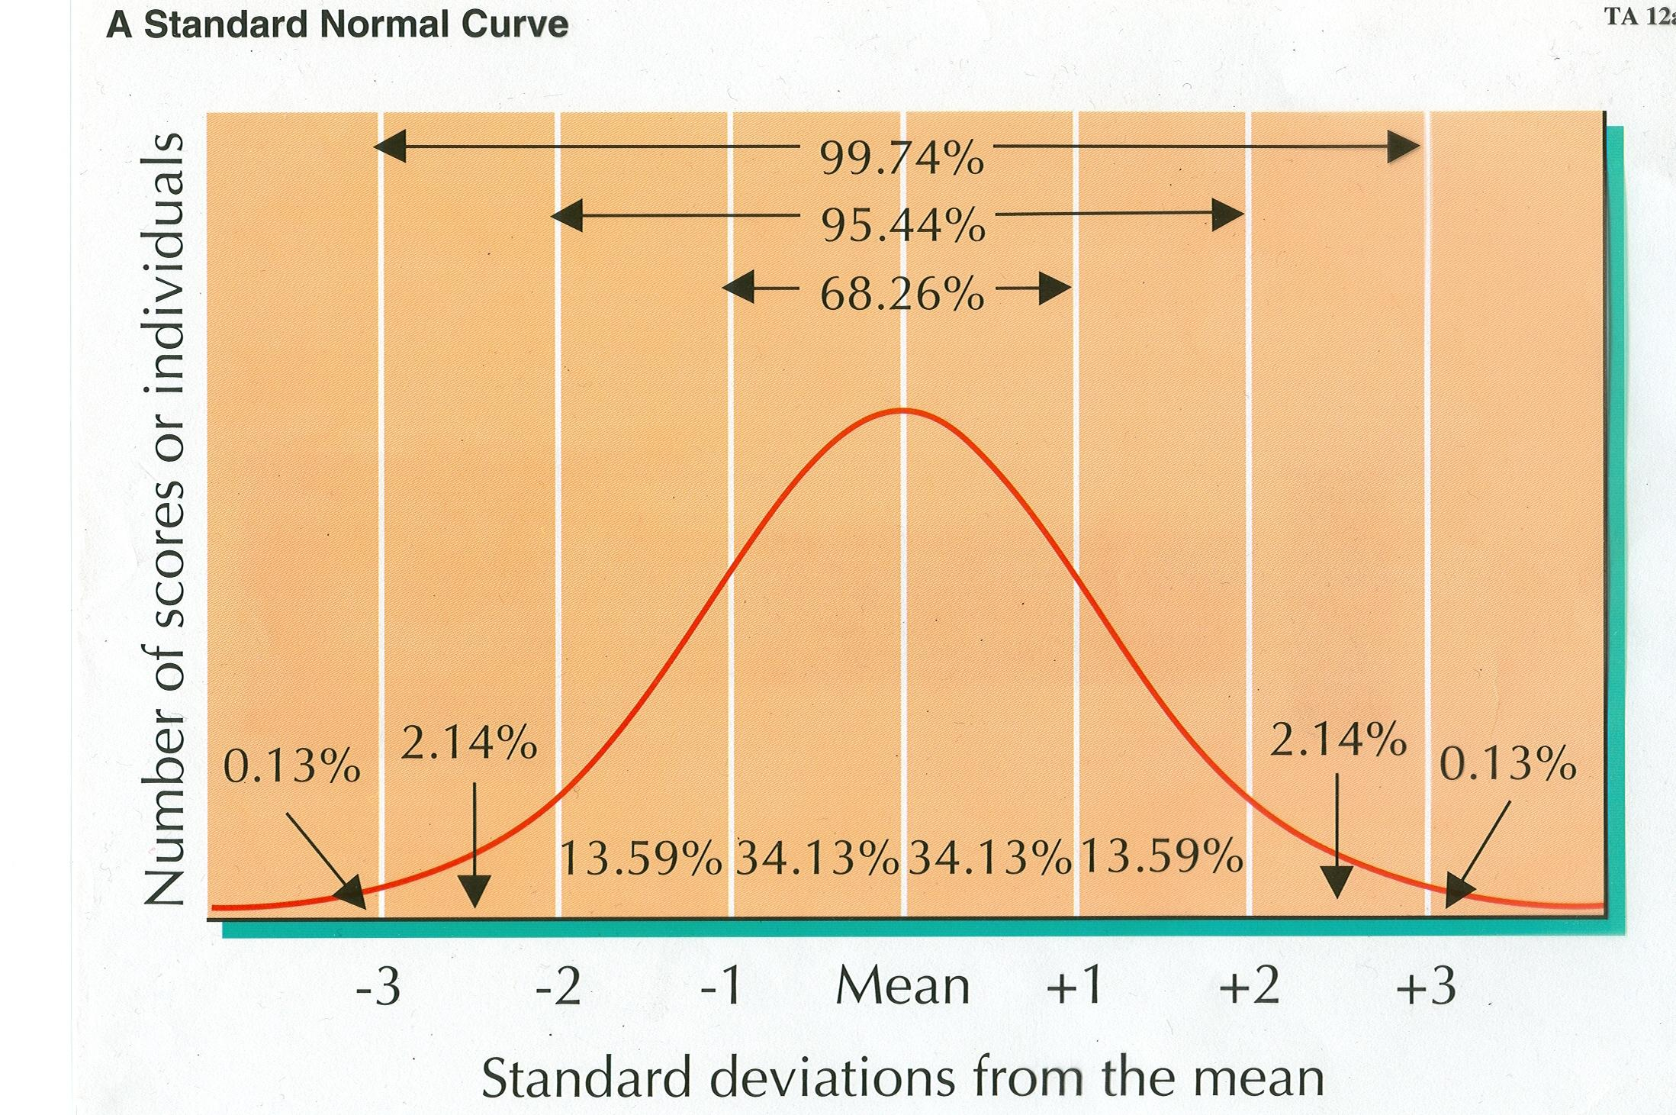

Slide 62
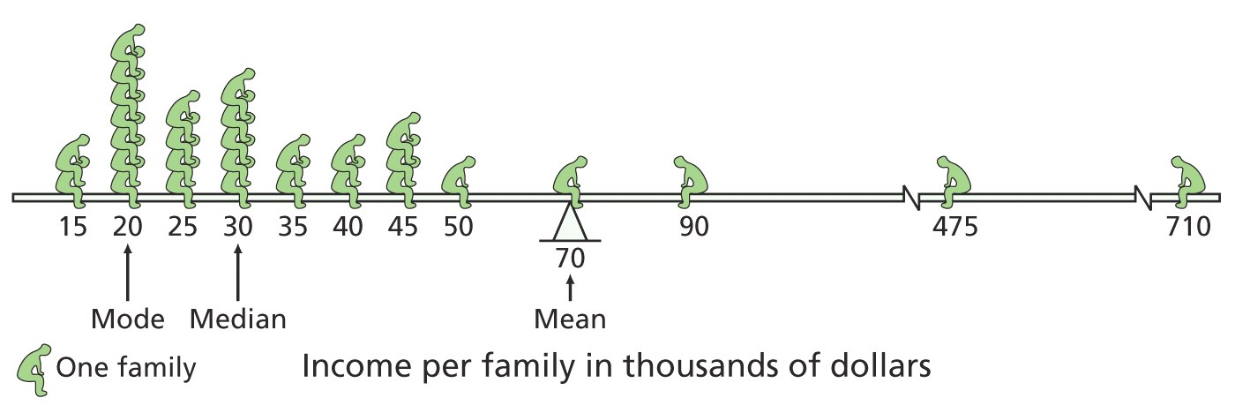

Slide 63
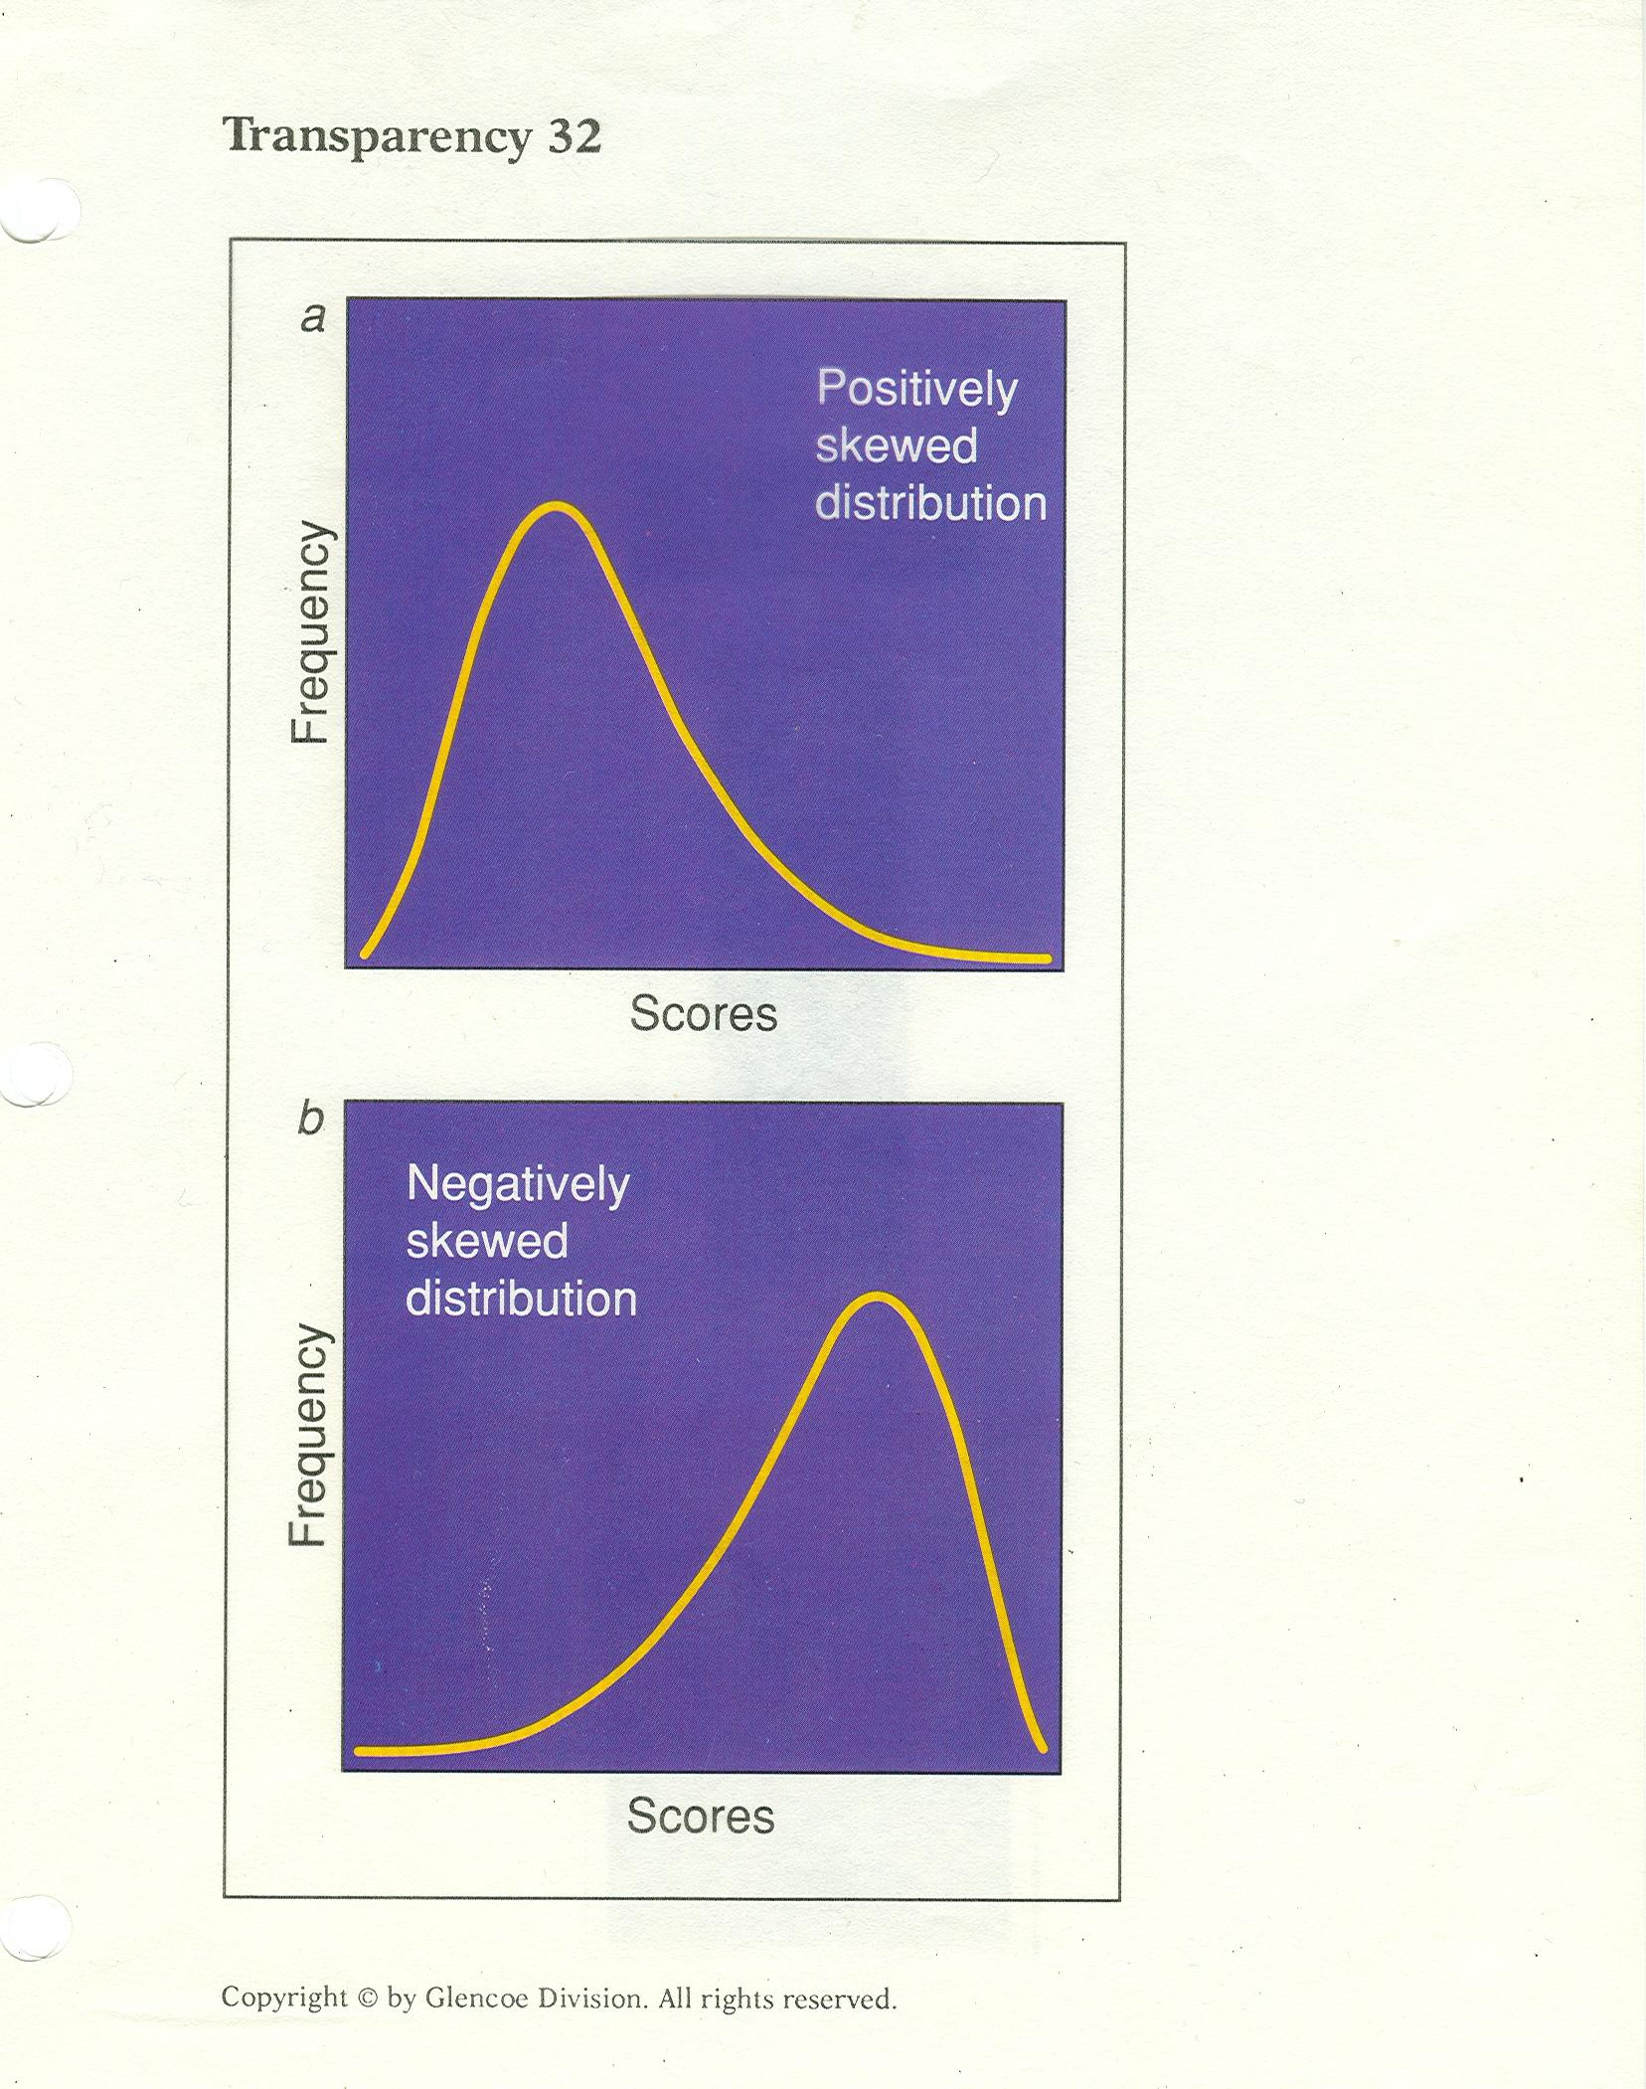

Slide 64
A helpful stats mnemonic?
The skew is the few

Slide 65
End of “Stats and
Research” powerpoint

Slide 66
