Slide 1
Day 2
AP Psychology
T. Cummings
Keefe Tech

Slide 2
Recap Day #1 – Debriefing/Content “The Newspaper Article”
How do we meaningfully test any claim?
What is the evidence?
Amazing Randi v. Uri Geller on The Tonight Show

Slide 3
“People’s desire to believe in the paranormal is stronger than all the evidence that it does not exist.”
-Susan Blackmore, PhD

Slide 4
Recap Day #1 – Debriefing/Content
How do we meaningfully test any claim?
What is the evidence?
Amazing Randi v. Uri Geller on The Tonight Show
Concepts: hypothesis, controlled experiments, experimenter bias, replication, IV/DV, use of confederates, confirmation bias, perhaps more!

Slide 5
Recap Day #1 Demonstrations of alleged ‘parapsychological phenomena’
What’s the evidence?
Can it be replicated?
How do we test a hypothesis?
Who set up the conditions?
Once you believe, do you attend only to evidence that confirms your belief?
Confirmation Bias

Slide 6
Research Methods and Statistics 10-14% AP Exam
Unit 1
Graphic Organizer
Quiz Friday
(Open Note)
Assignment Reading Pages #1-20 // #1-13 THIS WEEK, TAKE NOTES

Slide 7
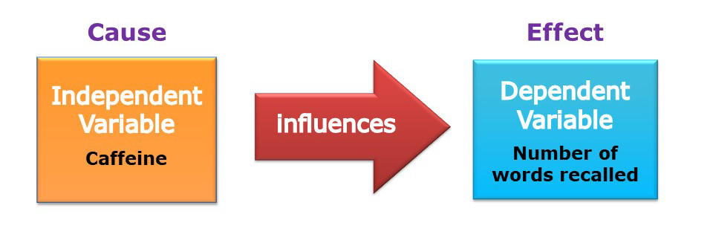
Controlled Experiments
n=100 College Freshmen
(How were participants Randomly Selected from the greater population)
Experimental Group?
Control Group?
Remember: “They’re testing the effect of the IV on the DV…”
What else could effect number of words recalled (the DV) other than Caffeine (the IV)? (Confounding Variables)
…caffeine tolerance?
Random Assignment!!! …the distributions of individual differences in tolerance to caffeine should be similar for participants in experimental and control groups, which would rule out caffeine tolerance as an alternative explanation of the results. A study is not valid without Random Assignment.

Slide 8
Warm-Up:
Watch the commercial for Belsomra.
What is the claim?
What is the population (n=)?
Who is in the experimental group?
Who is in the control group?

Slide 9
The Independent Variable & The Dependent Variable
“They’re testing the effect
of __________
on __________”

Slide 10
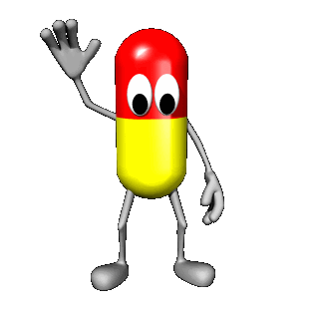
Independent Variable
Whatever is being manipulated in the experiment.
Hopefully the independent variable brings about change.
If there is a drug in an experiment, the drug is almost always the independent variable.

Slide 11
Dependent Variable
Whatever is being measured in the experiment.
It is dependent on the independent variable.
The dependent variable would be the effect of the drug.

Slide 12
The Independent Variable & The Dependent Variable
“They’re testing the effect
of __________
on __________”

Slide 13
Legless Rats…
“The number of legs a rat has will impact its speed in a maze”

Slide 14
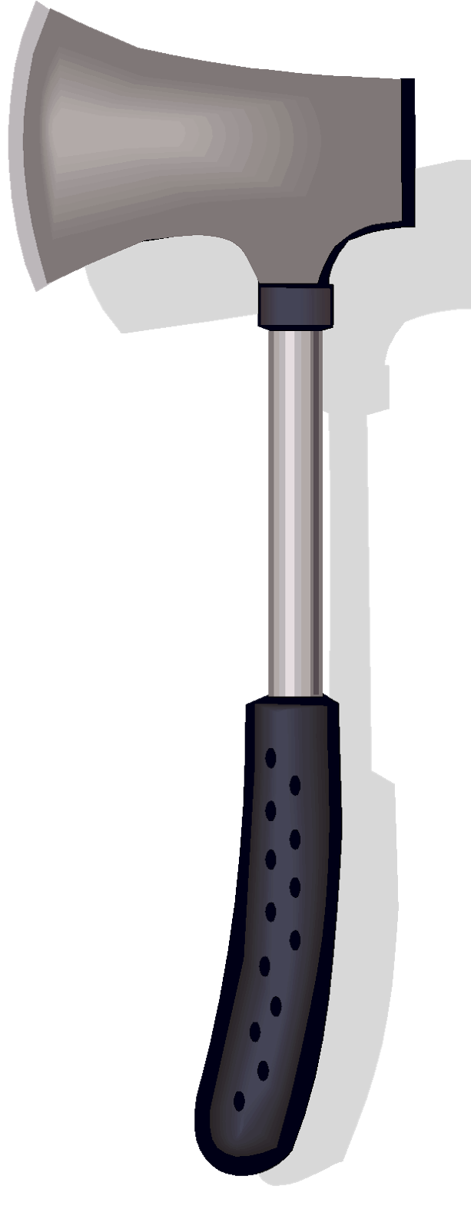
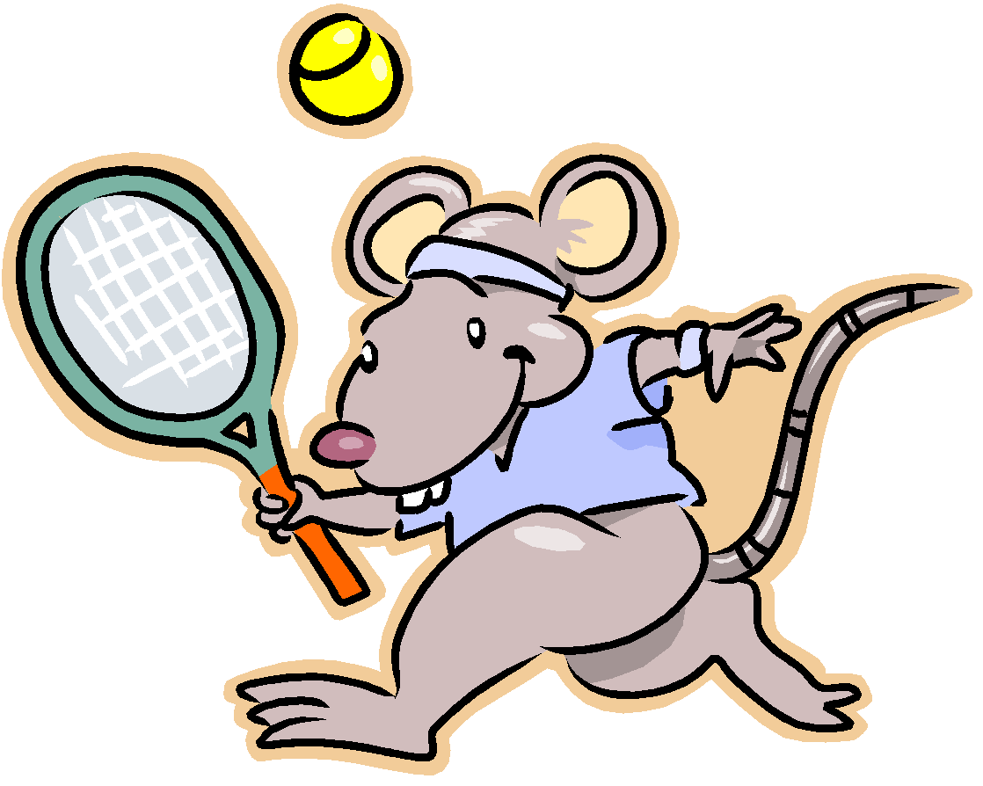

Slide 15
“They’re testing the effect
of __________
on __________”

Slide 16
Legless Rat Experiment
IV:
DV:
Control Group:
Experimental Group:

Slide 17
The null hypothesis
“The independent variable will have no effect on the dependent variable”
In an experiment, you are not so much trying to “prove” your hypothesis as you are gathering data to see if you can reject the null hypothesis

Slide 18
Confounding variables:
Any variable other than the IV that
could cause a change in the DV
creating differences between your groups

Slide 19
DEMO: RANDOM ASSIGNMENT
(Names in a hat)

Slide 20
Random Assignment
Each subject has an equal chance of being assigned to the control or experimental group

Slide 21
Why random assignment?
Balance/equalize group characteristics
Eliminates participant confounding variables
It is not a true experiment without it

Slide 22
Day 3
AP Psychology – Unit 1: Research Methods & Stats
T. Cummings
Keefe Tech

Slide 23
Getting Started:
Register with College Board – You Must Do This!
Homework (IV & DV Practice) → Ticket Out The Door Basket
Questions?
Quiz Friday re: reading Ch. 1 (p.1-13)
What were the issues with ‘Legless Rats’?
Controlled Experiment
Claim → Hypothesis
IV → DV
Experiment Group
Control Group
Random Selection (external of study)
Random Assignment (internal of study)
Confounding Variables
Replication
Operational Definitions

Slide 24
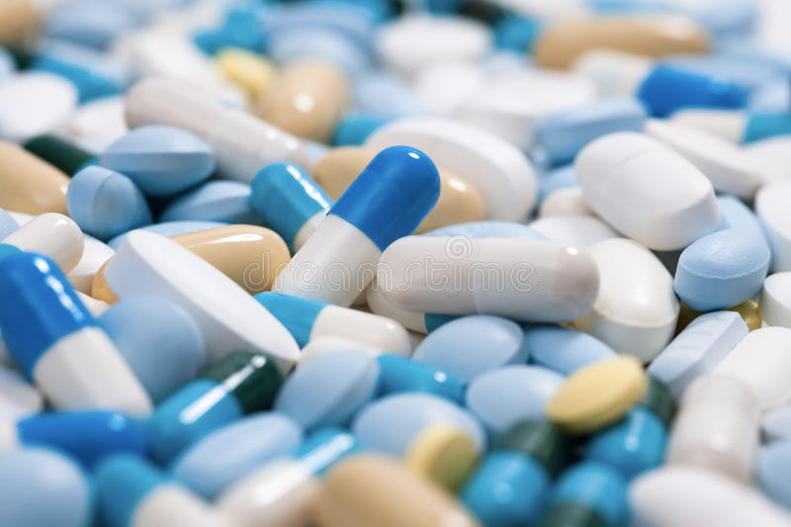
Placebos and the Placebo Effect (Expectancy)
White sugar pill will give you a placebo, if you want a stronger effect go to a smaller blue pill with a letter stamped on it. Stronger yet, a gel capsule and of course anything intravenous will give you an even more powerful placebo effect. Also note the nocebo effect- getting side effects from the placebo
Make sure to mention sham surgeries here.
Also, NPR 5/11/2016 using a Nike putter vs. no name putter creates a sports equipment type of placebo.

Slide 25
A double blind control for possible experimenter bias
Neither the participants nor the researcher
or data gatherer know the hypothesis or
who has been assigned to what group

Slide 26
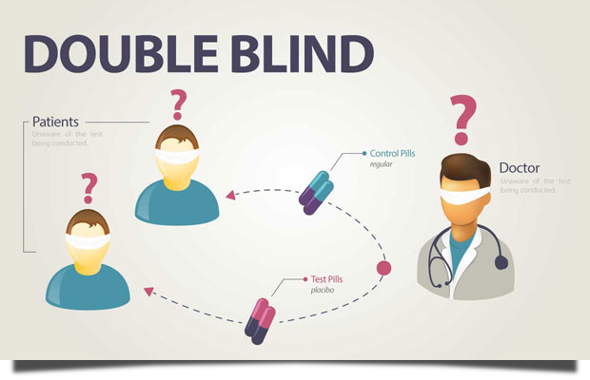
DOUBLE BLIND DESIGN
WHY IS USING A DOUBLE BLIND DESIGN CRITICAL?
Random Assignment of test subjects to the experimental and control groups is a critical part of any double-blind research design. The key that identifies the subjects and which group they belonged to is kept by a third party, and is not revealed to the researchers until the study is complete.
Researchers / Clinicians:
Rule out bias
Experimenter Bias → Confirmation Bias
Real World Implications:
Wanting to advance science → inventing in bad research / drugs
Dangerous / non-effective drugs going to market
Patients
Rule out bias
Expectation Effect:
A participant knowing their group assignment could alter their commitment to the study
Control / Placebo
Experiment

Slide 27
Practice! Experimental Design
Using Social Psychological Examples to Teach the Methods Unit
Experiment Examples
With your partner, attempt experiments #1-6.
Debrief to Follow ☺

Slide 28
Day 4
AP Psychology – Unit 1: Research Methods & Stats
Ethics, Violations, & Other Research Methods
T. Cummings
Keefe Tech

Slide 29
APA Ethical Guidelines:
* Volunteers only!
* Researchers must obtain informed consent
* Researchers must insure a minimum amount of deception
* Researchers must induce a minimum of harm or stress
* Researchers must maintain the confidentiality of the volunteers
* Volunteers have the right to discontinue at any time
* Researchers have an obligation to debrief after the research is ended

Slide 30
Institutional Review Board (IRB)

Slide 31
Ethics in social science research:
*1920: John B. Watson and “Little Albert”
*1963: Stanley Milgram’s
“electric shock” study
*1932-72: The Tuskegee Syphilis Study
*1968: Blue Eyes, Brown Eyes.

Slide 32
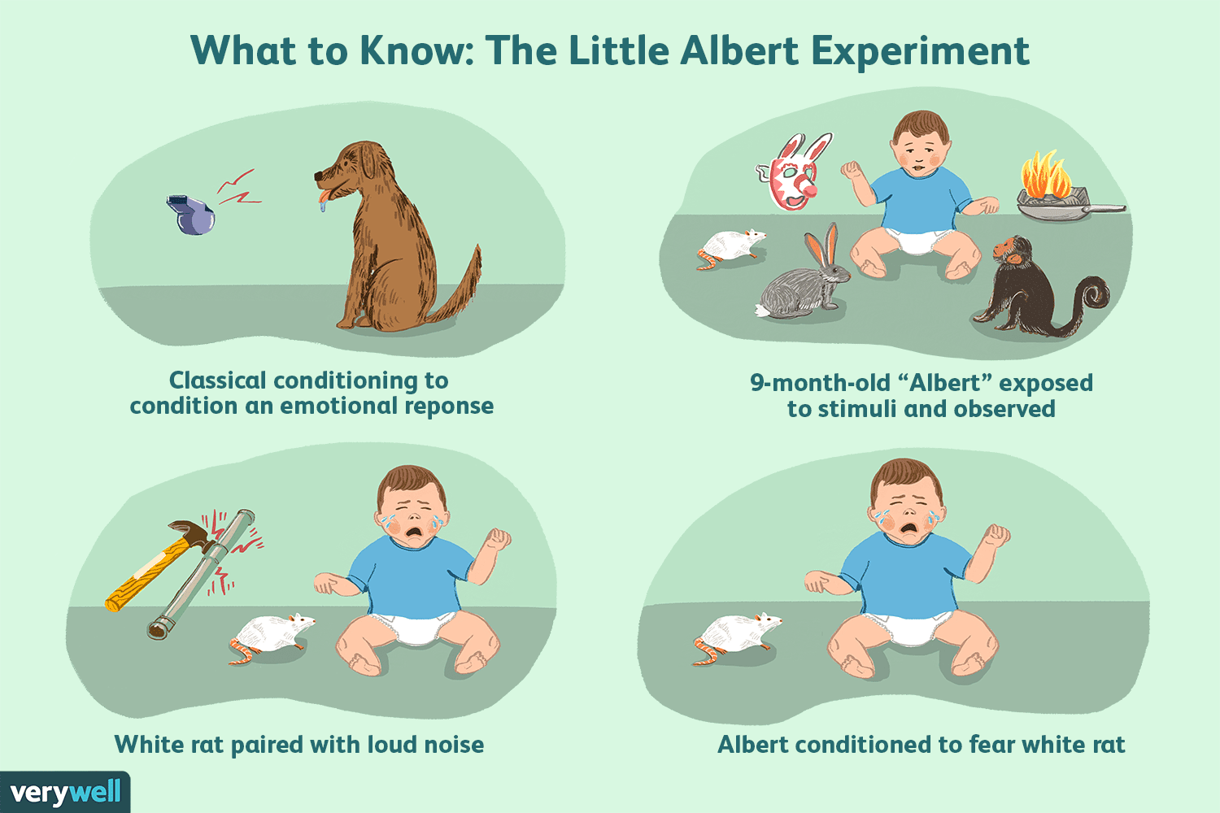
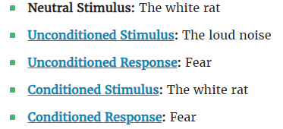
“Little Albert”, 1920, John B. Watson (Classical Conditioning)
Watson had originally planned to decondition Albert to the stimulus, demonstrating that conditioned fears could be eliminated. However, Albert was removed from the experiment before this could happen.
he died at six years of age
Ethical Violations (Today):
Informed Consent
Protection from Physical or Emotional Harm
Confidentiality
Debriefing
More on this in our LEARNING UNIT!

Slide 33
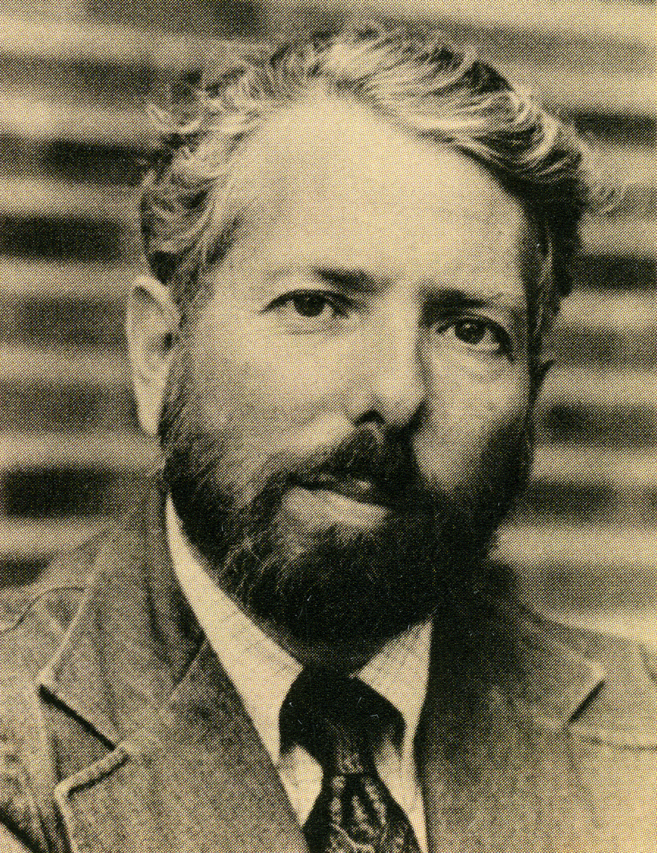
Stanley Milgram
Yale- 1963

Slide 34
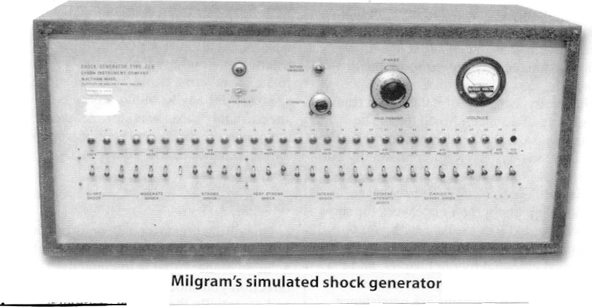

Slide 35
Milgram video with original footage
https://drive.google.com/open?id=1j_piWh_Tpt5CZvs8jwv7TsnlxixqvRgW

Slide 36
Ethical Violations of the Milgram Experiment Obedience to Authority:
Deception – the participants actually believed they were shocking a real person and were unaware the learner was a confederate of Milgram's.
Protection of participants - Participants were exposed to extremely stressful situations that may have the potential to cause psychological harm. Many of the participants were visibly distressed.
Milgram did debrief the participants fully after the experiment and also followed up after a period of time to ensure that they came to no harm. But NOT ALL.
Right to Withdrawal - The BPS states that researchers should make it plain to participants that they are free to withdraw at any time (regardless of payment).
Did Milgram give participants an opportunity to withdraw? The experimenter gave four verbal prods which mostly discouraged withdrawal from the experiment.

Slide 37
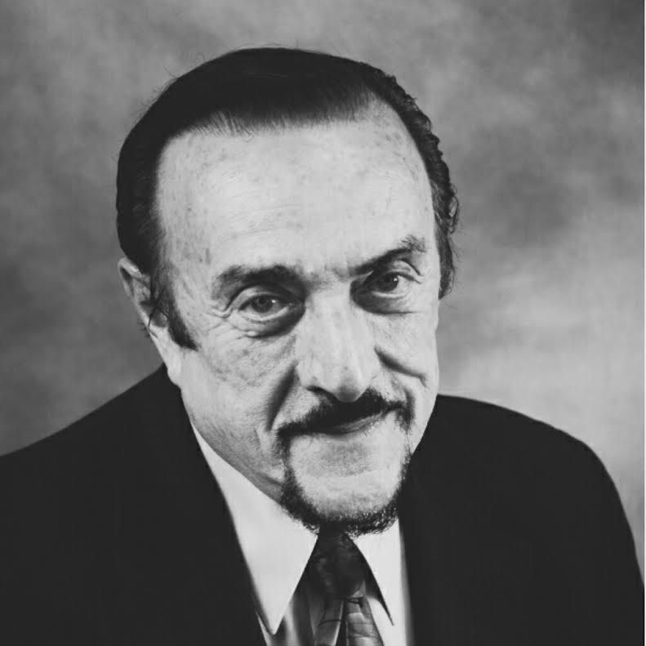
Recall Zimbardo’s “Mock Prison” study at Stanford (1971)

Slide 38
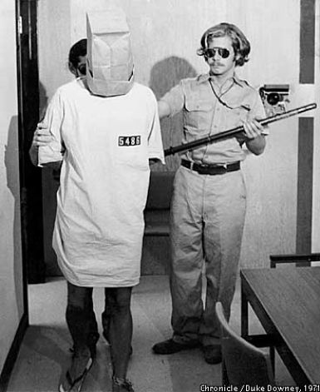
Stanford Prison Experiment (1971)

Slide 39
The AP Exam
AP Psychology Exam – Thursday May 9th, 2019 – Afternoon
100 MC → 70 mins (2/3 Grade)
2 FRQ → 50 mins (1/3 Grade) –BLUE OR BLACK INK
FRQ #1
FRQ #2

