Slide 1
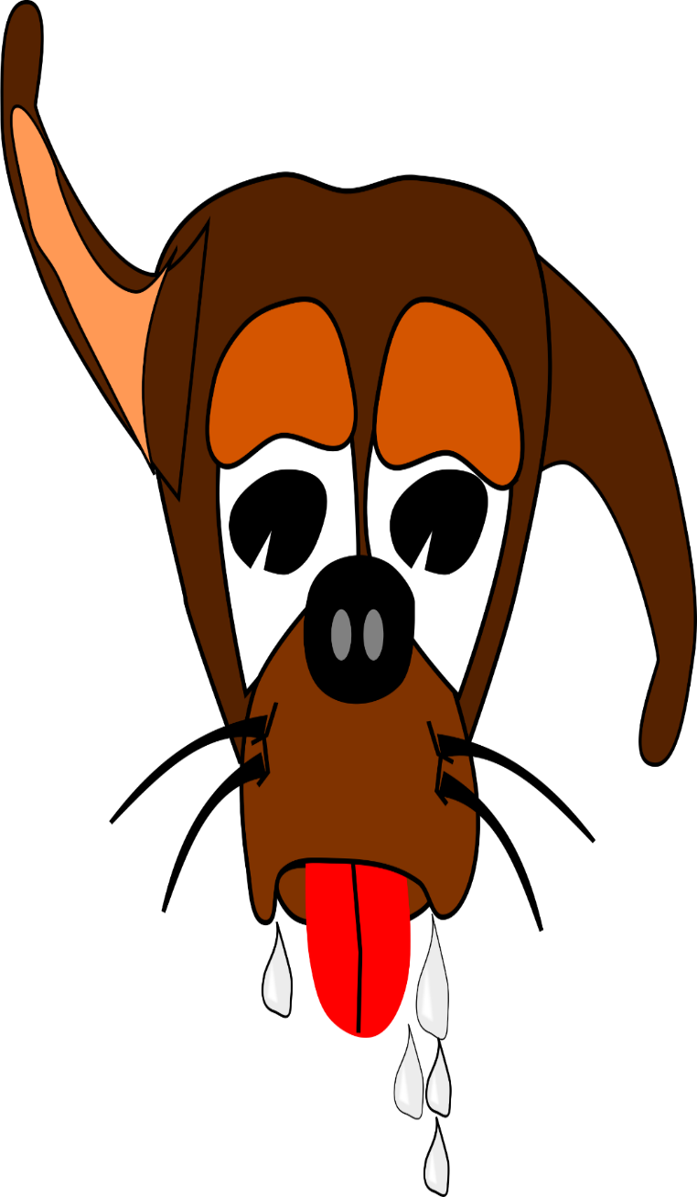
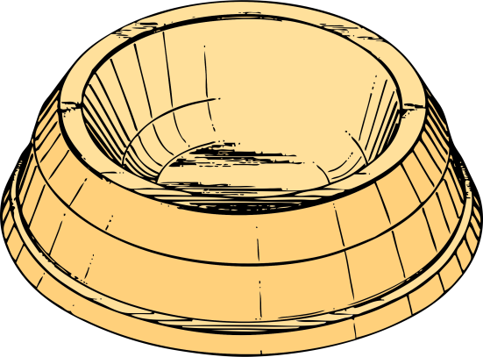
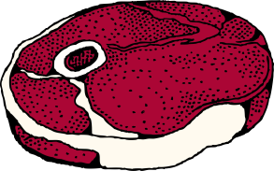
AP Psychology Learning
KT AP PSYCHOLOGY
Unit Bell-
Ringers /
Exit Tickets

Slide 2
Table of Contents
Title Slide Slide 1
Table of Contents Slide 2
Directions Slide 3
Student Response Template/Handout Slide 4
Introduction Questions Slide 5
Stimulus vs. Response Slide 8
Classical Conditioning & Pavlov’s Experiments Slide 11
Acquisition & Extinction Slide 14
Generalization & Spontaneous Recovery Slide 17
Identifying the UCS, UCR, CS, & CR Slide 20
Shaping Behavior Slide 23
Reinforcement & Punishment – 1 Slide 26
Reinforcement & Punishment – 2 Slide 29
Schedules of Reinforcement – 1 Slide 32
Schedules of Reinforcement – 2 Slide 35
Cognitive Maps & Latent Learning Slide 38
Intrinsic Motivation & Biological Predispositions Slide 41
Operant Conditioning Principles in Schools Slide 44
Observational Learning & Modeling Slide 47
Thorndike, Pavlov, Watson, Skinner, & Bandura Slide 50
Classical vs. Operant Conditioning Slide 53

Slide 3
Instructions
Use the following 17 sets of fully adaptable multiple choice, matching, free response, and personal reflection questions (45 items total) to get your students actively previewing and/or reviewing material from your unit on learning.
These easy to integrate questions are perfect for AP test prep, sparking class discussion, and providing quick feedback on student understanding and mastery.
The fourth slide is an answer form template to be printed out and given to students.
Each day’s question(s) has three slides in this package. The first, contains only questions, answer choices (where applicable), and corresponding images. The second slide adds highlighted answers to the mix. The third slide provides teachers with a list of (2-6) extra resources (websites, articles, videos, simulations) to teach/assign students on the questioned terms and concepts. In total, there are links to 51 extra resources!
While designed as a way to start class, these are also useful as exit activities.

Slide 4
Psychology of Learning
Bell-Ringers
Week of
____/_____/_______
Name: _____
Period: _____
Day | Answers

Slide 5
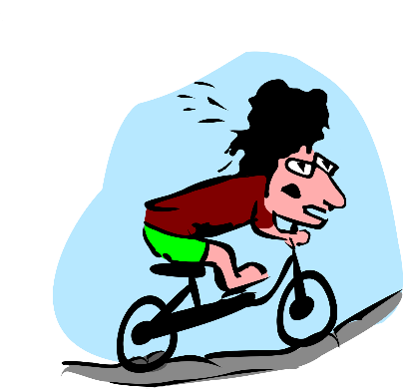
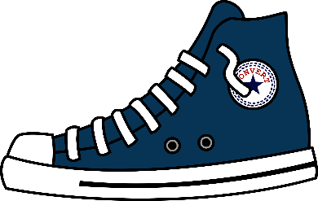
Learning, Bell-Ringer
How did you learn to do the following things?
If you don’t remember, provide an
educated guess.
Ride a bike
Eat
Read and write
Speak
Tie your shoes
Breathe
Want money
Be afraid of the dark/spiders, etc…

Slide 6
Learning, Bell-Ringer
How did you learn to do the following things?
If you don’t remember, provide an
educated guess.
Ride a bike
Eat
Read and write
Speak
Tie your shoes
Breathe
Want money
Be afraid of the dark/spiders, etc…
Answers will vary but can likely be tied to a number of learning principles such as conditioning, shaping, observational learning, consequences, etc.

Slide 7
Learning Concept Resources
Learning Unit Vocabulary: Quizlet - https://quizlet.com/65266025/learning-psychology-flash-cards/
Article: The Myth of Learning Styles – The Atlantic - https://www.theatlantic.com/science/archive/2018/04/the-myth-of-learning-styles/557687/
Article: Strategies for Learning from Failure – Harvard Business Review - https://hbr.org/2011/04/strategies-for-learning-from-failure
Wikipedia – Learning - https://en.wikipedia.org/wiki/Learning

Slide 8
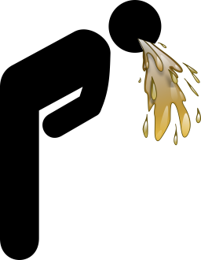
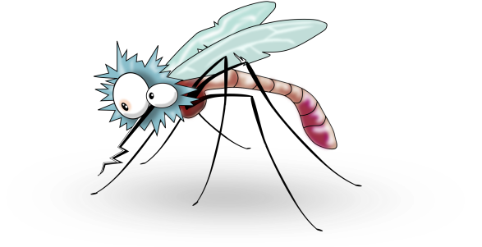
Learning, Bell-Ringer
Stimulus - Anything in the environment that one can respond to.
Response – Behavior/reaction performed by an individual.
Label the following as a “stimulus” or “response.”
Smiling when psych class starts. _________
The sound of police sirens. _________
Vomiting after eating bad food. _________
The smell of freshly baked bread. _________
A mosquito landing on your arm. _________

Slide 9
Learning, Bell-Ringer
Stimulus - Anything in the environment that one can respond to.
Response – Behavior/reaction performed by an individual.
Label the following as a “stimulus” or “response.”
Smiling when psych class starts. Response
The sound of police sirens. Stimulus
Vomiting after eating bad food. Response
The smell of freshly baked bread. Stimulus
A mosquito landing on your arm. Stimulus

Slide 10
Learning Concept Resources
Article: Difference Between a Stimulus & Response. - http://www.differencebetween.net/science/biology-science/difference-between-stimulus-and-response/
Quizlet: Stimulus & Response examples - https://quizlet.com/70477767/stimulus-vs-response-flash-cards/

Slide 11
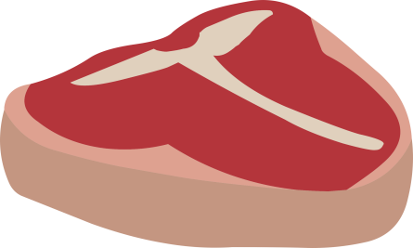
Learning, Bell-Ringer
Directions: Match the Classical Conditioning terms (1-4) with the appropriate definition and application to Pavlov’s experiments (a-d).
Unconditioned Stimulus _____
Unconditioned Response _____
Conditioned Stimulus _____
Conditioned Response _____
Originally a neutral stimulus (sound of a bell) that, after association with an unconditioned stimulus, comes to trigger a response.
A stimulus, such as food, that automatically and naturally triggers a response.
An unlearned, naturally occurring response to a stimulus, like salivation in the dog when food is in its mouth.
A learned response to a previously neutral stimulus. In Pavlov’s experiments, salivation when hearing the bell.

Slide 12
Learning, Bell-Ringer
Directions: Match the Classical Conditioning terms (1-4) with the appropriate definition and application to Pavlov’s experiments (a-d).
Unconditioned Stimulus __B__
Unconditioned Response __C__
Conditioned Stimulus __A__
Conditioned Response __D__
Originally a neutral stimulus (sound of a bell) that, after association with an unconditioned stimulus, comes to trigger a response.
A stimulus, such as food, that automatically and naturally triggers a response.
An unlearned, naturally occurring response to a stimulus, like salivation in the dog when food is in its mouth.
A learned response to a previously neutral stimulus. In Pavlov’s experiments, salivation when hearing the bell.

Slide 13
Learning Concept Resources
Video: How To Train a Brain, Crash Course Psychology #11 - https://www.youtube.com/watch?v=qG2SwE_6uVM
Video: Neutral, conditioned & unconditioned stimuli & responses. Khan Academy - https://www.khanacademy.org/test-prep/mcat/behavior/learning-slug/v/classical-conditioning-neutral-conditioned-and-unconditioned-stimuli-and-responses
Article: What is Classical Conditioning? – Very Well Mind - https://www.verywellmind.com/classical-conditioning-2794859

Slide 14
Learning, Bell-Ringer
1) During acquisition, a(n) ______ is presented shortly before a(n) ______.
UCR; CR
CS; CR
CS; UCS
UCS; CS
2) In classical conditioning, when a conditioned response no longer occurs in the presence of the conditioned stimulus, ______ has taken place.
Spontaneous recovery
Extinction
Acquisition
Generalization

Slide 15
Learning, Bell-Ringer
1) During acquisition, a(n) ______ is presented shortly before a(n) ______.
UCR; CR
CS; CR
CS; UCS
UCS; CS
2) In classical conditioning, when a conditioned response no longer occurs in the presence of the conditioned stimulus, ______ has taken place.
Spontaneous recovery
Extinction
Acquisition
Generalization

Slide 16
Learning Concept Resources
Simulation: Classical Conditioning – PsychSim Tutorials - http://bcs.worthpublishers.com/webpub/Ektron/Myers_Psychology%2010e/PsychSim5_Tutorials/ClassicalConditioning/ClassicalConditioning.htm
Video: Baby Albert Experiments - https://www.youtube.com/watch?v=FMnhyGozLyE
Article: Classical Conditioning – Simply Psychology - https://www.simplypsychology.org/classical-conditioning.html
Article: What Is Classical Conditioning? (And Why Does It Matter?) – Scientific American - https://blogs.scientificamerican.com/thoughtful-animal/what-is-classical-conditioning-and-why-does-it-matter/

Slide 17
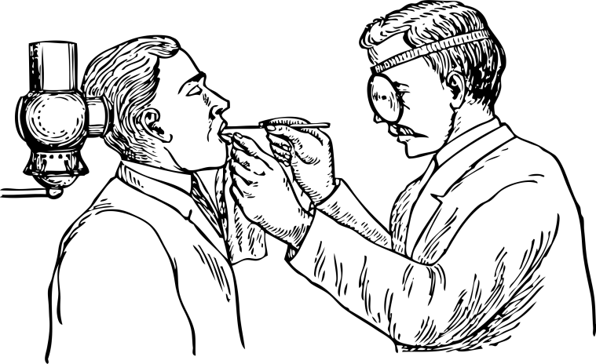
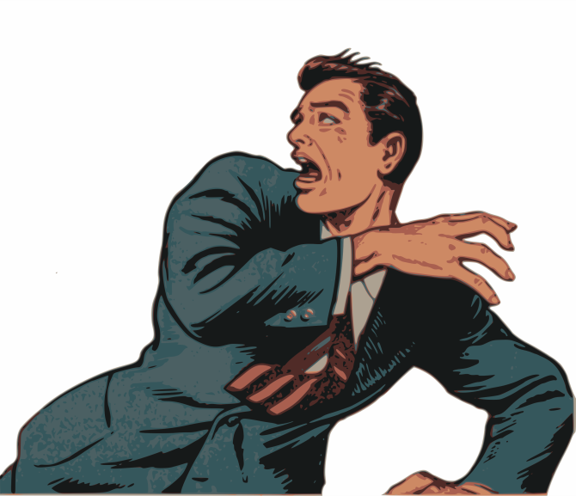
Learning, Bell-Ringer
After a horrific experience being operated on by an unlicensed dentist, Matt is terrified of the sound of the dentist drill. One day at home, Matt tried installing a door but became terrified when he started to use a power drill. This is because of…
Generalization
Discrimination
Extinction
Acquisition
2. After avoiding the dentist for a year his fear of drills became extinct. If Matt’s fear suddenly returned after a period of rest, this would be called…
The law of effect
Discrimination
Spontaneous recovery
An unconditioned response

Slide 18
Learning, Bell-Ringer
After a horrific experience being operated on by an unlicensed dentist, Matt is terrified of the sound of the dentist drill. One day at home, Matt tried installing a door but became terrified when he started to use a power drill. This is because of…
Generalization
Discrimination
Extinction
Acquisition
2. After avoiding the dentist for a year his fear of drills became extinct. If Matt’s fear suddenly returned after a period of rest, this would be called…
The law of effect
Discrimination
Spontaneous recovery
An unconditioned response

Slide 19
Learning Concept Resources
Video: Extinction, Spontaneous Recovery, Generalization, & Discrimination – Khan Academy - https://www.khanacademy.org/test-prep/mcat/behavior/learning-slug/v/classical-conditioning-extinction-spontaneous-recovery-generalization-discrimination
Article: The Role of Classical Conditioning in Taste Aversions – Very Well Mind - https://www.verywellmind.com/what-is-a-taste-aversion-2794991
Quizlet Test: Classical Conditioning - https://quizlet.com/1666170/test

Slide 20
Learning, Bell-Ringer
1) Kanye proposed to Kim at an Applebee’s restaurant and to his great delight, she said “Yes.” Now every time Kanye goes to Applebee’s he gets a happy feeling. What is the unconditioned response?
a) The restaurant
b) Feeling happy in the restaurant
c) The acceptance of the proposal
d) Feeling happy when the proposal was accepted
What about the…(choose a, b, c, or d)
2) US –
3) CR –
4) CS –

Slide 21
Learning, Bell-Ringer
1) Kanye proposed to Kim at an Applebee’s restaurant and to his great delight, she said “Yes.” Now every time Kanye goes to Applebee’s he gets a happy feeling. What is the unconditioned response?
a) The restaurant
b) Feeling happy in the restaurant
c) The acceptance of the proposal
d) Feeling happy when the proposal was accepted
What about the…(choose a, b, c, or d)
2) US – c) The acceptance of the proposal
3) CR – b) Feeling happy in the restaurant
4) CS – a) The restaurant

Slide 22
Learning Concept Resources
Article: Classical Conditioning Examples - https://www.psychestudy.com/behavioral/learning-memory/classical-conditioning/classical-examples
Article: Classical Conditioning in Therapy – Simply Psychology - https://www.simplypsychology.org/behavioral-therapy.html
Video: Classical Conditioning - https://www.youtube.com/watch?v=cP5lCleK-PM

Slide 23
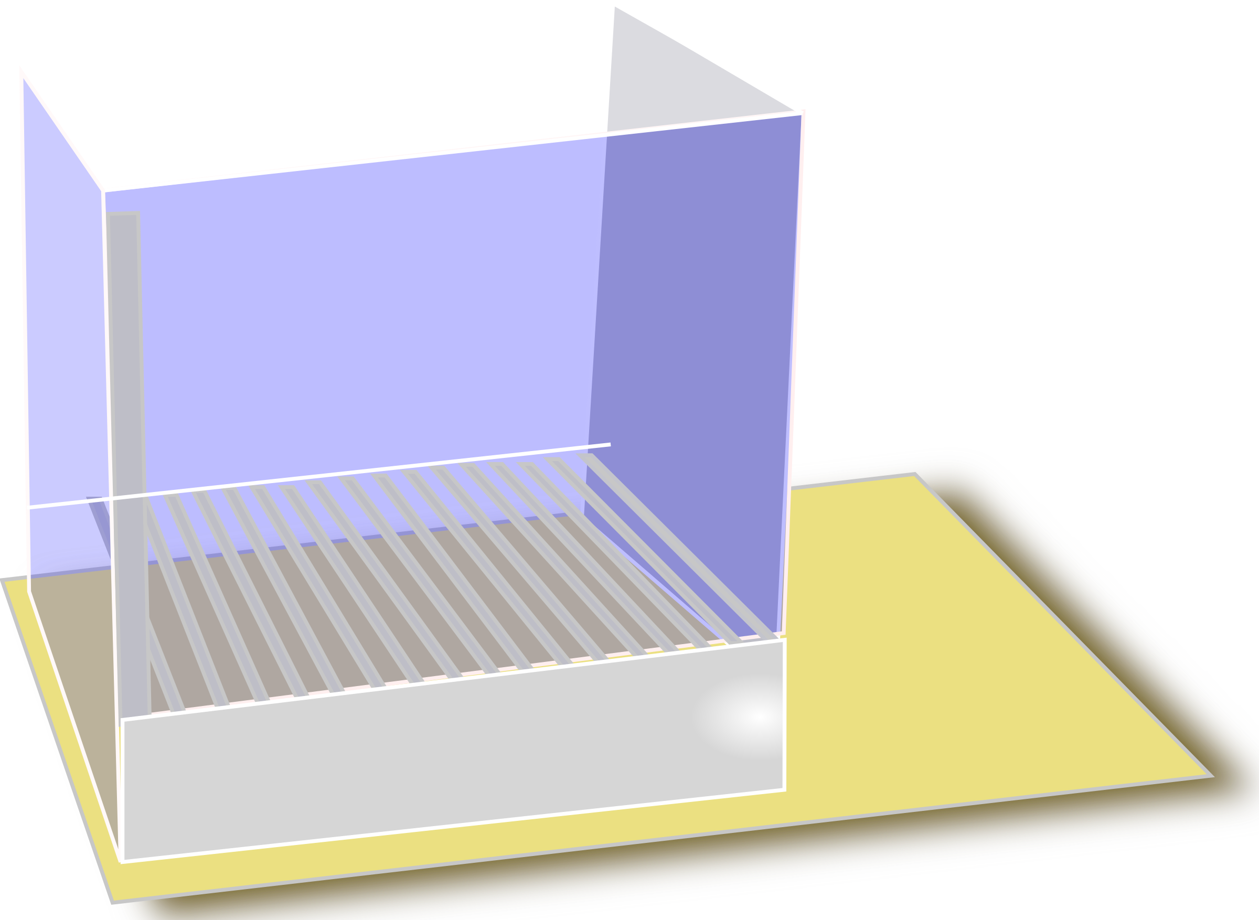
Learning, Bell-Ringer
Directions: Put the following steps for shaping a rat to push a lever in chronological order. 1 = First / 5 = Last
_______ Rat pushes the lever
_______ Rat turns its head towards the lever
_______ Rat moves towards the lever
_______ Put rat in Operant Chamber
_______ Rat reaches toward the lever

Slide 24
Learning, Bell-Ringer
Directions: Put the following steps for shaping a rat to push a lever in chronological order. 1 = First / 5 = Last
___5___ Rat pushes the lever
___3___ Rat turns its head towards the lever
___2___ Rat moves towards the lever
___1___ Put rat in Operant Chamber
___4___ Rat reaches toward the lever

Slide 25
Learning Concept Resources
Video: Operant Conditioning: Shaping – Khan Academy - https://www.khanacademy.org/test-prep/mcat/behavior/learning-slug/v/operant-conditioning-shaping
Video: Interview with B.F. Skinner - https://www.youtube.com/watch?v=I_ctJqjlrHA
Article: Skinner & Operant https://www.simplypsychology.org/operant-conditioning.html
Wikipedia: Shaping - https://en.wikipedia.org/wiki/Shaping_(psychology)

Slide 26
Learning, Bell-Ringer
1. Rory’s father gives him $10 for washing the car. This consequence best illustrates…
Positive reinforcement
Negative reinforcement
Positive punishment
Negative punishment
2. Brittany was fighting with her sister. Her mother says she can’t use her phone tomorrow. This consequence best illustrates…
Positive reinforcement
Negative reinforcement
Positive punishment
Negative punishment

Slide 27
Learning, Bell-Ringer
1. Rory’s father gives him $10 for washing the car. This consequence best illustrates…
Positive reinforcement
Negative reinforcement
Positive punishment
Negative punishment
2. Brittany was fighting with her sister. Her mother says she can’t use her phone tomorrow. This consequence best illustrates…
Positive reinforcement
Negative reinforcement
Positive punishment
Negative punishment

Slide 28
Learning Concept Resources
Simulation: Operant Conditioning – PsychSim Tutorials - http://bcs.worthpublishers.com/webpub/Ektron/Myers_Psychology%2010e/PsychSim5_Tutorials/Operant_Conditioning/operant_conditioning.htm
Article: How Does Operant Conditioning Work - General Psychology - http://general-psychology.weebly.com/how-does-operant-conditioning-work.html
Video: - Operant conditioning: Positive-and-negative reinforcement and punishment – Khan Academy - https://www.khanacademy.org/test-prep/mcat/behavior/learning-slug/v/operant-conditioning-positive-and-negative-reinforcement-and-punishment

Slide 29
Learning, Bell-Ringer
1. Amanda is 4 years old. Her mother spanks her for running out into the street. This best illustrates…
Positive reinforcement
Negative reinforcement
Positive punishment
Negative punishment
2. Your teacher says you don't have to take the final exam if you have an “A" at the end of the semester.
This consequence best illustrates…
Positive reinforcement
Negative reinforcement
Positive punishment
Negative punishment

Slide 30
Learning, Bell-Ringer
1. Amanda is 4 years old. Her mother spanks her for running out into the street. This best illustrates…
Positive reinforcement
Negative reinforcement
Positive punishment
Negative punishment
2. Your teacher says you don't have to take the final exam if you have an “A" at the end of the semester.
This consequence best illustrates…
Positive reinforcement
Negative reinforcement
Positive punishment
Negative punishment

Slide 31
Learning Concept Resources
Article: Corporal punishment study shows kids misbehave within 10 minutes of spanking – PsyPost.org - https://www.psypost.org/2014/04/corporal-punishment-study-shows-kids-misbehave-within-10-minutes-of-spanking-24436
Article: Punishing a Child is Effective – If Done Correctly – PsyPost.org - https://www.psypost.org/2015/08/punishing-a-child-is-effective-if-done-correctly-36467
Article: Parents who use warmth instead of spanking foster greater social competence in their children – PsyPost.org - https://www.psypost.org/2016/09/parents-use-warmth-instead-spanking-foster-greater-social-competence-children-45138

Slide 32
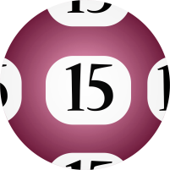
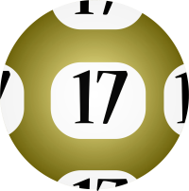
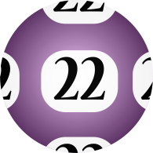
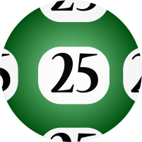
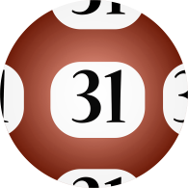
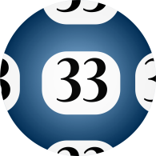
Learning, Bell-Ringer
1. Buying a lottery ticket and winning is reinforced on a _______ schedule.
Fixed-Ratio
Variable-Ratio
Fixed-Interval
Variable-Interval
2. By receiving a paycheck every Friday for delivering packages, Jaden's hard work is reinforced on a ________ schedule.
Fixed-Ratio
Variable-Ratio
Fixed-Interval
Variable-Interval

Slide 33
Learning, Bell-Ringer
1. Buying a lottery ticket and winning is reinforced on a _______ schedule.
Fixed-Ratio
Variable-Ratio
Fixed-Interval
Variable-Interval
2. By receiving a paycheck every Friday for delivering packages, Jaden's hard work is reinforced on a ________ schedule.
Fixed-Ratio
Variable-Ratio
Fixed-Interval
Variable-Interval

Slide 34
Learning Concept Resources
Video: Kahn Academy – Schedules of Reinforcement, https://www.khanacademy.org/test-prep/mcat/behavior/learning-slug/v/operant-conditioning-schedules-of-reinforcement
Article: What is a Schedule of Reinforcement – Very Well Mind - https://www.verywellmind.com/what-is-a-schedule-of-reinforcement-2794864

Slide 35
Learning, Bell-Ringer
1. Receiving notifications that someone has interacted with your latest Insta-Snap-Tweet-Book post reinforces your social media behavior on a ________ schedule.
Fixed-Ratio
Variable-Ratio
Fixed-Interval
Variable-Interval
2. A strawberry picker earns $2 for every three pint boxes he fills. This work is reinforced on a _________ schedule.
Fixed-Ratio
Variable-Ratio
Fixed-Interval
Variable-Interval

Slide 36
Learning, Bell-Ringer
1. Receiving notifications that someone has interacted with your latest Insta-Snap-Tweet-Book post reinforces your social media behavior on a ________ schedule.
Fixed-Ratio
Variable-Ratio
Fixed-Interval
Variable-Interval
2. A strawberry picker earns $2 for every three pint boxes he fills. This work is reinforced on a _________ schedule.
Fixed-Ratio
Variable-Ratio
Fixed-Interval
Variable-Interval

Slide 37
Learning Concept Resources
Article: Schedules of Reinforcement – University of Iowa, Comparative Cognition Laboratory - https://psychology.uiowa.edu/comparative-cognition-laboratory/glossary/schedules-reinforcement
Graphic: Schedules of Reinforcement – University of North Carolina - https://autismpdc.fpg.unc.edu/sites/autismpdc.fpg.unc.edu/files/Reinforcement-Table1.pdf

Slide 38
Learning, Bell-Ringer
Mental representations of the layout of our environment, or for lab rats representations of a maze, are known as…
Generalization
Cognitive Maps
Spontaneous Recovery
Conditioned Reinforcement
Modeling
2. Such mental representations are based on ___________, which occurs without reinforcement but becomes apparent when an incentive is given.
Cognitive Maps
Operant Chambers
Latent Learning
Observational Learning

Slide 39
Learning, Bell-Ringer
Mental representations of the layout of our environment, or for lab rats representations of a maze, are known as…
Generalization
Cognitive Maps
Spontaneous Recovery
Conditioned Reinforcement
Modeling
2. Such mental representations are based on ___________, which occurs without reinforcement but becomes apparent when an incentive is given.
Cognitive Maps
Operant Chambers
Latent Learning
Observational Learning

Slide 40
Learning Concept Resources
Simulation: Maze Learning – PsychSim Tutorials - http://bcs.worthpublishers.com/webpub/Ektron/Myers_Psychology%2010e/PsychSim5_Tutorials/MazeLearning/MazeLearning.htm
Article: Rats, Bees, and Brains: The Death of the "Cognitive Map“ – Scientific American - https://blogs.scientificamerican.com/thoughtful-animal/httpblogsscientificamericancomthoughtful-animal20110712rats-bees-and-brains-the-death-of-the-cognitive-map/
Article: Tolman, Latent Learning – Simply Psychology - https://www.simplypsychology.org/tolman.html

Slide 41
Learning, Bell-Ringer
1. Promising students a pizza party for doing work they already enjoy doing is most likely to undermine…
Latent Learning
Shaping
Secondary Reinforcement
Intrinsic Motivation
Generalization
2. It would be much easier to train your dog (Sparky) to bark for a treat than it would be to train Sparky to do back flips for a treat. This shows the significance of ________ in learning.
Biological Predispositions
Primary Reinforcement
Spontaneous Recovery
Latent Learning
Delayed Reinforcement

Slide 42
Learning, Bell-Ringer
1. Promising students a pizza party for doing work they already enjoy doing is most likely to undermine…
Latent Learning
Shaping
Secondary Reinforcement
Intrinsic Motivation
Generalization
2. It would be much easier to train your dog (Sparky) to bark for a treat than it would be to train Sparky to do back flips for a treat. This shows the significance of ________ in learning.
Biological Predispositions
Primary Reinforcement
Spontaneous Recovery
Latent Learning
Delayed Reinforcement

Slide 43
Learning Concept Resources
Video: Biological Constraints on Learning – Khan Academy https://www.khanacademy.org/test-prep/mcat/behavior/learning-slug/v/biological-constraints-on-learning
Article: The Difference Between Intrinsic Motivation & Extrinsic Motivation – Livestrong - https://www.livestrong.com/article/174305-the-difference-between-intrinsic-motivation-extrinsic-motivation/
Article: Biological Preparedness and Classical Conditioning - Very Well Mind - https://www.verywellmind.com/what-is-biological-preparedness-2794879

Slide 44
Learning, Bell-Ringer
When you think about learning at school what kinds of
things come to mind? (Be nice!)
2) In addition to our academic learning, school environments provide many examples of operant learning. Identify three operant conditioning principles used in school, define the terms, and provide applications to your school experiences.

Slide 45
Learning, Bell-Ringer
When you think about learning at school what kinds of
things come to mind? (Be nice!)
2) In addition to our academic learning, school environments provide many examples of operant learning. Identify three operant conditioning principles used in school, define the terms, and provide applications to your school experiences.
Answers will vary but may include concepts such as homework, writing papers, teachers, boring/interesting, stress, good times in psychology class, etc.
Answers will vary but may include concepts such as shaping, reinforcement, punishment, schedules of reinforcement, intrinsic/extrinsic motivation, etc. Example sentence: My teacher makes use of positive reinforcement, or the addition of a desirable stimulus to increase good behaviors. For example, students are given candy and extra credit for cleaning up the classroom after school.

Slide 46
Learning Concept Resources
Article: Behaviorism in the Classroom – The Learning Scientists - http://www.learningscientists.org/blog/2017/8/10-1
Article: What Is Operant Conditioning and How Does It Work? – Very Well Mind - https://www.verywellmind.com/operant-conditioning-a2-2794863
Article: Operant Conditioning & Addiction – American Addiction Centers - https://www.mentalhelp.net/articles/operant-conditioning-and-addiction/

Slide 47
Learning, Bell-Ringer
1. The Bobo doll experiments, carried out by Albert Bandura, in which children watched an adult hit & yell at a “Bobo doll” and then imitated the same aggressive behaviors demonstrated which type of learning?
Classical conditioning
Operant Conditioning
Secondary Learning
Observational Learning
2. Seven-Year-Old Riley watches his dad get a hug from his mom because he cut the grass. The next day, Riley asked if he could mow the lawn. What role did Riley’s dad play in this example of learning?
Model
Reinforcer
Observer
Example

Slide 48
Learning, Bell-Ringer
1. The Bobo doll experiments, carried out by Albert Bandura, in which children watched an adult hit & yell at a “Bobo doll” and then imitated the same aggressive behaviors demonstrated which type of learning?
Classical conditioning
Operant Conditioning
Secondary Learning
Observational Learning
2. Seven-Year-Old Riley watches his dad get a hug from his mom because he cut the grass. The next day, Riley asked if he could mow the lawn. What role did Riley’s dad play in this example of learning?
Model
Reinforcer
Observer
Example

Slide 49
Learning Concept Resources
Article: How Observational Learning Affects Behavior – Very Well Mind - https://www.verywellmind.com/what-is-observational-learning-2795402
Video: Bobo Beat Down – Crash Course Psychology #12 - https://www.youtube.com/watch?v=128Ts5r9NRE
Video: Bandura Bobo Doll Experiment - https://www.youtube.com/watch?v=zerCK0lRjp8

Slide 50
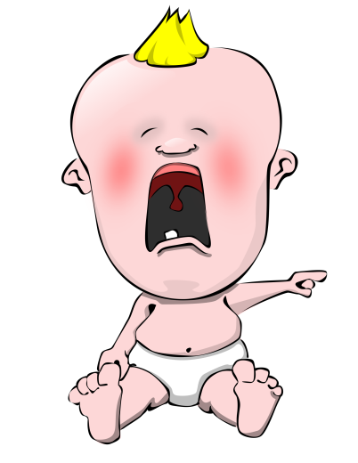
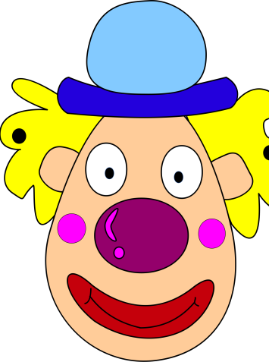
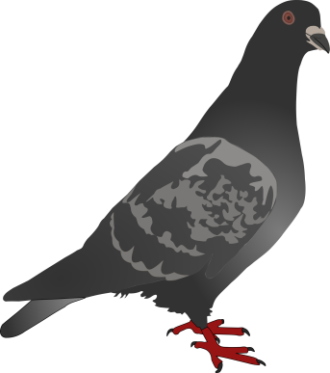
Learning, Bell-Ringer
Directions: Match the names of the influential figures in psychology with the learning concepts they are most closely associated with.
B.F. Skinner A. Classical Conditioning
John Watson B. Conditioning of emotions
Ivan Pavlov C. Operant Conditioning
Albert Bandura D. The Law of Effect
E.L. Thorndike E. Observational Learning

Slide 51
Learning, Bell-Ringer
Directions: Match the names of the influential figures in psychology with the learning concepts they are most closely associated with.
B.F. Skinner A. Classical Conditioning
John Watson B. Conditioning of emotions
Ivan Pavlov C. Operant Conditioning
Albert Bandura D. The Law of Effect
E.L. Thorndike E. Observational Learning

Slide 52
Learning Concept Resources
Website: Albert Bandura – www.professoralbertbandura.com
Website: The B.F. Skinner Foundation - https://www.bfskinner.org/
Article: John B. Watson, Notes on a Scandal – American Psychological Association - https://www.apa.org/monitor/2012/10/scandal.aspx
Article: Ivan Pavlov Biogoraphy – Nobel Prize Organization - https://www.nobelprize.org/prizes/medicine/1904/pavlov/facts/
Article: B.F. Skinner – Harvard University, Department of Psychology - https://psychology.fas.harvard.edu/people/b-f-skinner

Slide 53
Learning, Bell-Ringer
1) Compare and contrast classical (CC) and operant conditioning (OC).
Classical
Operant

Slide 54
Learning, Bell-Ringer
1) Compare and contrast classical (CC) and operant conditioning (OC).
Classical
Operant
Both CC & OC are forms of associative learning.
Both forms of learning can be used to modify behavior and are core components of the behavioral perspective.
CC involves forming associations between stimuli (CS and US) as where OC involves forming an association between behaviors and the resulting events (reinforcement and punishment).
Etc.

Slide 55
Learning Concept Resources
Video: The difference between classical and operant conditioning - Peggy Andover - Ted-Ed - https://www.youtube.com/watch?v=H6LEcM0E0io
Article: Classical & Operant Conditioning. Khan Academy - https://www.khanacademy.org/test-prep/mcat/behavior/learning-slug/a/classical-and-operant-conditioning-article

