Slide 1
The Civil War Begins Strengths and Strategies

Slide 2
Union Strengths
More people (soldiers, factory workers)
More guns, ammunition, war materials
More factories
More food
More railroads to move troops/supplies
Great leader (Lincoln)

Slide 3
Confederate Strengths
First-rate generals
Strong military tradition
Motivated soldiers who were defending their homeland
Profits from cotton

Slide 4
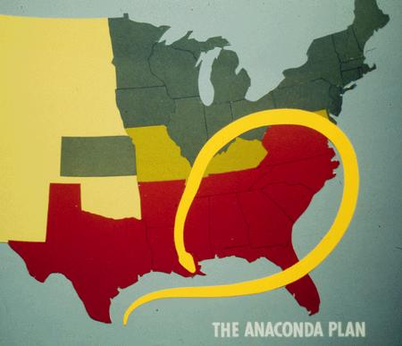
Union Strategy
Anaconda Plan:
1. Union to
blockade South
2. Split Confederacy
in two by taking
control of
Mississippi River
3. Capture Richmond, VA
(Confederate capital)

Slide 5
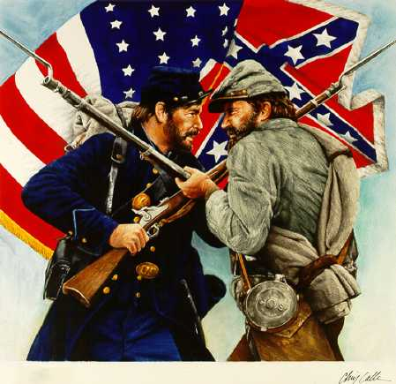
Confederate Strategy
Survive as a nation
Encourage
attacks
Defend
homeland
Invade the
North when
possible

Slide 6
Early Battles of the Civil War: The First Battle of Bull Run
In July 1861, Lincoln ordered Union Commander, General Irvin McDowell, to lead his army into Virginia to capture Richmond
On July 21, 1861, Union troops fought Confederate troops in Manassas in the First Battle of Bull Run
At first, Union troops were winning, but Confederates rallied behind Thomas “Stonewall” Jackson.
Union troops retreated back to Washington.
The first victory of the Civil War belonged to the Confederacy.

Slide 7
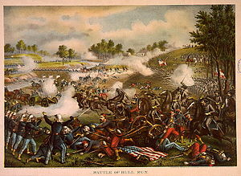
Early Battles of the Civil War: The First Battle of Bull Run

Slide 8
Early Battles of the Civil War: The Monitor and the Merrimack
The Confederacy created a new war ship by bolting iron plates on to an old wooden steam ship called the Merrimack.
Union ships cannon balls bounced off the Merrimack making it seemingly indestructible.
Lincoln ordered a union ‘ironclad” ship to be made (called the Monitor).
When these ships met in battle, neither did serious damage to the other.
Wooden ships were now a thing of the past.

Slide 9
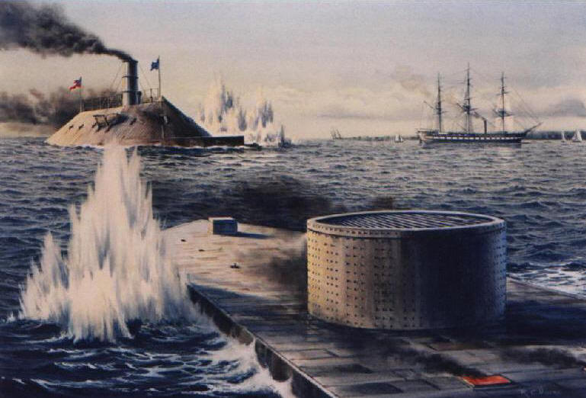
Early Battles of the Civil War: The Monitor and the Merrimack

Slide 10
Early Battles of the Civil War: Antietam
After several Confederate victories early in the war, General Lee decided to attack the North in Maryland.
The two armies met at Antietam Creek on September 17, 1862.
75,000 Union troops battled 40,000 Confederate troops.

Slide 11
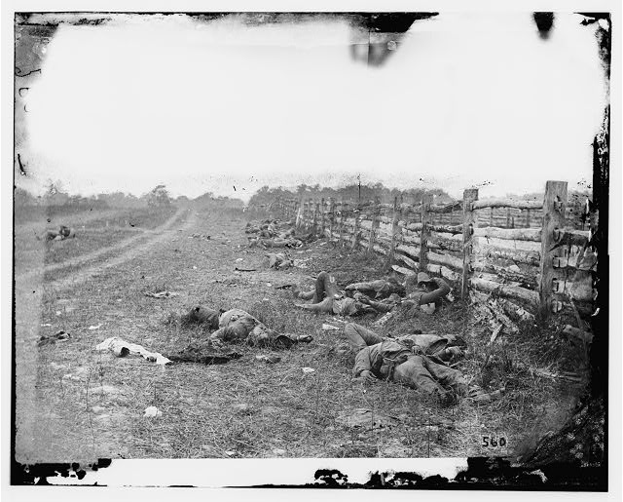
Early Battles of the Civil War: Antietam
Casualties were very high on both sides, but the Union army prevailed.
The Confederacy retreated and instead of chasing them and finishing them off, General McClellan waited…

