Slide 1
AP Psychology
First Day of Class
Mr. Cummings
Write your name on your name card.

Slide 2
Do Now
Explain in your own words what you think psychology is

Slide 3
What Do You Already Know About Psychology?

Slide 4
ESP
How many sense do we have?

Slide 5
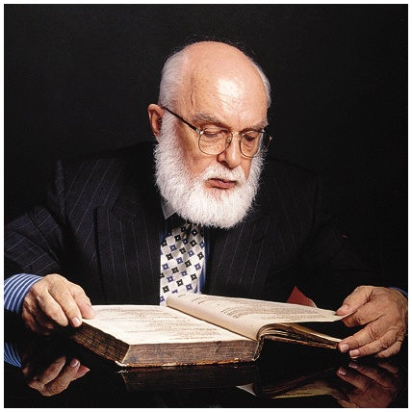
The Need for Psychological Science
Critical Thinking
thinking that does not blindly accept arguments and conclusions
examines assumptions
discerns hidden values
evaluates evidence
Overconfidence will inhibit this

Slide 6
The Need for Psychological Science
Psychologists, like all scientists, use the scientific method to construct theories that organize observations and imply testable hypotheses

Slide 7
The Need for Psychological Science
Theory
an explanation using an integrated set of principles that organizes and predicts observations
Hypothesis
a testable prediction
often implied by a theory

Slide 8
The Need for Psychological Science
Operational Definition
a statement of procedures (operations) used to define research variables
Example-
intelligence may be operationally defined as what an intelligence test measures

Slide 9
The Need for Psychological Science
Replication
repeating the essence of a research study to see whether the basic finding generalizes to other participants and circumstances
usually with different participants in different situations

Slide 10
Experimentation
Experiment
an investigator manipulates one or more factors (independent variables) to observe their effect on some behavior or mental process (the dependent variable)
by random assignment of participants the experiment controls other relevant factors
For study to be considered an experiment it needs to include either random assignment OR manipulation of one independent variables

Slide 11
Independent Variable
Whatever is being manipulated in the experiment.
Hopefully the independent variable brings about change.
If there is a drug in an experiment, the drug is almost always the independent variable.

Slide 12
Dependent Variable
Whatever is being measured in the experiment.
It is dependent on the independent variable.
The dependent variable would be the effect of the drug.

Slide 13
Beware of Confounding Variables
The object of an experiment is to prove that A causes B.
Factors which can influence or compromise the results of the experiment
If I wanted to prove that smoking causes heart issues, what are some confounding variables?
Lifestyle and family history may also effect the heart.

Slide 14
Practice!

