Slide 1
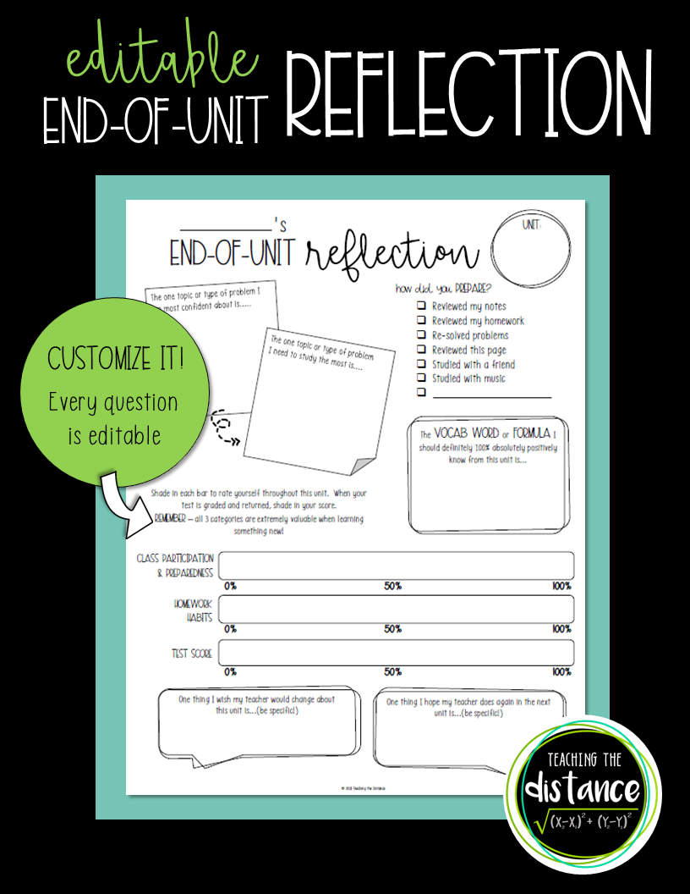

Slide 2
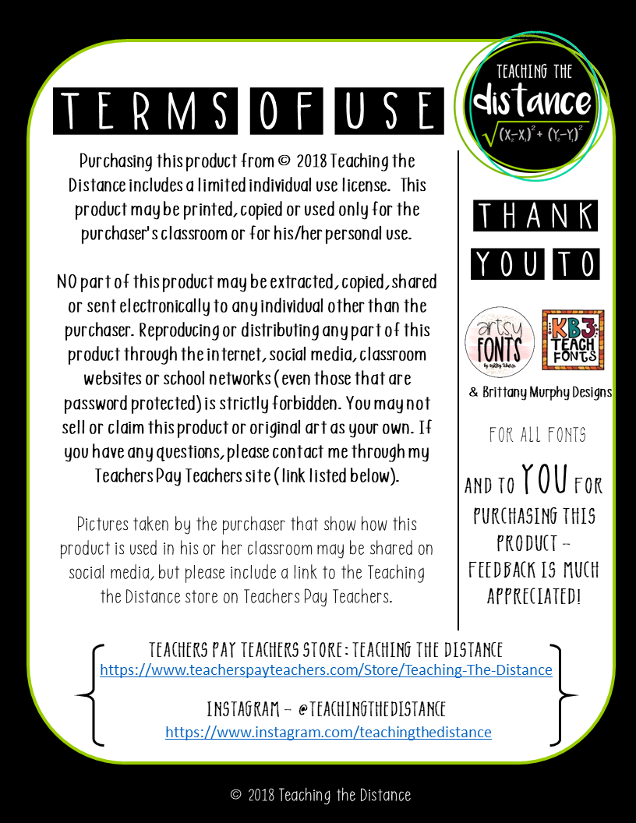

Slide 3
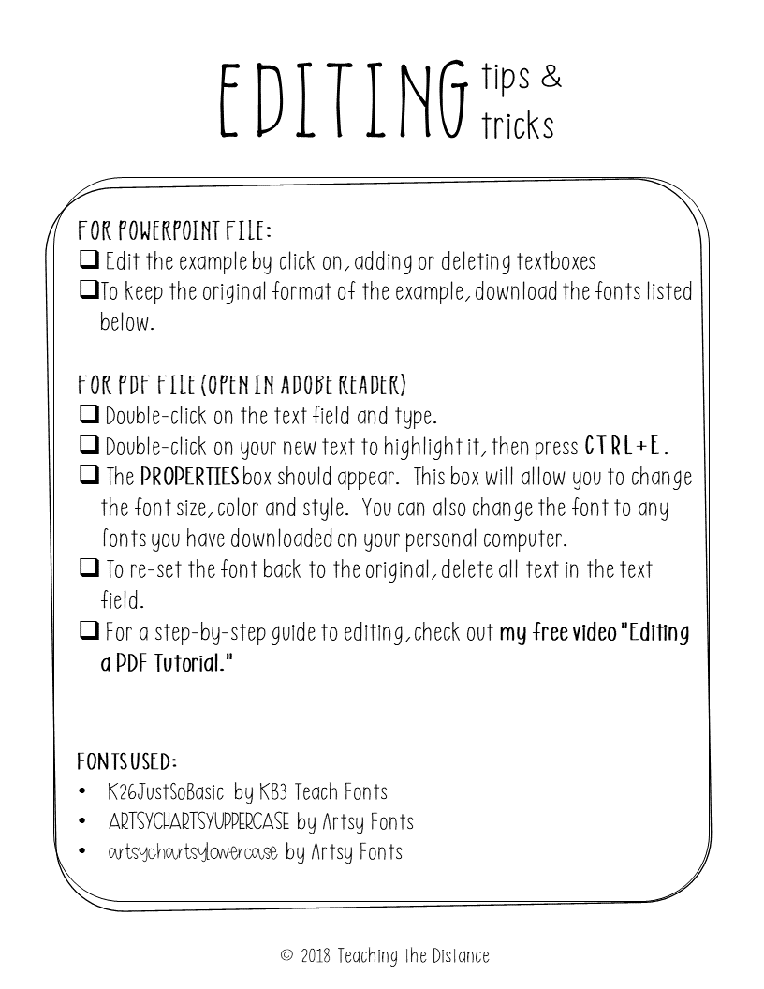

Slide 4
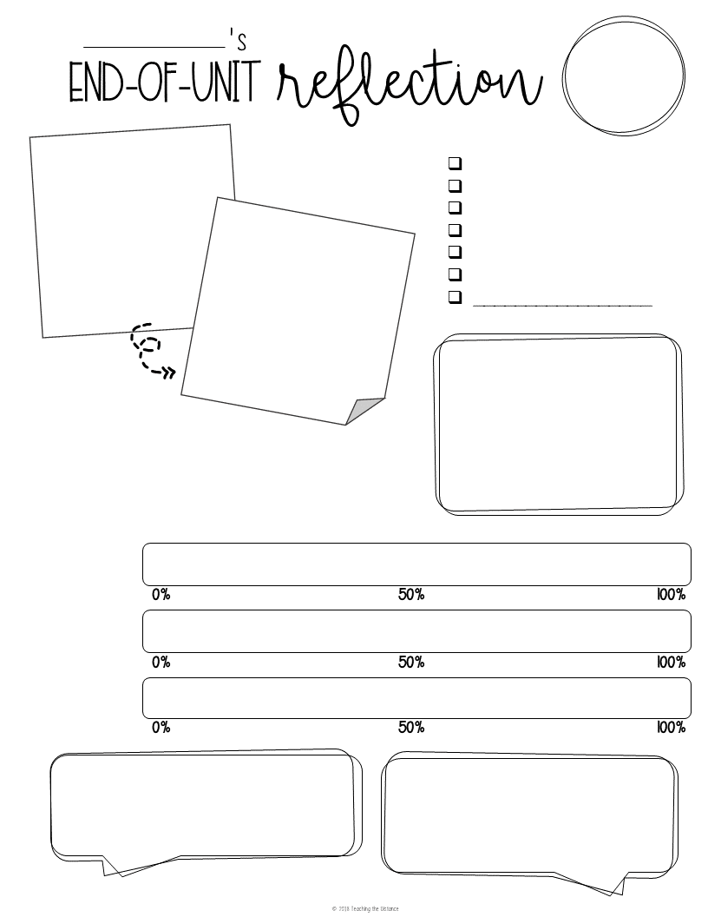
Unit:
Learning
The one topic or type of problem I am most confident about is.....
How did you prepare?
Reviewed my notes / G.O.
Reviewed my homework
Back of book Practice Exam.
Reviewed the website
Watched YouTube videos
Took online quizzes
The one topic or type of problem I need to study the most is....
The vocab word I should definitely 100% absolutely positively know from this unit is...
Shade in each bar to rate yourself throughout this unit. When your test is graded and returned, shade in your score.
Remember – all 3 categories are extremely valuable when learning something new!
Class participation
& preparedness
Homework
habits
Test score
One thing I wish my teacher would change about this unit is...(be specific!)
One thing I hope my teacher does again in the next unit is...(be specific!)

Slide 5
