Slide 1
Harlow’s Experiments on Attachment in Monkeys

Slide 2
Learning intention
LI: To understand Harlow’s 1958 Experiments on attachment in monkeys.
SC: I can explain Harlow’s experiments and I understand their aims, results and conclusions in understanding attachment.
Notes:
about the same time Ainsworth was developing her theory on attachment in human infants, American psychologist Harry Harlow was undertaking research on attachment

Slide 3
IV and Dv
Independent Variable (IV): Variable that the experimenter changes/manipulates. Normally has a direct effect on the dependent variable.
Dependent Variable (DV): Variable the experimenter measures, after making changes to the IV.

Slide 4
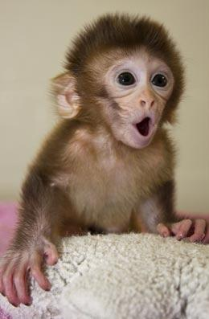
Harlow’s experiments on attachment in monkeys
Investigated factors influencing the development of attachment by infant monkeys to their mothers.
AIM:
To find out whether providing food or contact comfort is more important in the formation of infant-mother attachment.
PARTICIPANTS:
Eight newborn rhesus monkey’s separated from their mothers immediately after birth.
Notes:
https://www.youtube.com/watch?v=OrNBEhzjg8I
*Surrogate: is anyone or anything which “substitutes for” or plays the part of something else.

Slide 5
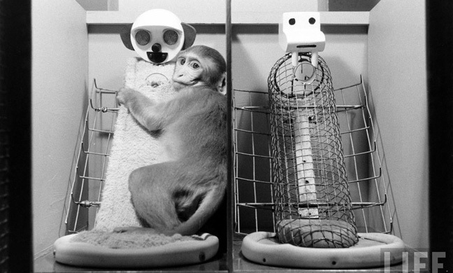
PROCEDURE
GROUP 1 | GROUP 2
Cloth monkey provided food. Wire monkey, nothing. | Wire monkey provided food. Cloth monkey, nothing.
What predictions can we make in relation to attachment and feeding??
If an infant’s attachment to it’s mother was based mostly on feeding, the infant monkey’s should prefer whichever surrogate had the bottle.
IS THIS CORRECT?
HOW DO WE TEST THIS?
Notes:
IV: Provision of food by either a cloth or wire mother
DV: Amount of contact time with mother.

Slide 6
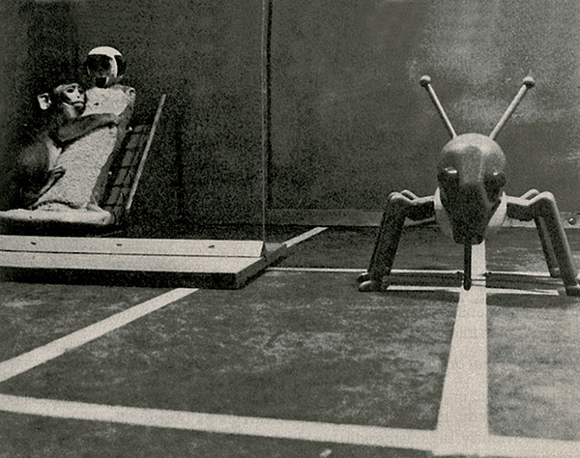
Procedure
The monkey’s were observed after they were made emotionally distressed.
Stressful conditions were created by various frightening objects in the monkeys cage; for example a mechanical moving spider.
CAN YOU PREDICT WHERE THEY WENT FOR COMFORT?

Slide 7
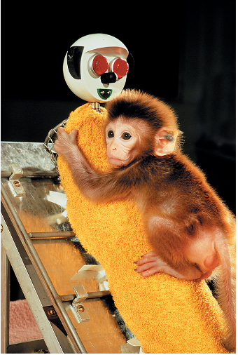
What results were found?
When frightened infant monkeys seek comfort from the cloth surrogate, even if the surrogate did not have a feed bottle.
All monkey’s spent far more time with their cloth surrogate than they did with their wire surrogate, regardless of which provided food.
No animal spent more that 1-2 hours with wire mother and all monkeys were spending around 15 hours a day in contact with the cloth surrogate.
What can we conclude from these findings??

Slide 8
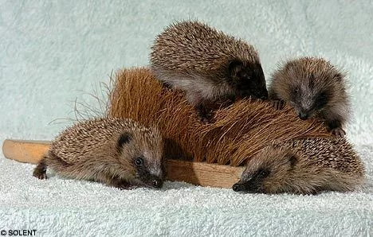
Conclusion
“Contact comfort” (softness of cloth) was more important than feeding in the formation of an infant monkey’s attachment to it’s mother.
Generalisation
Contact comfort is likely to be a crucial factor in human-infant caregiver attachment.
Notes:
Why would it be difficult to test this theory on humans?

Slide 9
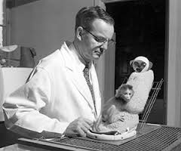
Other factors??
Contact comfort is not the only important variable in attachment.
Do you think social contact is important in development??
What do you think Harlow did to these monkeys to test social contact and development?

Slide 10
Removed all social contact!
Privation:
Involves removing the opportunity to satisfy a need, in this case the need for social contact!!!
Notes:
Maternal behaviour – “Motherless mothers”- inadequate mothers
Conclusion: positive social experiences with same age mates had limited the potential harmful effects of growing up motherless.

Slide 11
Removed all social contact!
Control Group
Reared “normally”
Used for comparison
Isolated 3 Months
Emotionally disturbed
Improved after 12 months
Isolated 6 Months
Isolated 12 Months
Severely impaired (self-destructive)
Behaviour slowly improved
Totally withdrawn, not interested
Improved slowly, not in all areas
Notes:
Maternal behaviour – “Motherless mothers”- inadequate mothers
Conclusion: positive social experiences with same age mates had limited the potential harmful effects of growing up motherless.

Slide 12
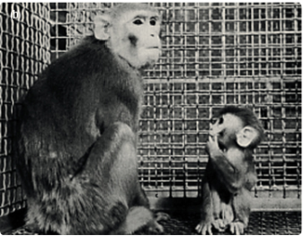
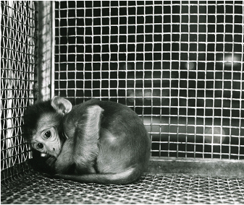

Slide 13
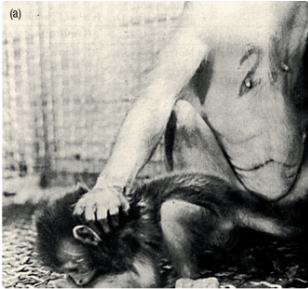
Factors influencing maternal behaviour in attachment
Female rhesus monkeys reared in total isolation for the first 12 months of life
Artificially impregnated (called ‘motherless mothers’) became completely inadequate mothers.

Slide 14
Factors influencing maternal behaviour in attachment
Avoided her baby and did not care at all when separated
Mother would violently abuse her baby when it approached her for contact or feeding. For example ‘sometimes biting infant and occasionally crushing the infants face and body to the floor’

