Slide 2
Tragic Prelude by John Steuart Curry

Slide 3
Warm-up Questions:
What did John Brown do?
Why did he do it?
Was John Brown a hero or a terrorist?

Slide 4
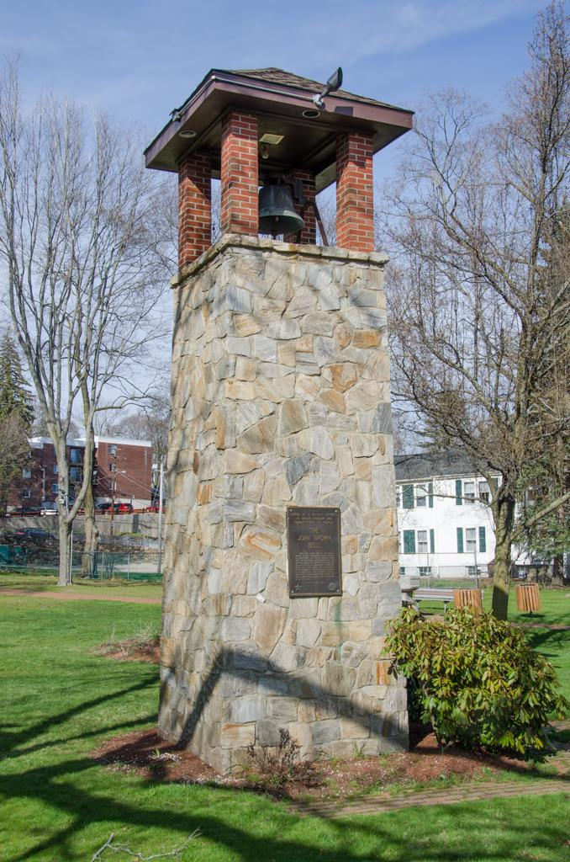
The John Brown Bell Marlborough, MA

