Slide 1
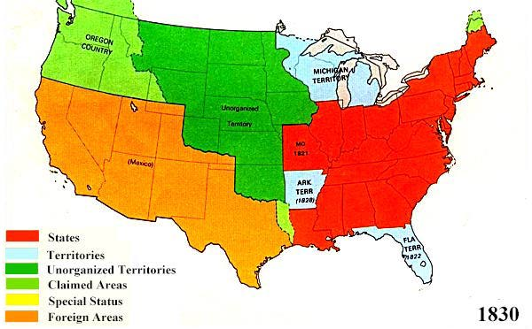
Manifest Destiny
In the 1st half of the 19th century(1800’s),
The West was controlled by:
Native Americans
The U.S.
Spain/Mexico (after 1821)
in the Southwest
Britain in the Northwest

Slide 2
Manifest Destiny
Americans (mostly Whites) were moving west:
Mountain men for fur trapping
Mormons for safety from other Christians
Missionaries to convert Native Americans to
Christianity
Easterners for new opportunities or to escape old problems

Slide 3
Manifest Destiny
Americans came to believe that
“Progress is God”
It was their destiny to
“Subdue the Continent”

Slide 4
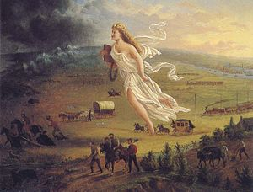
John L. O’Sullivan: “It is our Manifest Destiny to overspread the Continent allotted by Providence”

