Slide 1
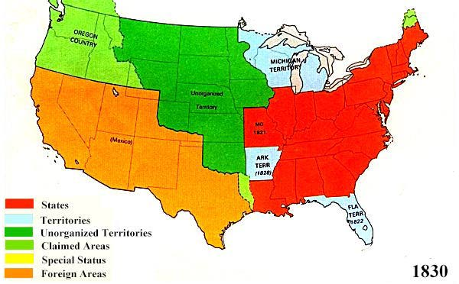
Manifest Destiny
Name: US History – Trails West
In the 1st half of the 19th century(1800’s),
The West was controlled by:
______________________
The U.S.
_____________ (after 1821)
in the Southwest
_________ in the Northwest

Slide 2
Manifest Destiny
Americans (mostly Whites) were moving west:
_______________________for fur trapping
______________ for safety from other Christians
________________ to convert Native Americans to
Christianity
______________________ for new opportunities or to escape old problems

Slide 3
Manifest Destiny
Americans came to believe that
“___________________”
It was their destiny to
“_______________________”

Slide 4
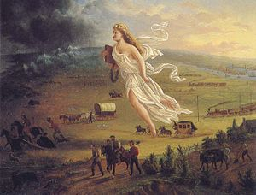
John L. O’Sullivan: “It is our __________ ___________to overspread the Continent allotted by Providence”

