Slide 1
Mexican War 1846-1848

Slide 2
Causes of the Mexican War
1. ___________ Destiny
2. Texas ______________ by the United States
3. ____________ dispute between Mexico and the U.S. over the boundary of Texas

Slide 3
Manifest Destiny
Belief that it was America’s God-given right and duty to expand west to the Pacific Coast

Slide 4
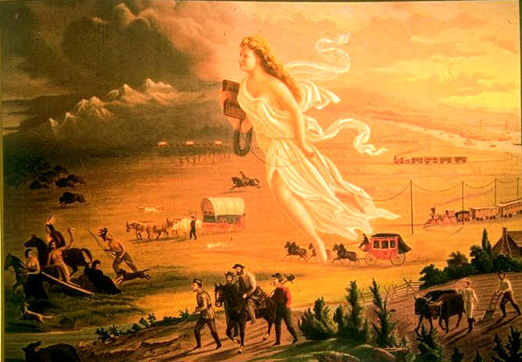
Manifest Destiny . . .
JOHN GAST‘S - "AMERICAN PROGRESS," (1872)

Slide 5
Texas Annexation
By March 1845 Congress had already approved Texas Annexation
The Republic of Texas hopes annexation will solve the republic’s financial & military problems
Texas becomes the 28th state in December of 1845
Mexico reacts by cutting off all _______________with the U.S.

Slide 6
Boundary Dispute
Texas and U.S. claim that the ________________ marks the southern border of Texas
Mexican government rejects this idea and argues that the real southern border is the _________________

Slide 7
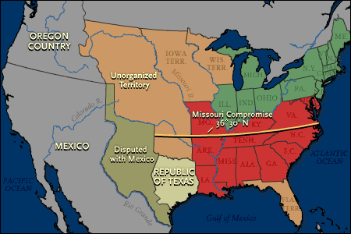
Rio Grande boundary
Nueces River boundary

Slide 8
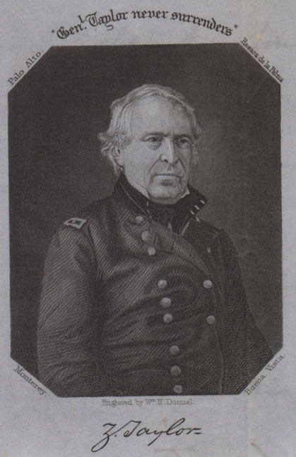
Steps to War
June 1845- President Polk ordered _____ ______________ to take U.S. troops into disputed border region
Polk claims this action is to protect Texas from possible Mexican attack

Slide 9
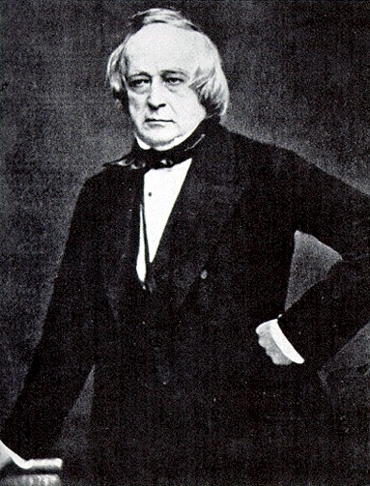
Steps to War
Meanwhile, Polk sent diplomat ________ ________to Mexico City to negotiate the purchase California & New Mexico for $30 million
Mexican officials refused to meet with Slidell
John Slidell

Slide 10
Steps to War
March 1846 – General Taylor’s troops made camp at the Rio Grande in disputed territory
April 1846 – Mexican commanders insisted U.S. troops must leave area and Taylor refused to move
Mexican forces crossed the Rio Grande and attacked group of 63 U.S. soldiers
11 Americans killed

Slide 11
Steps to War
May 11, 1846 – Polk addressed Congress
He declared that “_____________ __________________________ __________________________.”
Two days later Congress declared war on Mexico

Slide 12
Support of the War
For many Americans the war led to greater national pride
Many people who supported the war believed it would spread republican values
Many southerners supported the war, thinking any territory won would be organized into __________ states

Slide 13
Opposition to the War
Many members of the ________________ thought the conflict was unjustified
Northern _________________ feared any territory gained in the war might be organized into slave states
Illinois Congressman Abraham Lincoln wrote the “Spot Resolutions” in 1848– asking Polk to show the spot where American blood had been shed on American soil

Slide 14
The Mexican War
For American troops in Mexico, the war was one military ___________ followed by another.
Although outnumbered, Americans beat Mexican troops at the ________________________ then again in Mexico City.
By February 1848, the war was over.

Slide 15
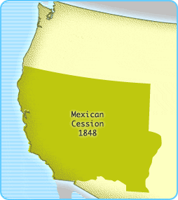
The Mexican Cession
Land gained from the War with Mexico

Slide 16
The Treaty of Guadalupe Hidalgo (1848)
Forced on Santa Anna and Mexico
Southern boundary of Texas set at the Rio Grande
U.S. gained:
Present-day states of _______________, Nevada, and Utah
Most of Arizona and __________________
Parts of Colorado and Wyoming
U.S. agreed to pay $15 million to Mexico and pay debts of Mexico to U.S. citizens

Slide 17
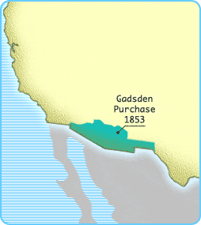
The Gadsden Purchase (1853)
The final piece of land to the U.S.
America purchased the strip of land, which is now New Mexico and Arizona for $10 million
Manifest Destiny was now completed

Slide 18
The Mexican War was extremely controversial!
SUPPORTERS blamed Mexico for the war:
They severed relations with the U.S., threatened war and refused to receive an American diplomat (John Slidell)
Mexico had "invaded our territory and shed American blood on American soil"

Slide 19
The Mexican War was extremely controversial!
OPPONENTS denounced the war:
As an immoral “land grab” by an expansionistic power against a weak neighbor
Polk deliberately provoked Mexico into war by ordering American troops into disputed territory
As an expansionist power play supported by Southern slave owners intent on acquiring more slave states

