Slide 1
Observational Learning
Observational Learning
learning by observing others
Modeling
process of observing and imitating a specific behavior
Prosocial Behavior
positive, constructive, helpful behavior
opposite of antisocial behavior
What is a Antisocial Behavior?

Slide 2
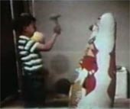
Observational Learning
Albert Bandura and his BoBo Doll
We learn through modeling behavior from others.
Observational learning + Operant Conditioning = Social Learning Theory

Slide 3
Observational Learning
Mirror Neurons
frontal lobe neurons that fire when performing certain actions or when observing another doing so
may enable imitation, language learning, and empathy

Slide 4
Other Terms
Learned Helplessness – When a person repeatedly fails at something and gives up or loses confidence (dogs being shocked).
Learn that no matter what you do you fail, so you give up or do not have any confidence.
Is a possible explanation for depression.

