Slide 1
Associative Learning
Conditioning
Classical | Operant
Pairing | Reward and punishment
Due to its dependency on pairing with natural, innate/instinctual behaviors, CC is limited. | Much of what we do in the modern day are deliberate, so that’s where Operate come in…

Slide 2
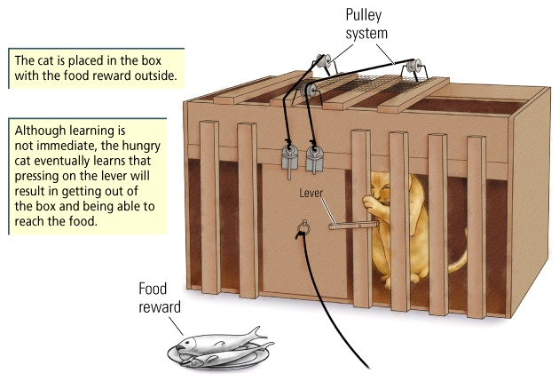
Thorndike’s “puzzle box”
“The Law of Effect”!

Slide 3
----------------------------------------
0 1 2 3 4 5 6 7
You are a fool sir! There’s right and
then there’s right …
and boy, is this right
We are born a “blank slate;”
Everything we do and are
is shaped through
interaction with our environment
“Tabula Rasa”

Slide 4
The biggest name to associate with
operant conditioning:
B. F. Skinner

Slide 5
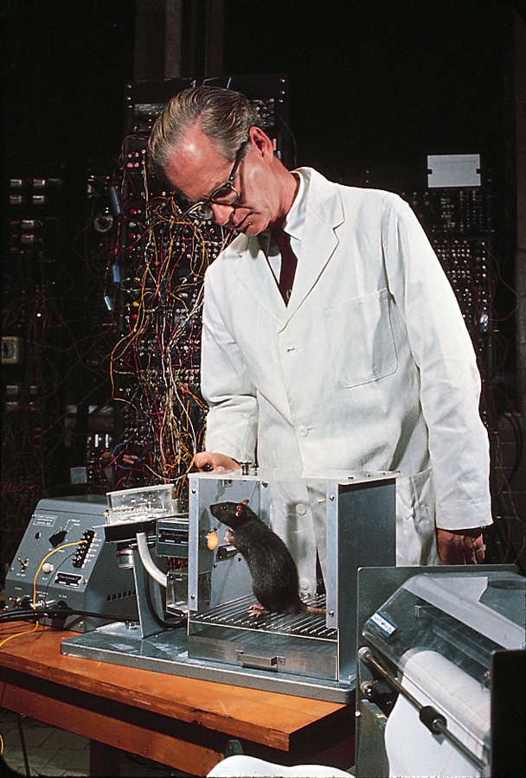
B.F. Skinner and
operant conditioning
*Behaviorism
*Free will does
not exist
*you’re the product
of the consequences
you’ve experienced
Notes:
5

Slide 6
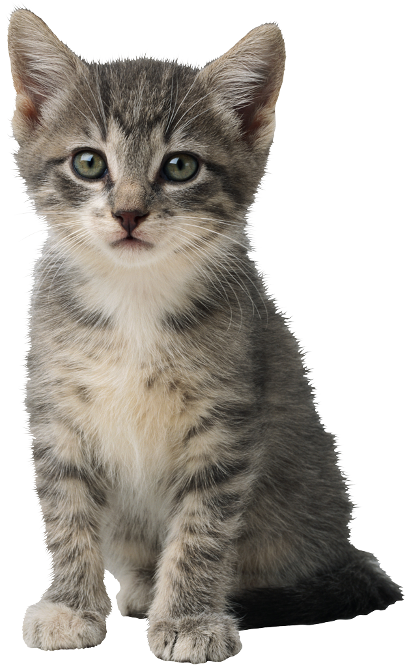
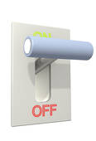
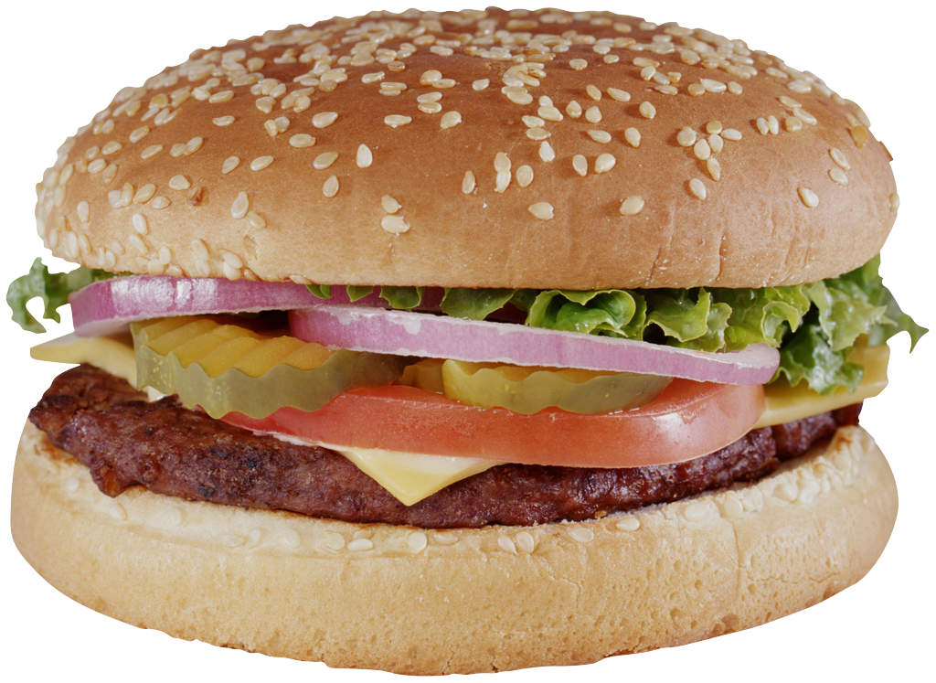
How do we operantly condition
this little one to press a lever?
Acquisition
Generalization
Discrimination
Extinction

Slide 7
Acquisition: the kitten is now pressing the lever;
she has “acquired” conditioning
Generalization: the kitten begins pressing other
similar levers or objects
Discrimination: the kitten does not generalize; she
“discriminates” between one type
of lever and another
Extinction: we decondition the kitten,
extinguishing the learned response
Spontaneous Recovery: a brief “flashback” to
the earlier conditioning even after extinction
Notes:
7

Slide 8
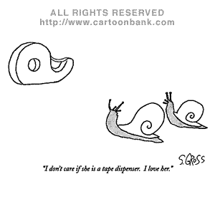
Generalization!

Slide 9
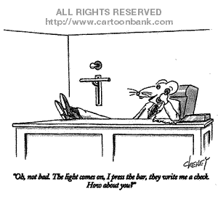

Slide 10
Videos: Shaping
Notes:
https://www.youtube.com/watch?v=vGazyH6fQQ4

Slide 11
Types of Consequences

Slide 12
More likely to
repeat the behavior
Behavior Reinforcing Consequence =
Behavior Punishing Consequence =
Less likely to
repeat the behavior
Punishment is sometimes called
“aversive training” – you theoretically
learn to avoid the punishment by
avoiding the behavior
Notes:
12

Slide 13
Reinforcement vs. Punishment
Strategy of changing behavior | Think… | Example
Positive (+) reinforcement | REWARD | Money
Negative (-) Reinforcement | RELEIF | Parents stop nagging you
Positive (+) Punishment | PAIN | Spanking
Negative (-) punishment | LOSS | You’re grounded (loss of social privileges)

Slide 14
CONSEQUENCE GRID
Stimulus Type | Add a Stimulus | Remove a Stimulus
Desired Stimulus
Aversive Stimulus

Slide 15
CONSEQUENCE GRID
Stimulus Type | Add a Stimulus | Remove a Stimulus
Desired Stimulus
Aversive Stimulus | Positive Punishment

Slide 16
Positive Punishment
A punch to the kidneys if you are late to class
Eating so much you get sick(?)
Wearing a hideous shirt and receiving unkind comments

Slide 17
CONSEQUENCE GRID
Stimulus Type | Add a Stimulus | Remove a Stimulus
Desired Stimulus |  | Negative Punishment
Aversive Stimulus | Positive Punishment

Slide 18
More examples of negative punishment:
* Losing your license after a DUI conviction
* Losing your cell phone because
you misuse it in school
* “No TV and no computer for
the rest of the night!”

Slide 19
Is getting a speeding ticket an
example of
Positive Punishment
or
Negative Punishment?
The ticket itself and the
accompanying embarrassment
and inconvenience seem like
positive punishment
The later loss of your
money when you pay
the ticket is closer to
negative punishment

Slide 20
CONSEQUENCE GRID
Stimulus Type | Add a Stimulus | Remove a Stimulus
Desired Stimulus | Positive Reinforcement | Negative Punishment or Omission Training
Aversive Stimulus | Positive Punishment

Slide 21
Examples of positive reinforcement?

Slide 22
CONSEQUENCE GRID
Stimulus Type | Supply a Stimulus | Remove a Stimulus
Desired Stimulus | Positive Reinforcement | Negative Punishment or Omission Training
Aversive Stimulus | Positive Punishment | Negative Reinforcement

Slide 23
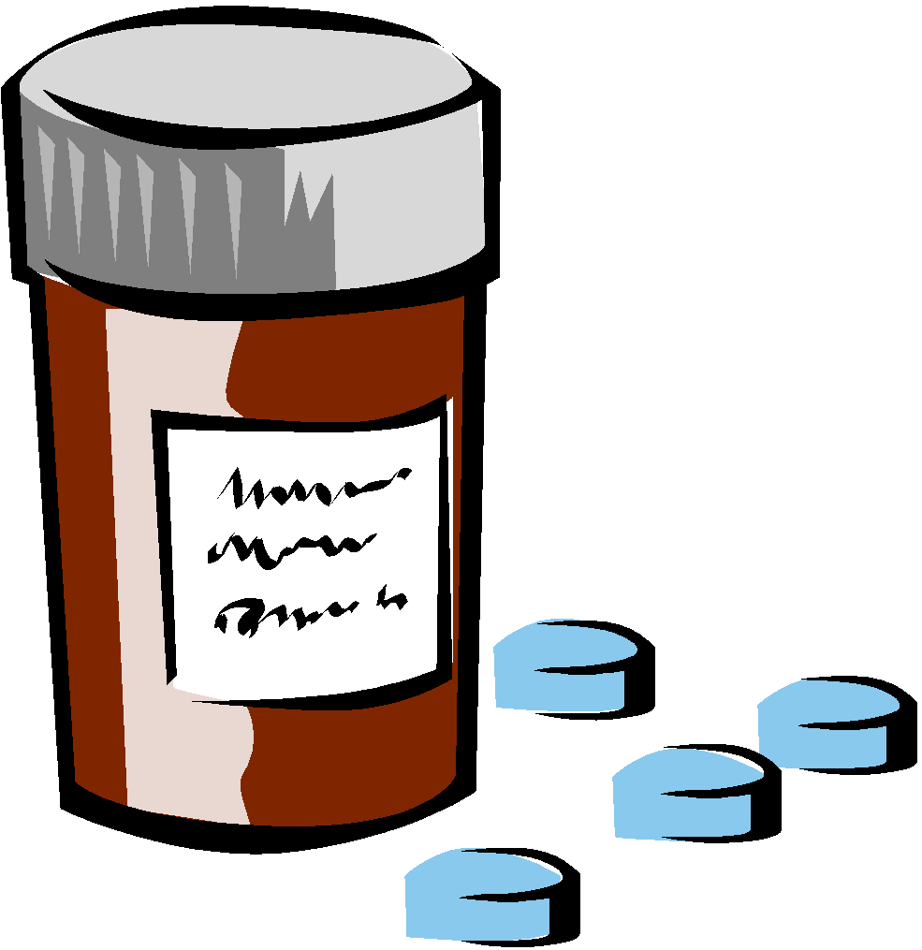
Negative reinforcement REINFORCES the behavior!
Negative reinforcement is not the same as punishment,
which DISCOURAGES the behavior!
Example: Taking an aspirin for a headache
is negatively reinforcing ... It removes the
pain of the headache
=
Notes:
23

Slide 24
If changing the baby’s diaper makes her stop shrieking,
you have been negatively reinforced for changing
diapers by the removal of the unpleasantness of the
baby shrieking; you will be more likely to change
her diaper in similar situations in the future
If banging on the apartment wall stops your
neighbors from being so noisy, you have been
negatively reinforced for banging on the wall

Slide 25
Negative Reinforcement…
asking an obnoxious student to leave class
leaving a theater during a bad movie
car safety belt noise
umbrella in the rain

Slide 26
CONSEQUENCE GRID
Stimulus Type | Supply a Stimulus | Remove a Stimulus
Desired Stimulus | Positive Reinforcement | Negative Punishment or Omission Training
Aversive Stimulus | Positive Punishment | Negative Reinforcement

Slide 27
How could using a drug like heroin be
both
Positive Reinforcement?
AND
Negative Reinforcement?

Slide 28
Homework Examples
Video: Mt. Splashmore

Slide 29
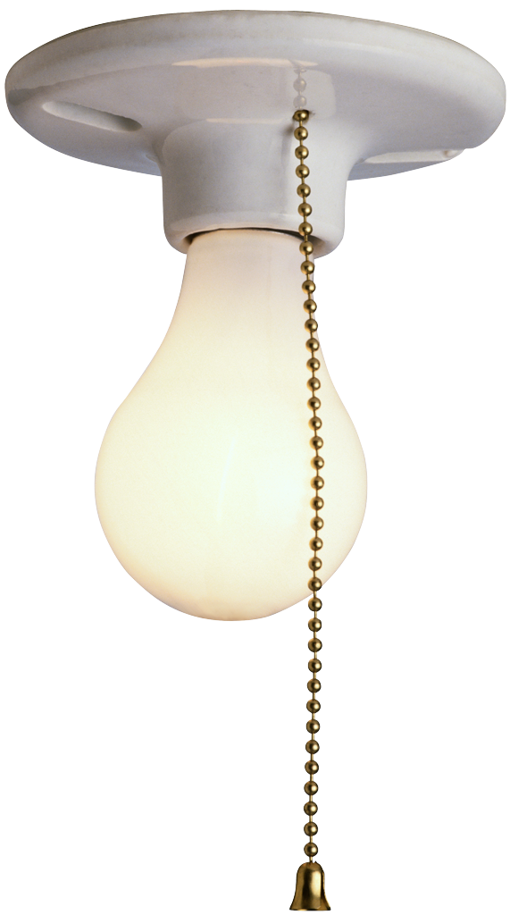
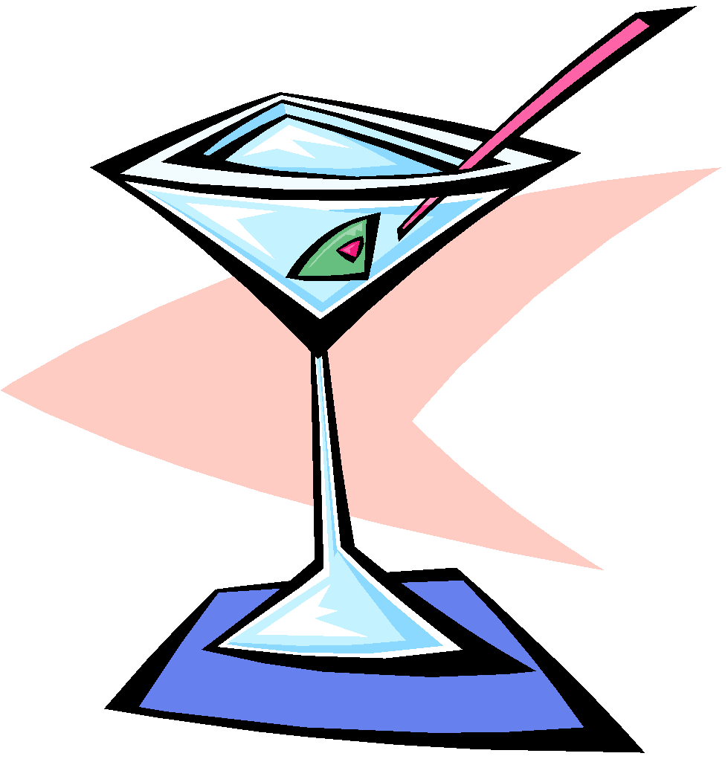
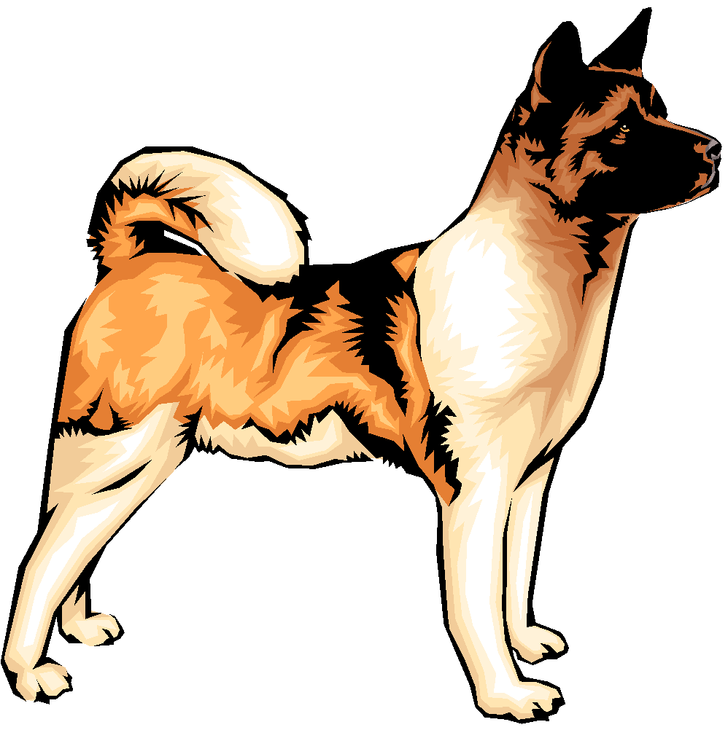
Other versions of
negative reinforcement:
* “escape learning”
* “avoidance learning”
Notes:
29

Slide 30
Contingency in Operant Conditioning
If this behavior is done, it will consistently be followed by this consequence

Slide 31
Contingency in operant conditioning:
“If I do A, then B will consistently follow”
*“If I am late to school, they
will throw acid in my face” (consequence type?)
*“If I study, I will be rewarded with a good grade”
(consequence type?)
*“If I behave in class, I’ll no longer
have to sit next to _______”
(consequence type?)

Slide 32
Article on $ for AP scores
Do the positives outweigh the negatives?

Slide 33
Overjustification Effect
offering an extrinsic
reward for a behavior an individual
is already willing to do can reduce
his or her original, intrinsic motivation
Notes:
33

Slide 34
The Premack Principle
Once you know what is reinforcing
for a particular individual, you can
use that as a reward for a behavior
they are less likely to perform

Slide 35
Schedules of reinforcement
Continuous schedules
Partial or intermittent schedules

Slide 36
Schedules of Reinforcement
Fixed Ratio (FR)
the consequence is delivered
after a set # of responses
(Ex. every 4 lever presses)
Extra credit in AP Psych?

Slide 37
Variable Ratio (VR):
the consequence is delivered after a
varying number of responses (ex: food arrives on
the average of every four lever presses)
Buying raffle tickets?
“door to door” sales?

Slide 38
Fixed Interval (FI)
the consequence is delivered for the
1st response after a set amount of time has passed (ex: the rat presses the lever after 10 minutes and receives food)
Going to work to get your paycheck?
Checking iPass for monthly grades?
Studying for a scheduled quiz?

Slide 39
Variable Interval (VI)
the consequence is delivered for the
1st response after a varying amount of time has passed
Studying for a pop quiz?

Slide 40
More examples…
Checking your computer every afternoon, knowing your romantic partner typically sends you a note at 3:00 pm.
You get a bonus whenever your boss sees you working diligently, but you never know when she might appear

Slide 41
You are given $100 for every 1,000 words in your newspaper articles
Some classes your teacher collects and grades the homework, but other classes the teacher does not
You receive one ‘F’ for every time you spell ‘perceive’ incorrectly

Slide 42
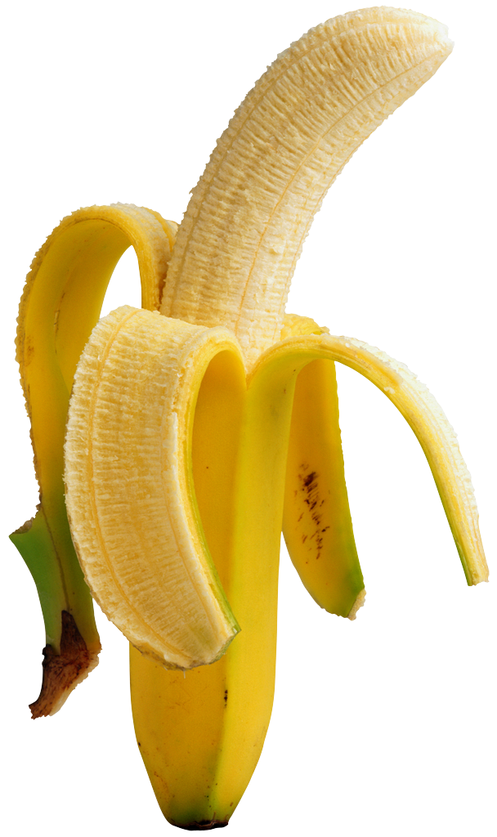
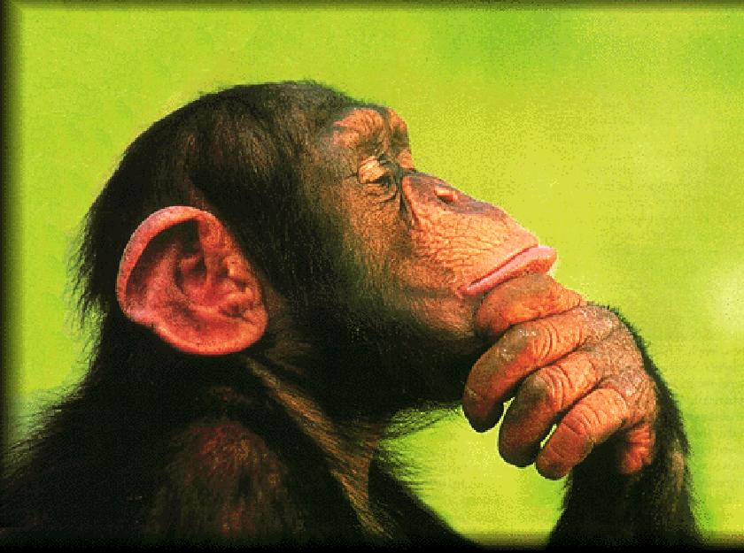
How might we condition a chimp
to work on an assembly line?

Slide 43
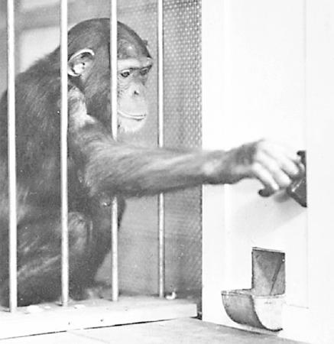
Poker chips normally have little or no value for chimpanzees, but this chimp will work hard to earn them once he learns that the “Chimp-O-Mat” will dispense food in exchange for them.
Notes:
43

Slide 44
The “Chimp-o-mat”
illustrates the distinction between
Primary reinforcers, which are
naturally reinforcing (food, water,
perhaps companionship/security), and
Secondary reinforcers, which the
subject has to learn to value

Slide 45
Operant conditioning loose ends
Superstitious behavior?
Instinctual drift?

Slide 46
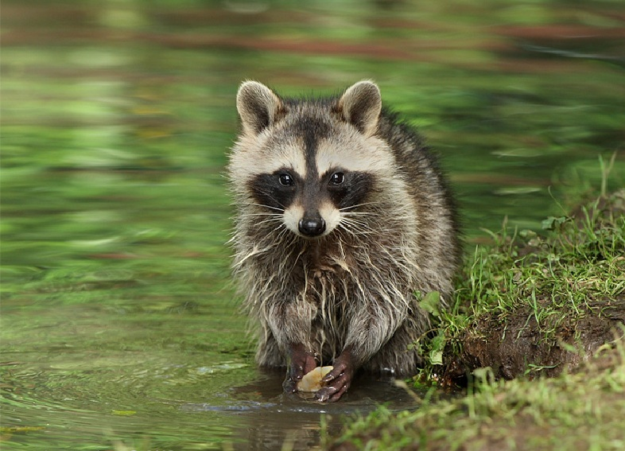

Slide 47
Have you changed your mind?
With ‘0’ meaning completely disagree and ‘10’ meaning
completely agree, assign a number to the following:
We can’t know what’s going on in anyone’s
mind, so we should just focus on what we
can see – that is, observable behaviors

Slide 48
End of “Operant Conditioning”
Powerpoint Presentation

