Slide 1
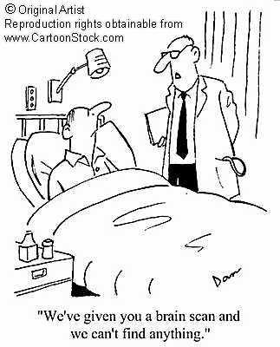

Slide 2
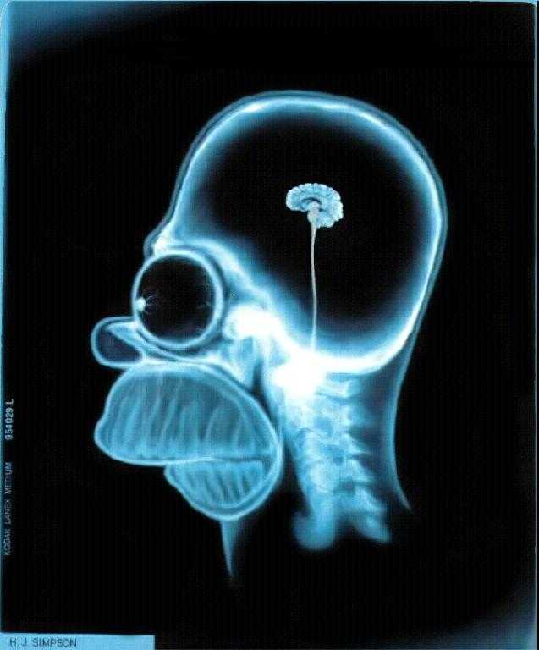

Slide 3
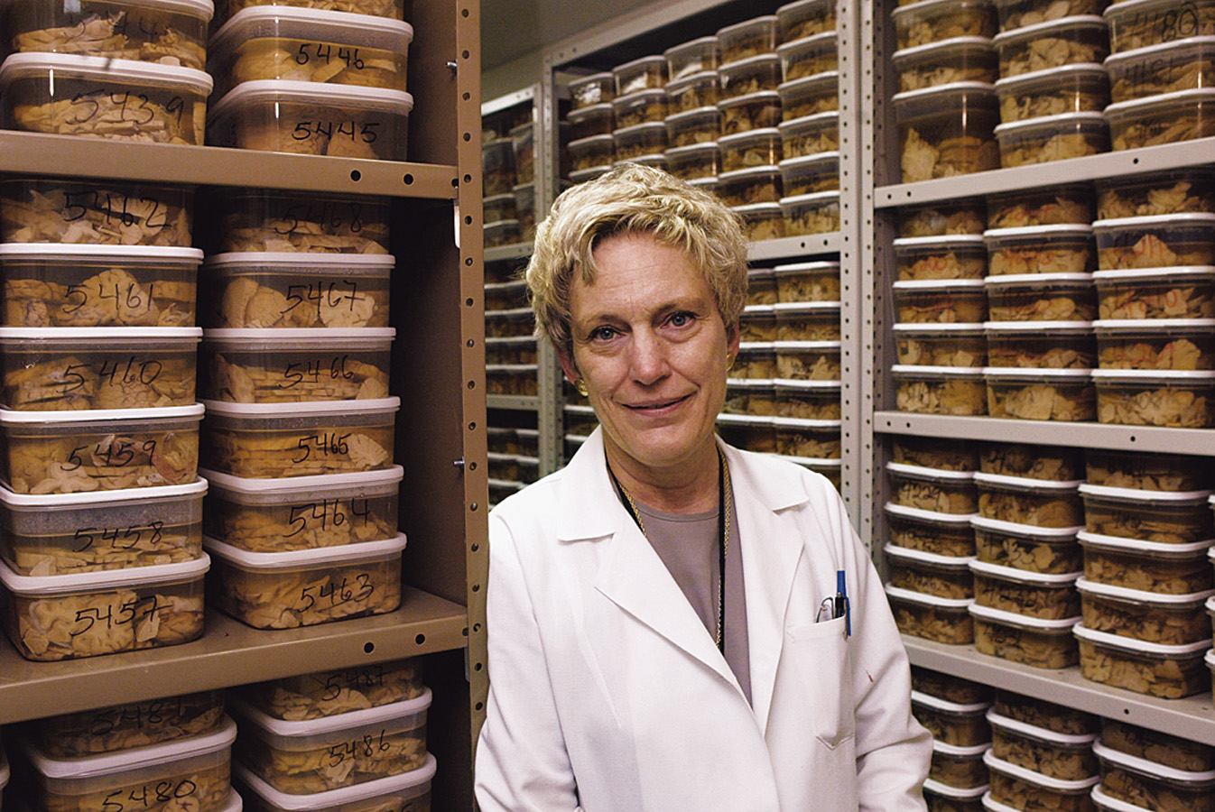
Clinical Observation
Clinical observations have shed light on a number of brain disorders. Alterations in brain morphology due to neurological and psychiatric diseases are now being catalogued.
Tom Landers/ Boston Globe

Slide 4
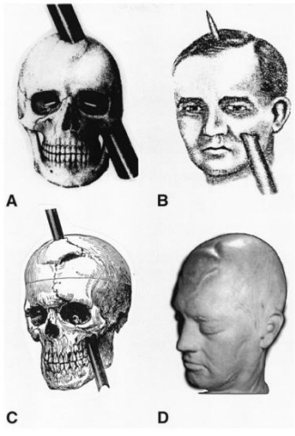
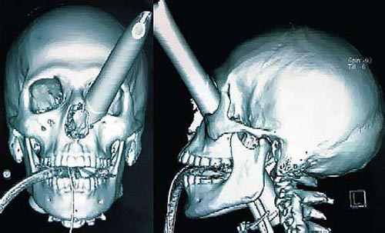
Ways to study the Brain!!!
Accidents: Phineas Gage.

Slide 5
Lesions
Cutting into the brain and looking for change.
Brain tumors also lesion brain tissue.

Slide 6
TWO MINUTE NEUROSCIENCE
Neuroimaging

Slide 7
Less Invasive ways to study the Brain
Electroencephalogram (EEG)
Computerized Axial Tomography (CAT)
Magnetic Resonance Imaging (MRI)
Positron Emission Tomography (PET)
Functional MRI

Slide 8
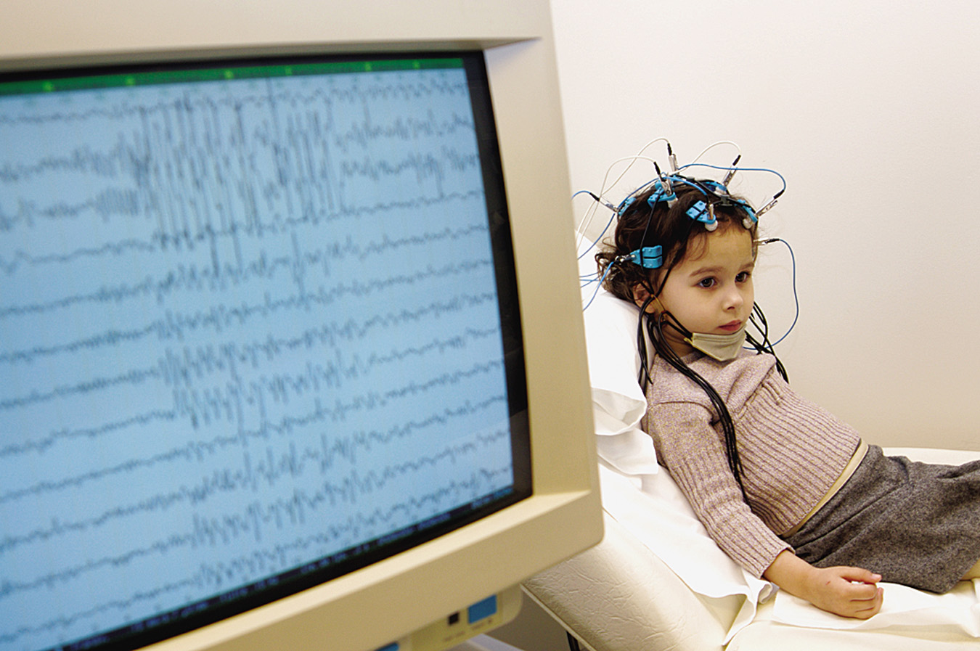
Electroencephalogram (EEG)
An amplified recording of the electrical waves sweeping across the brain’s surface, measured by electrodes placed on the scalp.
AJ Photo/ Photo Researchers, Inc.

Slide 9
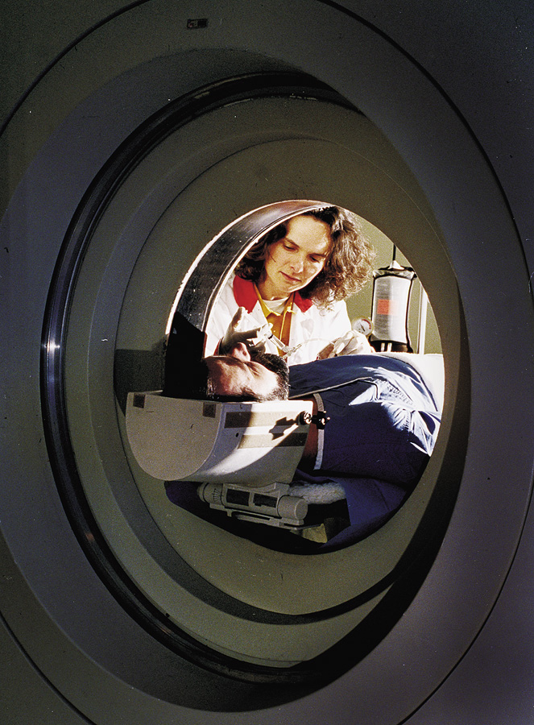
PET Scan
PET (positron emission tomography) Scan is a visual display of brain activity that detects a radioactive form of glucose while the brain performs a given task.
Courtesy of National Brookhaven National Laboratories

Slide 10
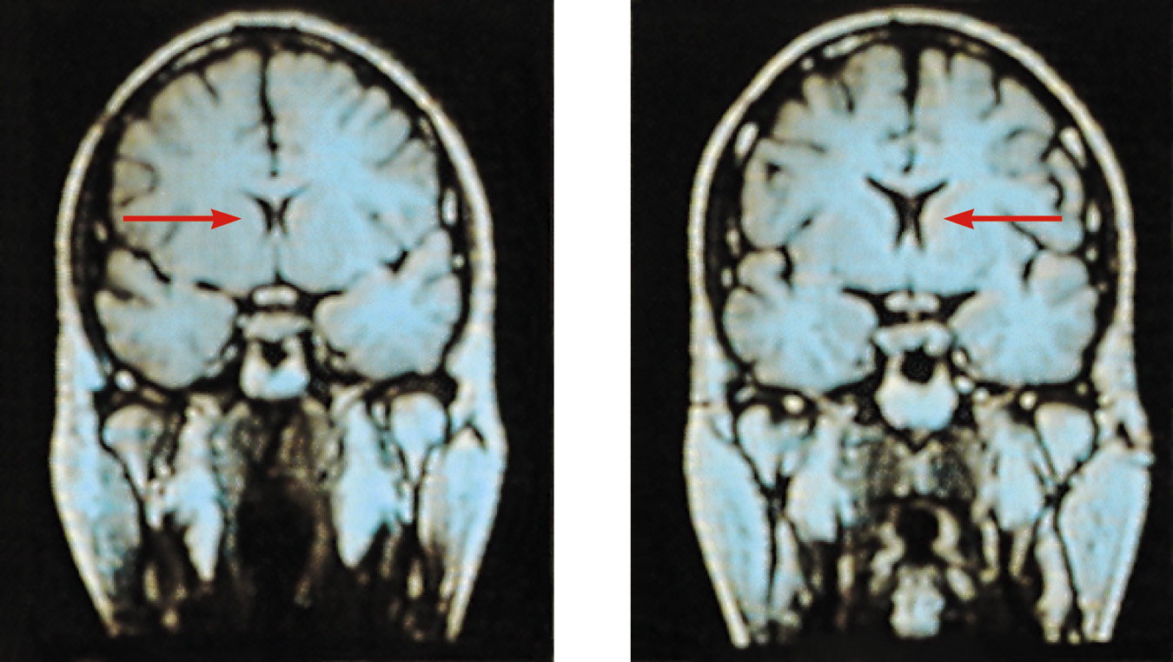
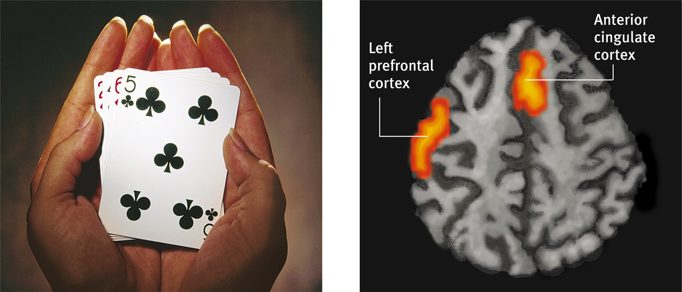
MRI Scan
MRI (magnetic resonance imaging) uses magnetic fields and radio waves to produce computer-generated images that distinguish among different types of brain tissue. Top images show ventricular enlargement in a schizophrenic patient. Bottom image shows brain regions when a participants lies.
Both photos from Daniel Weinberger, M.D., CBDB, NIMH
James Salzano/ Salzano Photo
Lucy Reading/ Lucy Illustrations

Slide 11
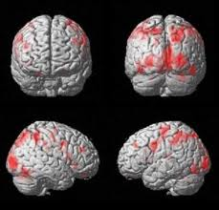
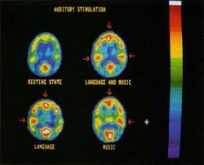
P.E.T. vs. fMRI

Slide 12
The Nervous System

Slide 13
Central Nervous System
The Brain and spinal cord
CNS

Slide 14
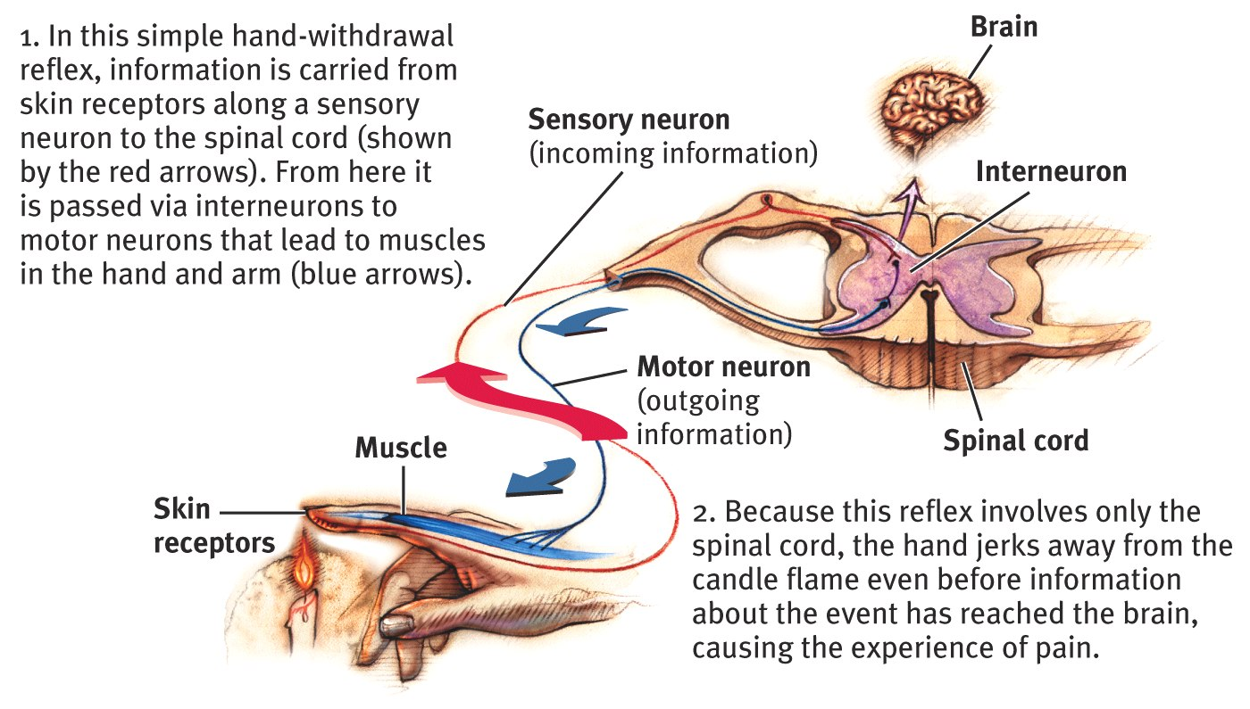
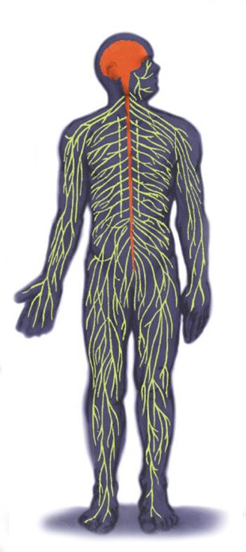
Central Nervous System
The Spinal Cord and Reflexes
Simple Reflex

Slide 15
Reflexes
Normally, sensory (afferent) neurons take info up through spine to the brain.
Some reactions occur when sensory neurons reach just the spinal cord.
Survival adaptation.

Slide 16
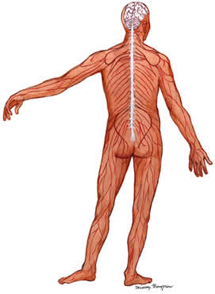
Peripheral Nervous System
All nerves that are not encased in bone.
Everything but the brain and spinal cord.
Is divided into two categories….somatic and autonomic.

Slide 17
Peripheral Nervous System
Somatic Nervous System: The division of the peripheral nervous system that controls the body’s skeletal muscles.
Autonomic Nervous System: Part of the PNS that controls the glands and other muscles.

Slide 18
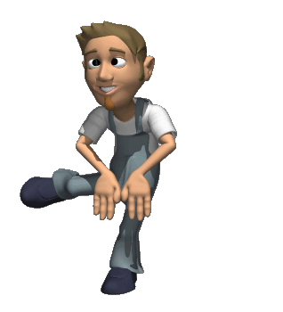
Somatic Nervous System
Controls voluntary muscle movement.
Uses motor (efferent) neurons.

Slide 19
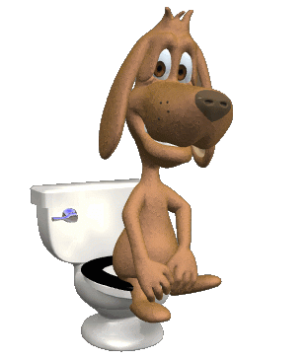
Autonomic Nervous System
Controls the automatic functions of the body.
Divided into two categories…the sympathetic and the parasympathetic

Slide 20
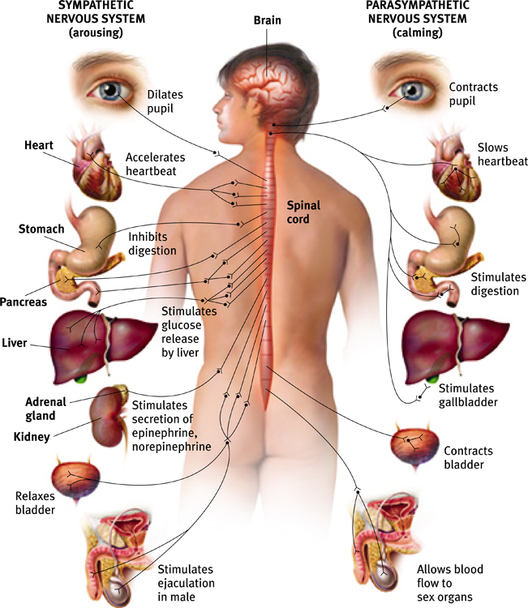
Autonomic Nervous System (ANS)
Sympathetic NS “Arouses”
(fight-or-flight)
Parasympathetic NS “Calms”
(rest and digest)

Slide 21
Sympathetic Nervous System
Fight or Flight Response.
Automatically accelerates heart rate, breathing, dilates pupils, slows down digestion.

Slide 22
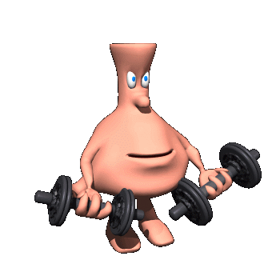
Parasympathetic Nervous System
Automatically slows the body down after a stressful event.
Heart rate and breathing slow down, pupils constrict and digestion speeds up.

Slide 23
Reason It Out: The Fight or Flight Response
Offer your prediction – in an emergency situation, what happens in regard to:
Heart Rate? (Accelerated)
Respiration? (Accelerated)
Adrenaline Levels? (Increased)
Endorphin Levels? (Increased)
The Pupils of the Eyes (Dilated)
Salivation (Inhibited)
Digestion (Inhibited)
Bowel & Blatter Function? (Relaxed/Constriction of Both)

