Slide 1
S&P Week #2
KT AP Psychology – 2018

Slide 2
Test your Blind Spot
Use your textbook. Close your left eye, and fixate your right eye on the black dot. Move the page towards your eye and away from your eye. At some point the car on the right will disappear due to a blind spot.

Slide 4
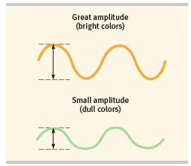
Phase One: Gathering Light
The height of a wave gives us it’s intensity (brightness).
The length of the wave gives us it’s hue (color).
The longer the wave the more red.
The shorter the wavelength the more violet.

Slide 5
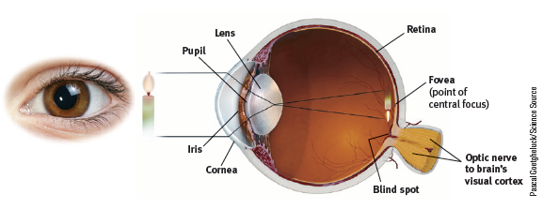
Phase Two: Getting the light in the eye

Slide 6
Parts of the eye
Cornea: Transparent tissue where light enters the eye.
Iris: Muscle that expands and contracts to change the size of the opening (pupil) for light.
Lens: Focuses the light rays on the retina.

Slide 7
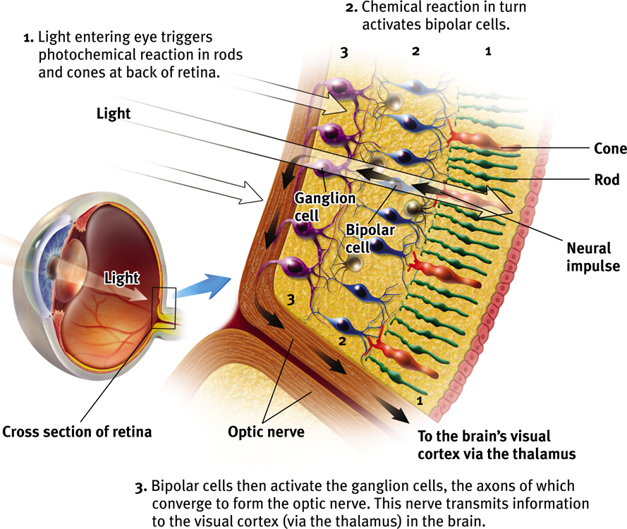
Retina
Retina: The light-sensitive inner surface of the eye, containing receptor rods and cones in addition to layers of other neurons (bipolar, ganglion cells) that process visual information.

Slide 8
Phase 3: Transduction
Transforming signals into neural impulses.
Order is Rods/Cones to Bipolar to Ganglion to Optic Nerve.

Slide 9
Photoreceptors
E.R. Lewis, Y.Y. Zeevi, F.S Werblin, 1969

Slide 10
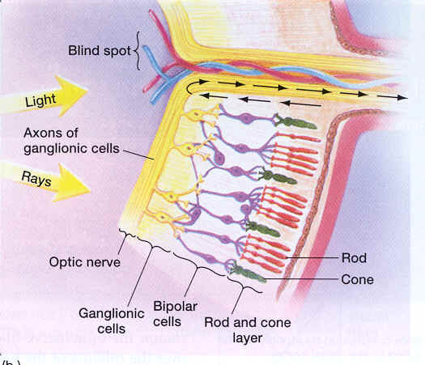
Transduction

Slide 11
Bipolar & Ganglion Cells
Bipolar cells receive messages from photoreceptors and transmit them to ganglion cells, which converge to form the optic nerve.

Slide 12
Visual Information Processing
Optic nerves connect to the thalamus in the middle of the brain, and the thalamus connects to the visual cortex.
Notes:
Preview Question 6: How does the brain process visual information?

Slide 13
Phase Four: In the Brain
Goes to the Visual Cortex located in the Occipital Lobe of the Cerebral Cortex.
We have specific cells that see the lines, motion, curves and other features of this turkey. These cells are called feature detectors.

Slide 14
Feature Detection
Feature detector nerve cells in the visual cortex of the occipital lobe respond to specific features, such as edges, angles, and movement. They receive information from specific ganglion cells.
They then pass the info. on to supercells in other cortical areas that respond to more complex problems.
Ex. Temporal Lobe-enables you to perceive faces. We use 30% of our cortex to recognize faces.

Slide 15
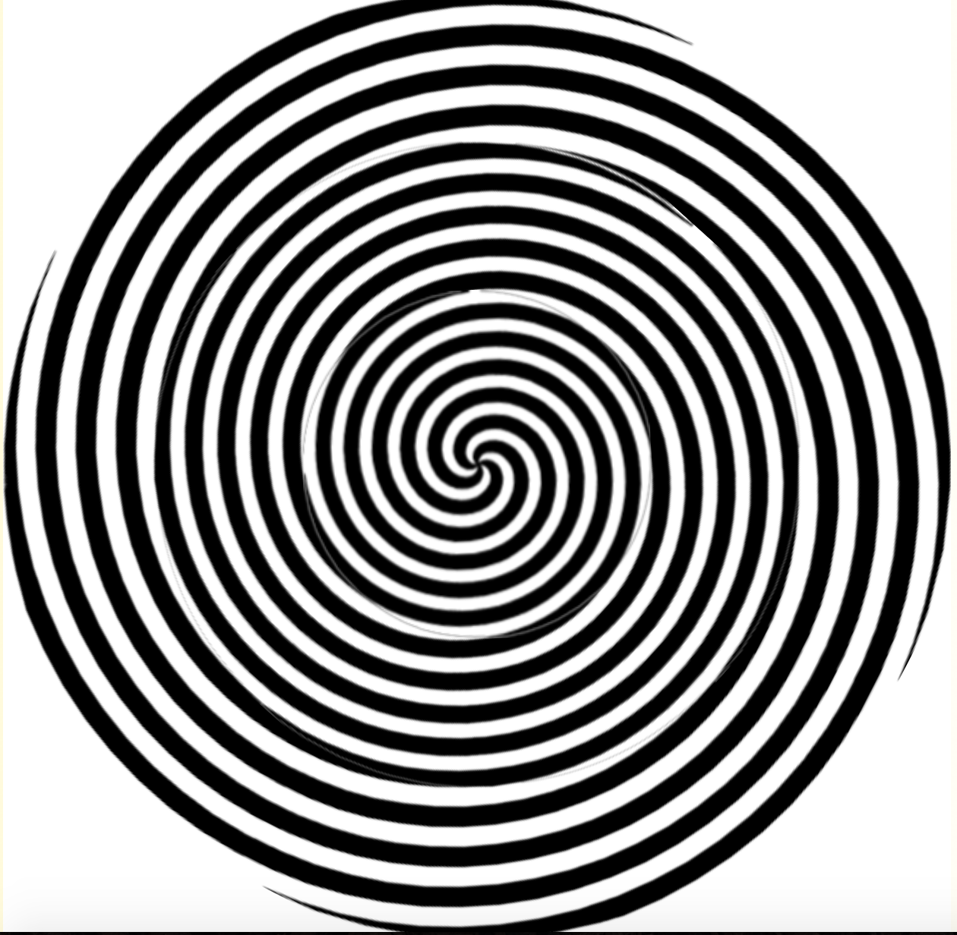
Motion Aftereffects
http://www.michaelbach.de/ot/mot_adaptSpiral/index.html
Are caused by the adaptation of motion-specific detectors that are tuned to the direction of the movement of the stimuli being viewed.

Slide 16
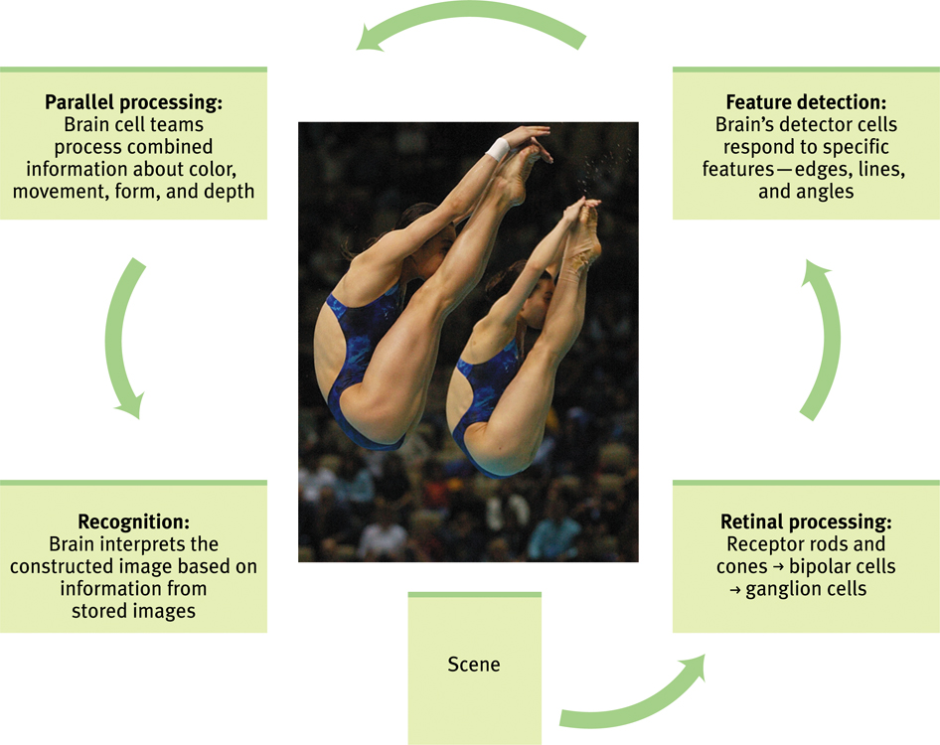
From Sensation to Recognition

Slide 17
Color Vision
Two Major Theories You Need To Know
Trichromatic Theory + Opponent-Process Theory

Slide 18
Trichromatic Theory
Three types of cones:
Red
Green
Blue
7 million hues, maybe more?

Slide 20
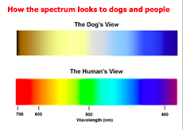

Slide 21
Trichromatic Color Theory
Any color can be created by combining the light waves of 3 primary colors –red, blue, green.
64% respond to red
33% respond to blue
2-3% respond to green
When we stimulate combinations of these cones, we see other colors.
For example, there are no receptors especially sensitive to yellow—when the cones we have are stimulated to varying degrees, we see yellow

Slide 22
Notes:
Mac users click on black circle to view online video. Original link: https://www.youtube.com/watch?v=_eVztKynhsk&feature=youtu.be
So what’s Kramer’s problem, Rods or Cones? Cones - color vision.

Slide 23
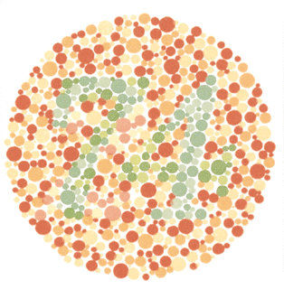
Color “Blindness”
Genetic disorder in which people are blind to green or red colors. This supports the Trichromatic theory.
Ishihara Test

Slide 24
Color Deficiency
Genetic disorder in which people are blind to green or red colors. This supports the Trichromatic theory.
Ishihara Test

Slide 25
COLOR BLINDNESS (Deficiency)
Most people with color–deficient vision are not color blind. They simply lack functioning red OR green sensitive cones.

Slide 26
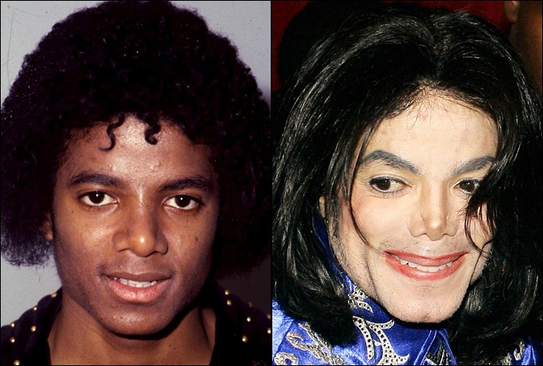
Opponent-Process theory
The sensory receptors come in pairs.
Red/Green
Yellow/Blue
Black/White
If one color is stimulated, the other is inhibited.

Slide 27
After Images
An after image is an image that stays with you even after you have stopped looking at something. As you stare at an object the light-sensitive cells at the back of your eyes become less responsive to the color of the object. When you shift your gaze to a white surface your visual system subtracts the color of the object. So for example example white light minus red light is blue-green light.
This reinforces the opponent process theory.

Slide 32
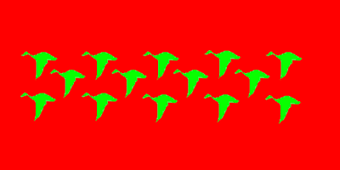

Slide 34
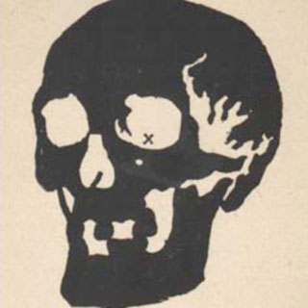

Slide 36
