Slide 1
Sensation and Perception 6-8%

Slide 2
Sensation and Perception
Discussion starters

Slide 3
If you had to give up one of
your senses, which would it be?
If you could only keep one of your
senses, which would you keep?
Note the importance of the
interaction between the senses!
Notes:
Handout: Survey of ranking senses

Slide 4
How is sensation different from perception?

Slide 5
Sensation & Perception
How do we construct our representations of the external world?
To represent the world, we must detect physical energy (a stimulus) from the environment and convert it into neural signals. This is a process called sensation.
When we select, organize, and interpret our sensations, the process is called perception.

Slide 6
SENSATION vs. PERCEPTION
Sensation: Your sensory organs take
in stimuli from the world
Perception: How your brain interprets
those stimuli based on our experiences,
memories and expectations

Slide 7
Examples to show S&P difference
“Our song”
Pain
New psych vocab
Watching political debates
Watching a football game

Slide 8
Bottom-Up Processing
The brain pieces together all of the incoming
stimuli to form a perception
This relies heavily on SENSATION
Notes:
Maybe link to data-driven (that is another name for it)

Slide 9
Bottom-up Processing
Analysis of the stimulus begins with the sense receptors and works up to the level of the brain and mind. Think of it as data-driven.
Letter “A” is really a black blotch broken down into features by the brain that we perceive as an “A.”

Slide 10
Top-Down Processing
Perceptual processing that is based on higher
level knowledge, expectation, memory
Note: The Proofreader’s Illusion
Notes:
Conceptually driven processing

Slide 11
Top-Down Processing
Information processing guided by higher-level mental processes as we construct perceptions, drawing on our experience and expectations. Think of it as conceptually-driven
THE CHT

Slide 12
Sensation and Perception
Bottom up vs. top down?
Wundt-Jastrow illusion
Backmasking
http://jeffmilner.com/backmasking/

Slide 13
Sensation and Perception
Bottom up vs. top down?
The proofreader’s illusion
Wundt-Jastrow illusion
http://www.michaelbach.de/ot/geom-Jastrow/index.html
Backmasking
http://jeffmilner.com/backmasking/stairway-to-heaven-backwards.html

Slide 14
Top Down Processing
Aoccdring to rscheearch at Cmbridge Uinvertisy. It deosn’t mttaer in what oredr the ltteers in a word are, the olny iprmoetnt tihng is that the frist and lsat ltteer be at the rghit pclae. The rset can be a total mses and you can still raed it wouthit a porbelm. This is bcusawe the huamn mnid deos not raed ervey lteter by istlef, but the word as a wlohe.

Slide 15
Likelihood Principle
Herman von Helmholtz
We will perceive the object that is most likely to be the cause of our sensory stimulation. That is, if a number of different objects could have caused a specific pattern of light and dark on the retina, we will perceive the object that is most likely to occur in that particular situation.

Slide 16
Perceptual Set
(a.k.a. “perceptual expectancy”)
Our expectations greatly
influence our experience

Slide 17
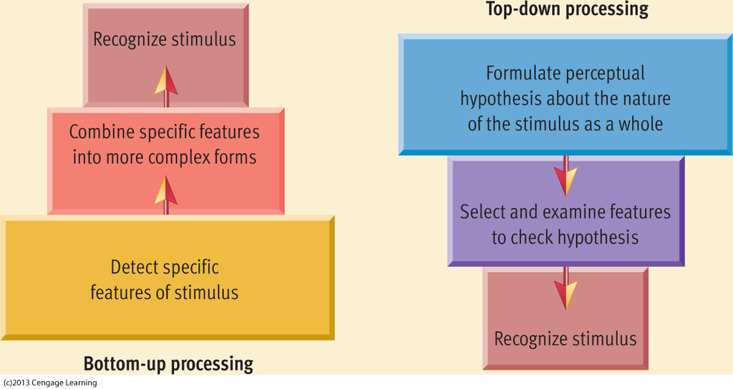

Slide 18
Bottom-Up vs Top-Down Processing
Notes:
This shows a solid example of Top-down processing over bottom up processing

Slide 19
Write what you see on a piece of scrap paper

Slide 20
Notes:
Why do we miss that? Perceptual Set, Top-Down Processing, Automatic Processing
I always ask students why they mess this up but a younger kid wouldn’t→you are using automatic processing they are using very controlled processing

Slide 21
What did that say?

Slide 22
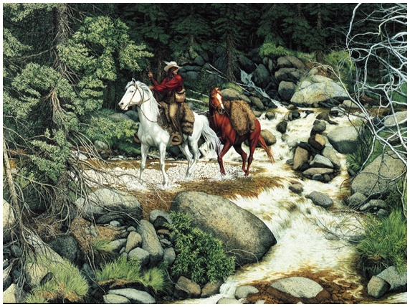
Making Sense of Complexity
Our sensory and perceptual processes work together to help us sort out complex images.
“The Forest Has Eyes,” Bev Doolittle
Notes:
Prosopagnosia

Slide 23
https://youtu.be/IGQmdoK_ZfY
https://youtu.be/xAFfYLR_IRY

Slide 24
Selective Attention
The focusing of conscious awareness on a particular stimulus
Cocktail Party Effect: ability to tend to only one voice of many
Flow: so caught up in an experience that miss out on obvious stimuli

Slide 25
Selective Attention and Accidents

Slide 26
Selective Inattention
Inattentional blindness: failing to see visible objects when our attention is directed elsewhere.
Change Blindness: failing to notice changes in the environment.
Change deafness
Choice Blindness: when the object of their preference is switched with another one, do not acknowledge the difference and tend to find explanations for this altered choice.
https://www.youtube.com/watch?v=_VPcl04Adh8
https://youtu.be/FWSxSQsspiQ?list=PLC0A3CAC7B3A0E288
https://youtu.be/ubNF9QNEQLA
http://www.simonslab.com/videos.html

Slide 27
http://channel.nationalgeographic.com/brain-games/videos/choice-blindness/
Choice Blindness
http://www.dailymotion.com/video/xq1p3e_national-geographic-test-your-brain-episode-1-pay-attention_shortfilms

Slide 28
Sensing the World
Senses are nature’s gift that suit an organism’s needs.
A frog feeds on flying insects; a male silkworm moth is sensitive to female sex-attractant odor; and we as human beings are sensitive to sound frequencies that represent the range of the human voice.

Slide 29
Exploring the Senses
What stimuli cross our threshold for
conscious awareness?
Transduction: Conversion of one form of energy into another…So in Sensation it’s the transforming of stimulus energies such as sights, sounds, and smells into neural impulses our brain can interpret.

Slide 30
Psychophysics
A study of the relationship between physical characteristics of stimuli and our psychological experience with them.
Physical World | Psychological World
Light | Brightness
Sound | Volume
Pressure | Weight
Sugar | Sweet

Slide 31
Thresholds
Absolute Threshold: Minimum stimulation needed to detect a particular stimulus 50% of the time.
Proportion of “Yes” Responses
0.00 0.50 1.00
0 5 10 15 20 25
Stimulus Intensity (lumens)
Notes:
Preview Question 1: What is an absolute threshold, and are we influenced by stimuli below it?

Slide 32
ABSOLUTE THRESHOLDS
Vision: a single candle flame from 30 miles on a dark, clear night.
Hearing: The tick of a watch from 20 feet in total quiet.
Smell: 1 drop of perfume in a 3 room apt.
Taste: 1 tsp. sugar in two gallons of water.
Touch: The wing of a bee on your cheek, dropped from 1 cm.
Why is this even important??

Slide 33
Signal Detection Theory
Predicts when we will detect new weak signals.
Why do people respond differently to the same stimuli?

Slide 34
Subliminal Threshold
Subliminal Threshold: When stimuli are below one’s absolute threshold for conscious awareness.
Priming: activation of certain associations-often unconsciously.
http://www.scentair.com/index.html

Slide 35
The difference threshold, also known
as the just noticeable difference (JND)
The minimum difference between 2
stimuli that one can detect 50% of the time

Slide 36
Difference Threshold/Just Noticeable Difference
JND
To function effectively we need absolute thresholds low enough to allow us to detect important sights, sounds, textures, tastes, and smells.
BUT we also need to detect small differences among stimuli.
Ex. Musician tuning an instrument; sound of your friends voice in a crowded hall
The minimum difference a person can detect between any two stimuli half the time.

Slide 37
Weber’s Law
the size of the JND tends to be a constant proportion to the initial stimulus
The greater the original stimulus, the more
you’d have to change it to notice a difference

Slide 38
Weber’s Law examples
Dating ages
Global warming
Backpack weight
Loud concert
Buying a house/other things
Notes:
Dating: you would take notice if your 17 year old friend was dating a 12 year old but a 45yr old woman marrying a 50yr old male would not be on your radar.
ECON: buying a house 500,000- realtor comes back and says oops I missed a $5000 charge—few people will walk away from the purchase
However if you but a $25000 car and dealer comes back and says oops I missed a $5000 charge, you will walk away from the purchase
It is the same amount but different proportions

Slide 39
Weber’s Law
Two stimuli must differ by a constant minimum percentage (rather than a constant amount), to be perceived as different.
Difference thresholds grow with the magnitude of the stimulus.
Proportion varies depending on stimulus:
Light: 8%
Weight: 2%

Slide 40
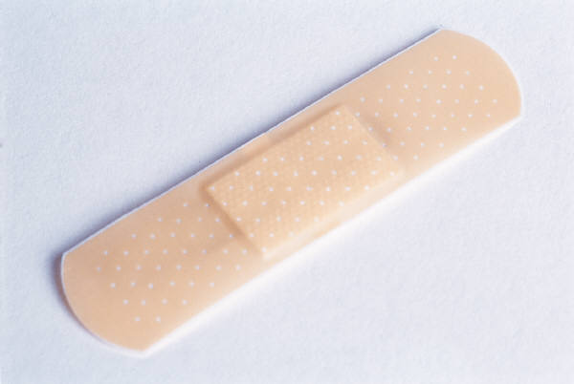
Sensory Adaptation
Diminished sensitivity as a consequence of constant stimulation.
Put a band aid on your arm and after awhile
you don’t sense it.
We perceive the world not exactly as it is,
but as it is useful for us to perceive it.
Notes:
Preview Question 3: What function does sensory adaptation serve?

Slide 41
Sensory Adaptation
Your receptor cells become less responsive after
prolonged exposure to a constant stimulus
Ex: cold ocean, hot shower, loud concert, music in your car
nasty smells
Habituation
Your brain stops paying attention to things that don’t
change. However, as soon as that thing changes, it
recaptures your attention
Ex: billboards, signs in the school, noise, posters in the room,
Home plate…

Slide 42
Sense Commonalities
The Thalamus
Receptor cells AND transduction

Slide 43
The specific receptors for
each of the sensory systems

Slide 44
The Visual System:
rods and cones in the retina responding to light waves

Slide 45
The Auditory
Sense:
hair cells in the cochlea
responding to sound waves

Slide 46
The Olfactory Sense:
olfactory cells in the nasal cavity
responding to airborne chemicals

Slide 47
The Vestibular Sense:
fluid and receptor cells in the semicircular canals
in the inner ear responding to gravity and changes in position

Slide 48
Sense Commonalities
The Thalamus
Receptor cells AND transduction
Interaction: Demo(s)

Slide 49
Sense Commonalities
The Thalamus
Receptor cells AND transduction
Interaction
Adaptation

Slide 50
Sensory Adaptation
Your receptor cells become less responsive after
prolonged exposure to a constant stimulus
Ex: cold ocean, hot shower, loud concert, music in your car, nasty smells
Habituation
Your brain stops paying attention to things that don’t
change. However, as soon as that thing changes, it
recaptures your attention
Ex: billboards, signs in the school, noise, posters in the room,
Home plate…

Slide 51
Perceptual Adaptation -goggles and video
Notes:
The video is about 4 minutes on a subject who wore inversion goggles for 7 consecutive days.

Slide 52
Sense Commonalities
The Thalamus
Receptor cells AND transduction
Interaction
Adaptation
Thresholds

Slide 53
Absolute Threshold
The minimum amount of
a stimulus one can detect 50%
of the time it is present
Notes:
Example: “mosquito ringtone” and shopkeepers using a high pitch frequency to keep teenagers from loitering
They have all taken hearing tests that measure absolute threshold. Also note humans can detect 20-20,000 hertz but as you get older that range shrinks.

Slide 54
Absolute Thresholds (Galanter, ’62)
Vision: candle flame on a clear
night from 30 miles away
Audition: tick of a watch
at 20 feet
Gustation: 1 teaspoon of
sugar in 2 gallons of water
Olfaction: 1 drop of perfume
in a 3 room apartment
Touch: bee’s wing on
cheek from height of ½ inch

Slide 55
SUBLIMINALS
The brain CAN receive
information that “you”
don’t perceive!

Slide 56
Subliminal messaging?
Movies? Advertising? Music?
“Eat Popcorn”
LIPTON ICE experiment (23/1000 sec)
Control 22%
Experimental group = 85%
Notes:
In experiment, they get three choices of beverage. In the control group, Lipton doesn’t even do as well as chance would predict (22%). Exper. Group is statistically significant, however the effect fades quickly→ keep looking into this experiment, see if I can find the original.
SNOPES: look at James Vicary he is the theatre/business owner who claimed to conduct the subliminal popcorn experiment. Vicary was a marketing consultant with a failing business

Slide 57
The Visual Sense

Slide 58
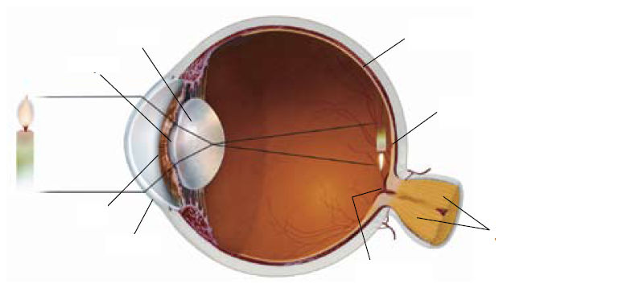
The Structure of the Eye

Slide 59
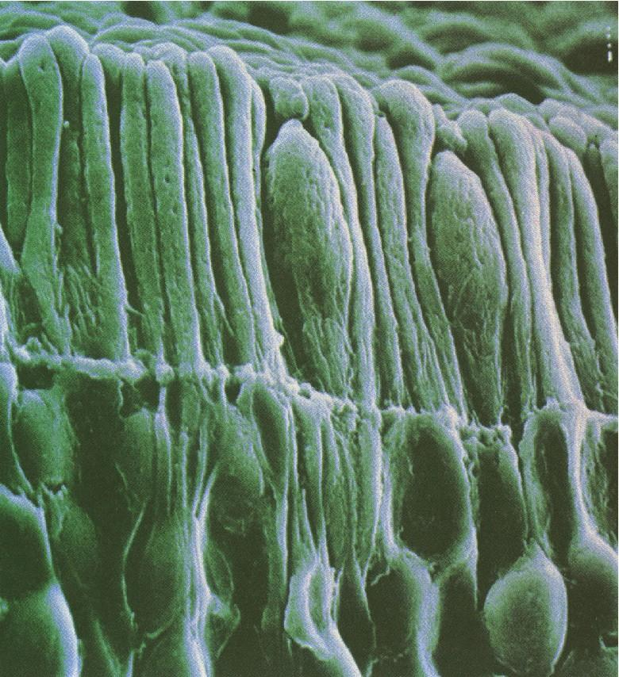

Slide 60
Rods & Cones
Rods
Cones
100 million per eye
5 million per eye
black/white/gray
color
Dark adaptation
Light adaptation
edge of retina (periphery)
center of retina (fovea)

Slide 61
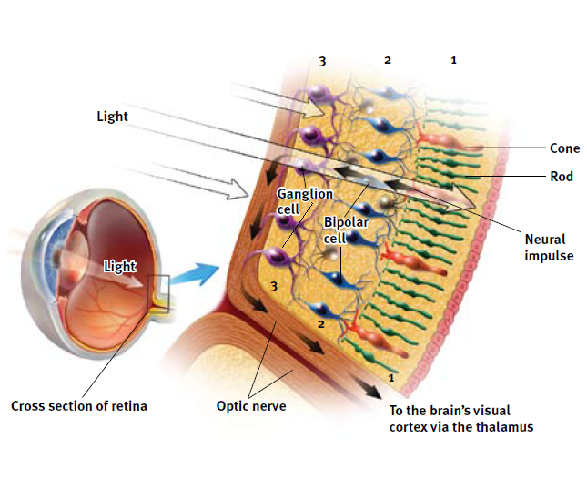
The Retina’s Reaction to Light

Slide 62
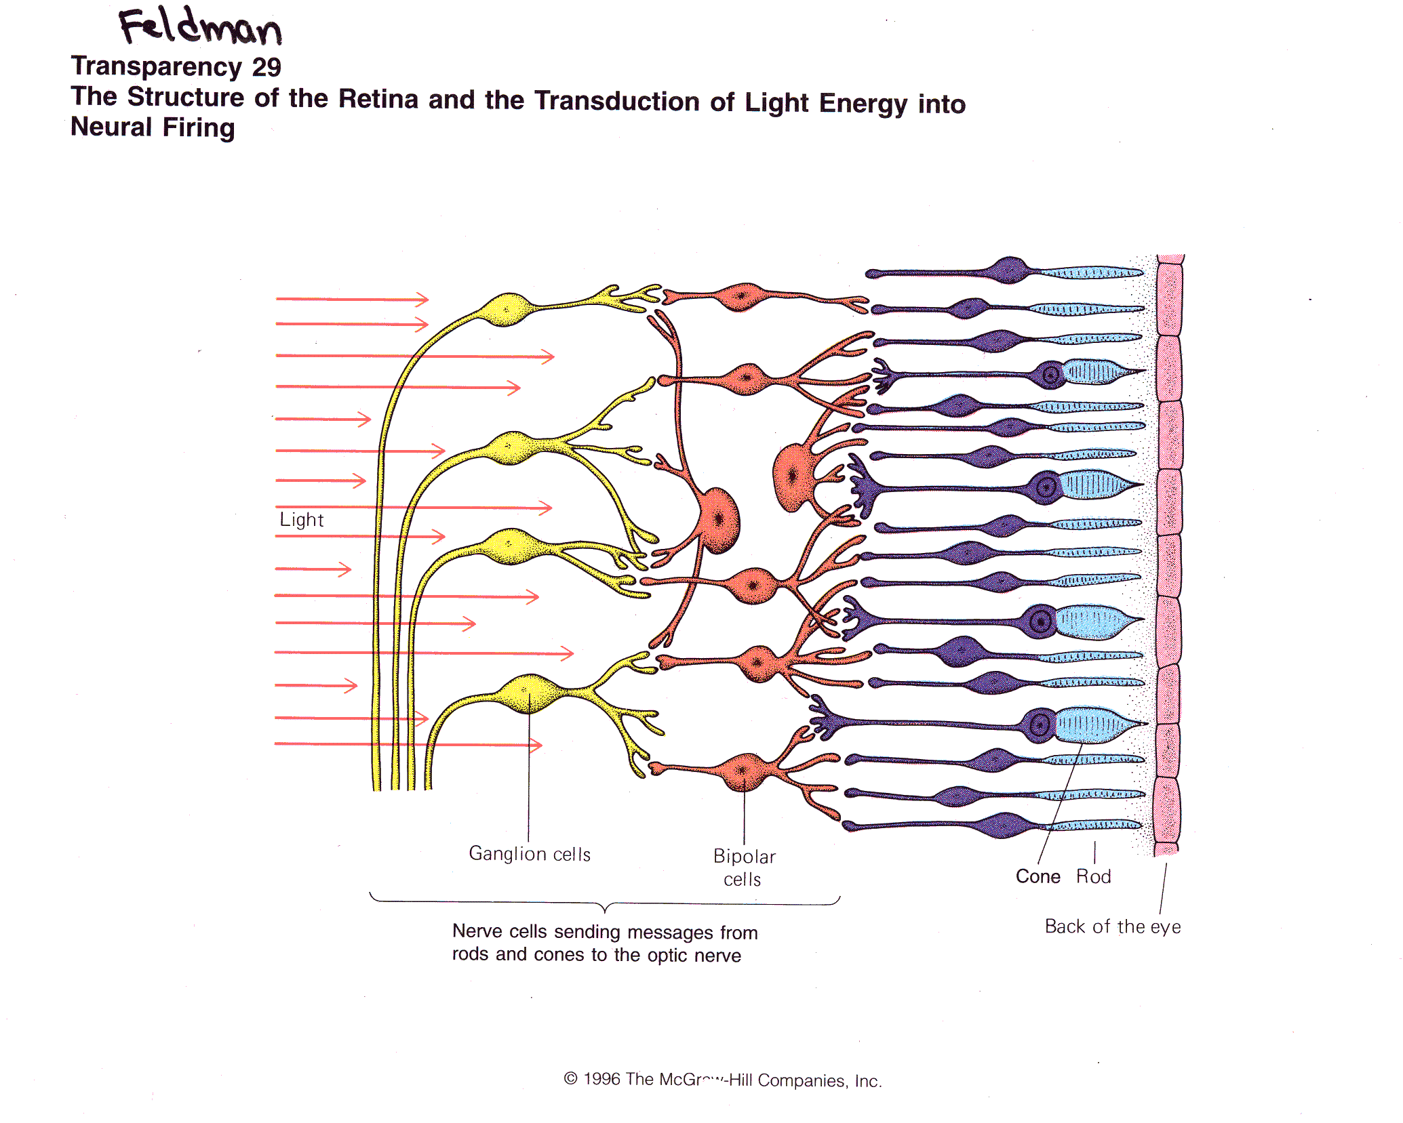
Rods and Cones
SUMMATION

Slide 63
Color Vision
Radiolab: Color
Notes:
Great Radiolab episode. More for your background knowledge than for your students.

Slide 64
Trichromatic Theory
Three types of cones:
Red
Green
Blue
7 million hues, maybe more?

Slide 66
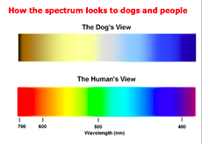

Slide 67
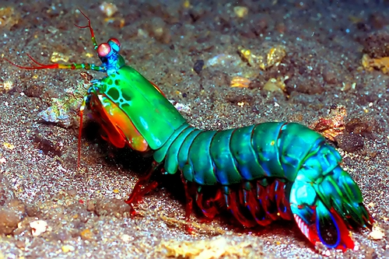
The Mantis Shrimp
(16 different types of cones!)
Notes:
A mantis shrimp has 16 different photoreceptors for color
Note: There is a great Radiolab program called “Colors”

Slide 68
Color Afterimages

Slide 69
Afterimage Effect

Slide 71
Opponent Process
Color Vision Theory:
Humans are equipped with
red/green cells and
blue/yellow cells
While one (for ex., red) is “excited”
the other (green for ex.) is “inhibited”

Slide 77
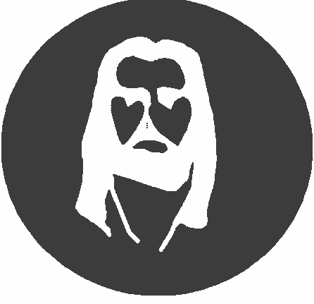
Opponent-Process Theory

Slide 79
Opponent Process
Color Vision Theory:
Humans are equipped with
red/green cells and
blue/yellow cells
While one (for ex., red) is “excited”
the other (green for ex.) is “inhibited”

Slide 80
Feature Detector Cells
Recall our spiral demo? That too was an opponent process demo
Hubel and Wiesel (1981 Nobel Prize)

Slide 81
Color Blindness?

Slide 82
A “Color Blindness” Test

Slide 83
The Auditory System

Slide 84
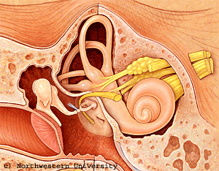

Slide 85
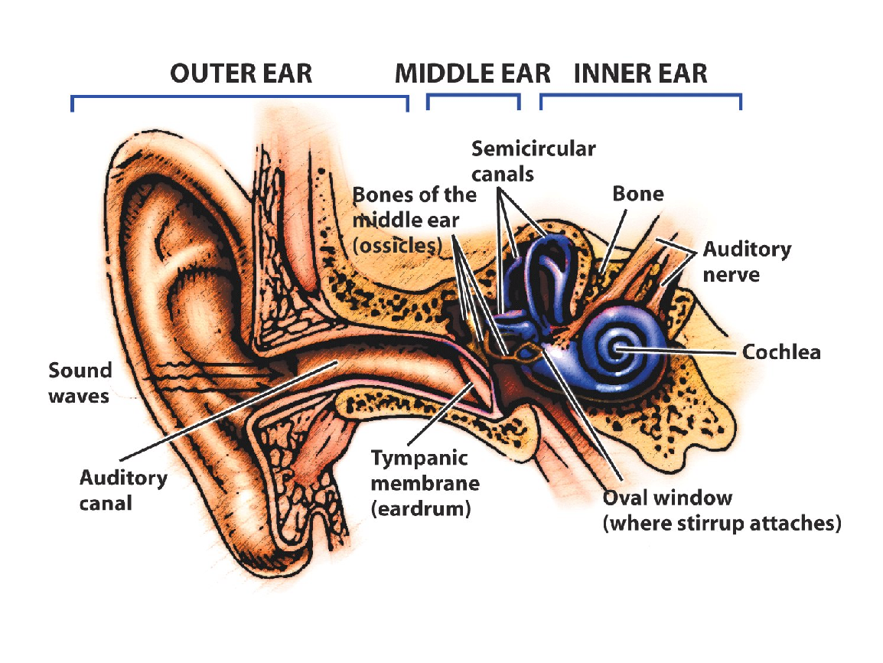

Slide 86
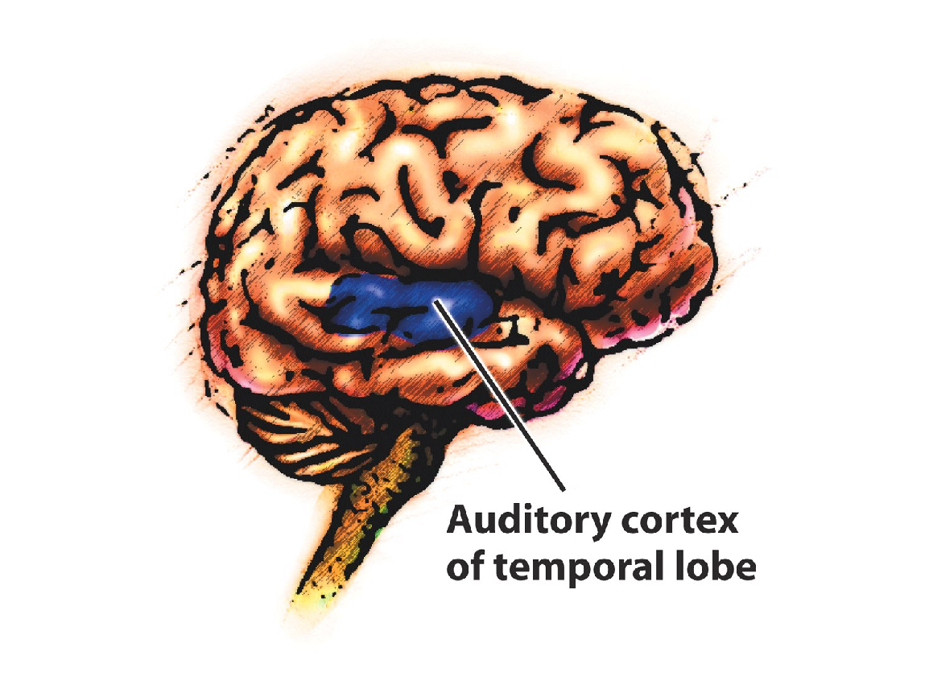
Hair cells transduce the
sound waves into
electrical signals
Those signals travel to
the thalamus, then to the auditory cortex

Slide 87
GUSTATION
a chemical sense
cells regenerate every 7-14 days
supertasters vs. nontasters
Sensory Interaction→ Smell + Taste + Texture = Flavor

