Slide 1
The AP Psychology Exam
Notes:
To help get a sense of how much participants know.

Slide 2
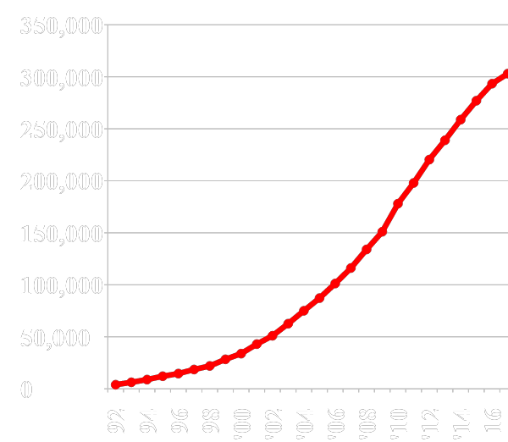
Number of Psychology AP Exam Takers
303,000
(8,500+ schools)
3916

Slide 3
The AP Psychology Exam:
What is the format?
What is the timing?
What is the weighting?
Notes:
To help get a sense of how much participants know.

Slide 4
AP Psychology Exam Overview

Slide 5
Exam Overview
Section | Number and Type of Questions | Weight | Other Info | Time
I | 100 Multiple-choice questions | 66.6% | 5 answer choices | 70 minutes
II | FRQ 1 Concept Application | 33.3% | 7 points | 25 minutes | 50 minutes
 | FRQ 2 Research Design |  | 7 points | 25 minutes

Slide 6
Exam Overview
Section | Number and Type of Questions | Weight | Other Info | Time
I | 100 Multiple-choice questions | 66.6% | 5 answer choices | 70 minutes
II | FRQ 1 Concept Application | 33.3% | 7 points | 25 minutes | 50 minutes
 | FRQ 2 Research Design |  | 7 points | 25 minutes
CED, page 165
The new exam will always follow specific criteria regarding the number of items in certain categories.
Task Types:
Concept understanding: define, explain, and apply concepts, behavior, theories, and perspectives in authentic contexts
Data analysis: analyze and interpret quantitative data
Scientific Investigation: analyze psychological research studies

Slide 7
Exam Weightings
Content, Application, and Practice: MCQ’s
The new exam will always follow specific criteria regarding the number of items in certain categories.
Skill Category | Exam Weighting
1: Concept Understanding | 75-80%
2: Data Analysis | 8-12%
3: Scientific Investigation | 12-16%

Slide 8
Exam Weightings
Unit Weights: MCQ’s
The new exam will always follow specific criteria regarding the number of items in certain categories.
Unit | Unit Title | Exam Weighting
1 | Scientific Foundations | 10-14%
2 | Biological Bases of Behavior | 8-10%
3 | Sensation and Perception | 6-8%
4 | Learning | 7-9%
5 | Cognitive Psychology | 13-17%
6 | Developmental Psychology | 7-9%
7 | Motivation, Emotion, and Personality | 11-15%
8 | Clinical Psychology | 12-16%
9 | Social Psychology | 8-10%

Slide 9
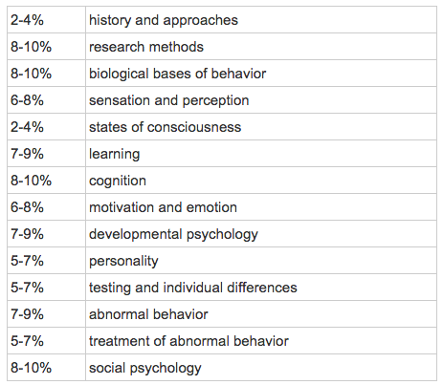
Exam Breakdown
Notes:
This is for the multiple choice only. FRQ’s can be about anything

Slide 10
AP Scoring Scale
5 = Extremely well qualified
4 = Well qualified
3 = Qualified
2 = Possibly qualified
1 = No recommendation

Slide 11
Preparing for the AP Psychology Exam
Perfection is not a reasonable goal
In 2018: 312,000+ took the exam
6 got a perfect 150 pts
Notes:
Based on Trevor Packer tweet 2018

Slide 12
Part 1: Multiple Choice
100 Questions
5 answer choices per question
Questions in random order
70 minutes (42 seconds per question)
2/3 overall exam credit

Slide 13
Part 1: Multiple Choice
Do not panic when you see a question about a concept you’ve never heard of before
Do not leave any questions blank!
There won’t be questions with “all of the above” or “none of the above”

Slide 14
Part 1: Multiple Choice
Released exams (1100+ questions)
1994, 1999, 2012 (publicly available)
2004, 2007 (purchase)
In your “Secure Documents”
2008 (model)
2013-2018 (international exams)
Coming in the Fall: 2019 exam
Notes:
Mention here the new plan by the Board to create a test bank- will be ready in 2019

Slide 15
Multiple Choice Analysis A big thanks to Laura Brandt

Slide 16
Part 2: Free Response
2 equally-weighted questions (7 points)
50 minutes (25 minutes per question)
Time prompt with 10 minutes to go
1/3 overall exam credit
Instructions call for dark blue or black ink
Common error: beginning to write before beginning to think (you must answer the question that is asked!)
Notes:
Starting in 2020, each FRQ will have 7 points so each term is worth 3.57 points in their overall score.

Slide 17
Part 2: FRQ Tips
Read both questions before you write
Do the one you know best first
Do not write an intro/conclusion
This is not a 5 paragraph essay
Always tie answer back to the prompt

Slide 18
How is the exam scored?
Each exam is scored on a 150 point scale
100 points come from the MC
50 points come from the free response items
Each free response is worth 25 points. Because each FRQ has 7 bullets, each bullet is worth 3.57 points to their overall score

Slide 19
How well do you need to do? -from Charlie Blair-Broeker
You’ll need about 112 total points (75%) for a 5
You’ll need about 94 points (63%) for a 4
You’ll need about 78 points (52%) for a 3

Slide 20
How well do you need to do? -from Charlie Blair-Broeker
If you assume half credit on the free response…
You’ll need about 87 MC points for a 5
You’ll need about 69 MC points for a 4
You’ll need about 53 MC points for a 3

Slide 21
2019 Results
5 = 20.2%
4 = 25.4%
3 = 18.8%
2 = 13.7%
1 = 22.0%
N = 314,000+
Mean = 3.14
SD = 1.43
A wealth of exam data is available at
AP Central.

Slide 22
Clarification? Comments?

