Slide 1
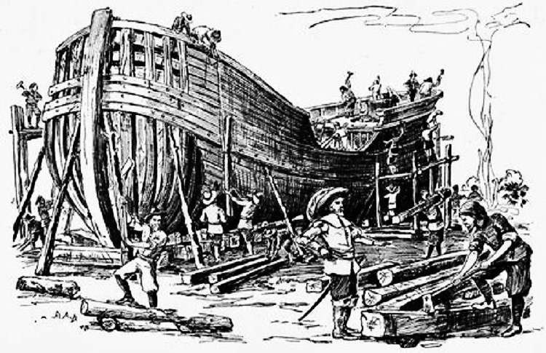
The Commercial North

Slide 2
The Commercial North
How was the North different from the South in the 17th and 18th centuries?
The North had a diversified economy.
Farmers grew a variety of crops
Manufacturing and fishing industries thrived
The North was wealthier
Larger cities
Slavery was less harsh/ fewer slaves in the North
Like the South, women had few legal rights

Slide 3
The Commercial North
How was the North different from the South in the 17th and 18th centuries?
Southerners depended on cash crops
The South depended more on slaves
The South was mainly rural and less prosperous

Slide 4
The Commercial North

Slide 5
The Commercial North
The Enlightenment
The Enlightenment was an intellectual and political movement based on reason and science
Key figures in the American Enlightenment included Ben Franklin and Thomas Jefferson
The Enlightenment encouraged Americans to read, think for themselves, and question the authority of the British Monarchy.

Slide 6
The Commercial North
The Great Awakening
The Great Awakening was a religious movement that emphasized the dangers of sin and the importance of church and God
Jonathan Edwards was a key figure in this movement
Preachers traveled from village to village encouraging people to acknowledge their sins and feel God’s love.
This movement strengthened to role of the church and also caused many to challenge the authority of the British monarchy.

