Slide 1
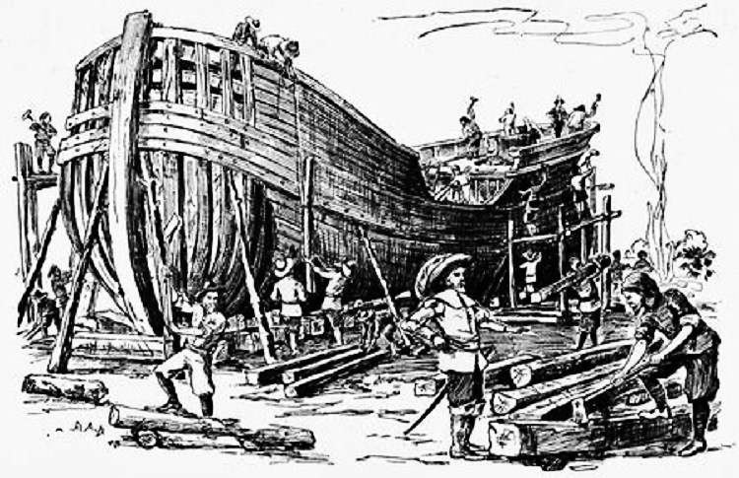
The Commercial North

Slide 2
The Commercial North
How was the North different from the South in the 17th and 18th centuries?
The North had a ___________________ economy.
Farmers grew a variety of crops
__________________ and fishing industries thrived
The North was _____________________
Larger ______________
Slavery was less harsh/ fewer slaves in the ____________
Like the South, women had few legal rights

Slide 3
The Commercial North
How was the North different from the South in the 17th and 18th centuries?
Southerners depended on ___________________
The South depended more on _____________
The South was mainly rural and _________ prosperous

Slide 4
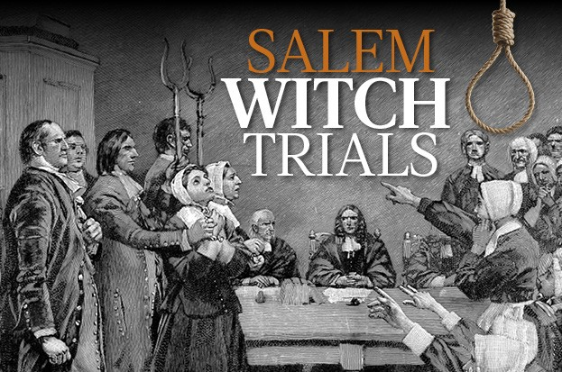
The Commercial North

Slide 5
The Commercial North
The Enlightenment
________________________was an intellectual and political movement based on reason and science
Key figures in the American Enlightenment included Ben Franklin and Thomas Jefferson
The Enlightenment encouraged Americans to read, think for themselves, and question the authority of the British Monarchy.

Slide 6
The Commercial North
The Great Awakening
_____________________________was a religious movement that emphasized the dangers of sin and the importance of church and God
Jonathan Edwards was a key figure in this movement
Preachers traveled from village to village encouraging people to acknowledge their sins and feel God’s love.
This movement strengthened to role of the church and also caused many to challenge the authority of the British monarchy.

