Slide 1
The First Years of the American Revolutionary War

Slide 2
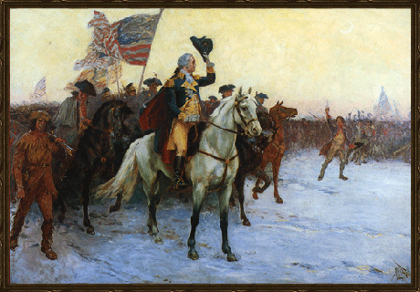
The Evacuation of Boston
For nine months after the Battle of Bunker Hill, the British Army remained in ________________.
In July 1775 _________ ___________________ arrived in Boston and began training the Continental Army.

Slide 3
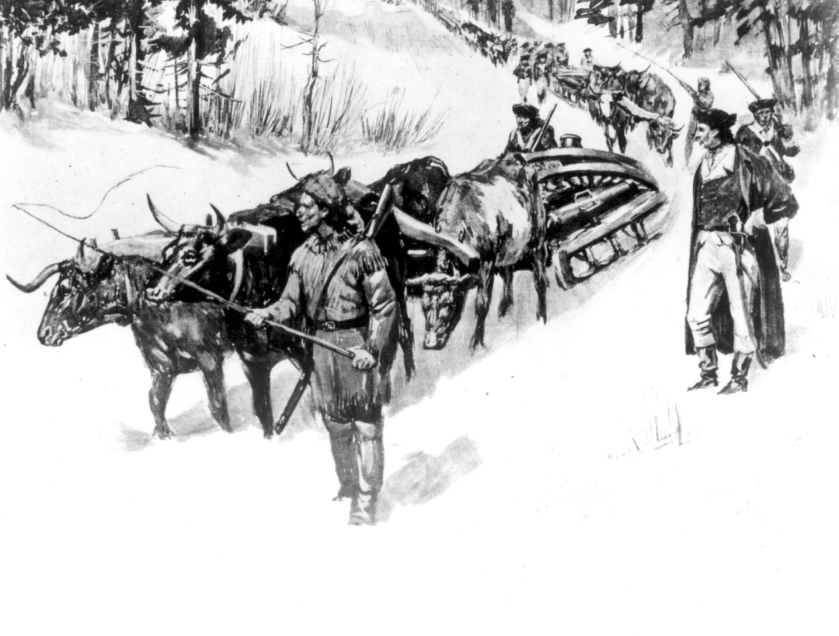
The Evacuation of Boston
In January 1776, General Henry Knox came to Boston with large cannons his Patriots had hauled from ______________________.
Washington used these guns to threaten British forces and British ships in the _________________

Slide 4
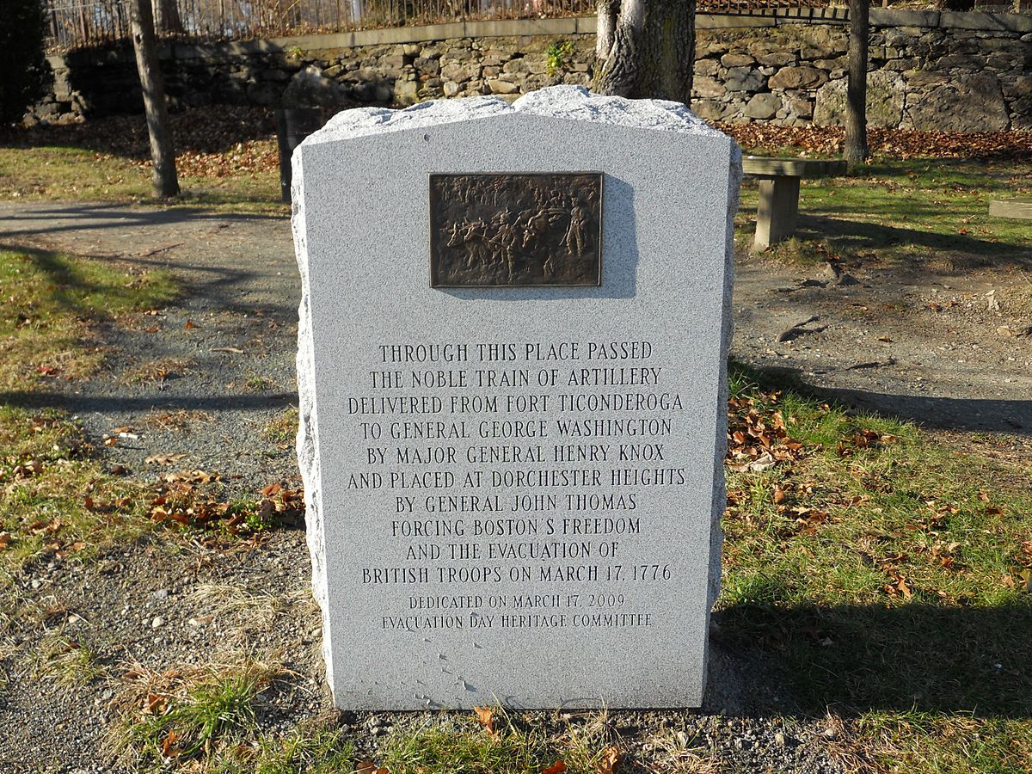

Slide 5
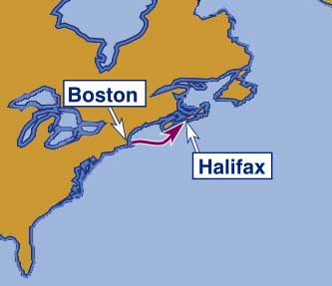
The Evacuation of Boston
Realizing they could no longer ______________ their position, the British fled to _____________ to regroup and plan the next phase of the war.

Slide 6
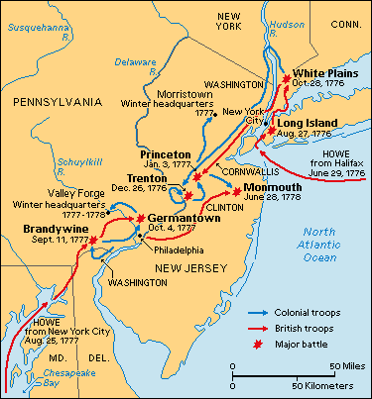
British Strategy to win the Revolutionary War
Realizing that the Americans were strongest in ____________________, the British decided to focus on fighting in the _____ _____________ colonies (NY, NJ, PA) where there were many ________________ (people loyal to the King).

Slide 7
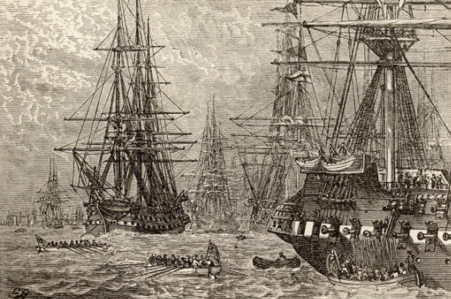
British Strategy to win the Revolutionary War
In the summer of 1776, the British Army invaded _____ ________________ and almost wiped out Washington’s army.
The British used German mercenaries called _________________ to help them defeat the Americans.

Slide 8
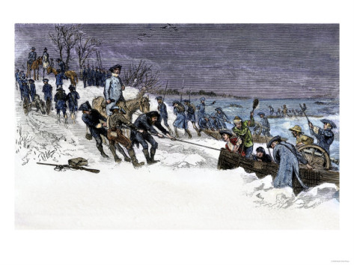
British Strategy to win the Revolutionary War
By October the British had forced the Continental Army out of __________ and into ______________________.
By the __________ of ____ Washington and his army were on the verge of collapse.

Slide 9
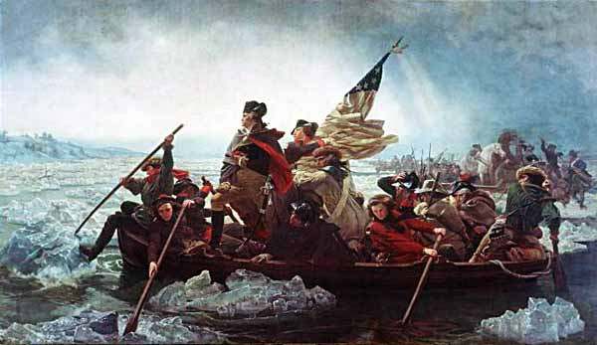
THE CROSSING

