Slide 1
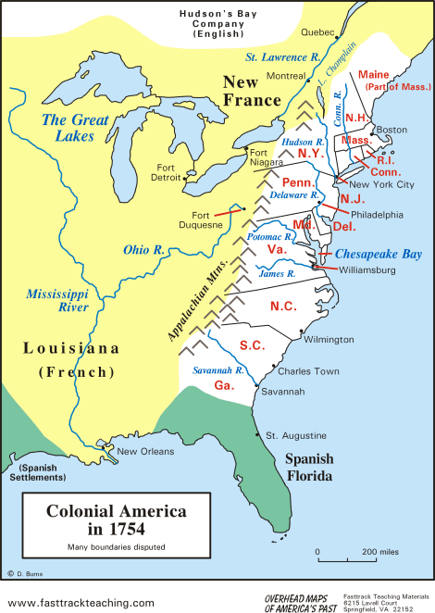
The French and Indian War
Background
In 1754, Great Britain had 13 established colonies in North America.
These colonies sent food and raw materials to Great Britain and bought finished goods from them.

Slide 2
The French and Indian War
Background
American colonies accepted British authority and Britain left the colonies alone… a policy know as salutary neglect.
France also had land claims in North America and benefited from the fur trade with Native Americans.
France and Britain were big rivals.

Slide 3
The French and Indian War
Causes of the French and Indian War
Land in the British colonies was getting scarce, so colonists began to move west
The rivalry for land led to the French and Indian War (1754-1763). Great Britain and the Americans fought the French and the Indians.
The British colonists fought so they would have access to land in the West.
The Native Americans fought to prevent the colonists from taking their land.

Slide 4
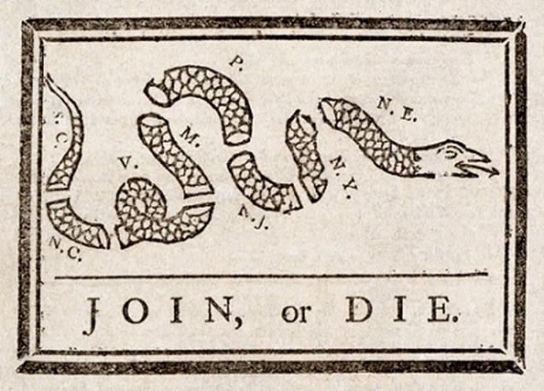
The French and Indian War
Fighting the French and Indian War
The Albany Plan of Union was an attempt to unite the colonies against the French; colonists, afraid of being governed by a central government, rejected the plan.
Britain and the colonists lost several battles early in the war.
Later, Britain gained the upper hand and defeated France. William Pitt (British Prime Minister) raised taxes and borrowed huge amounts of $ to pay for this expensive war.

Slide 5
The French and Indian War

Slide 6
The French and Indian War
The Effects of the War
The Treaty of Paris ended the war. Britain got Canada and all land east of the Mississippi River.
The war caused tensions between Britain and the colonies:
The colonists were shocked and disappointed with Britain’s strategy and fighting style
The British felt the colonies did not provide enough support and were ungrateful
Britain was in debt after the war. They began to look to the colonies as a source of revenue.

