Slide 1
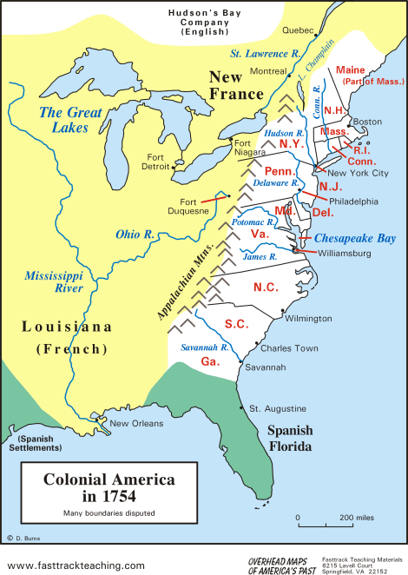
The French and Indian War
Background
In 1754, ___________had 13 established colonies in North America.
These colonies sent food and ________________to Great Britain and bought finished goods from them.

Slide 2
The French and Indian War
Background
American colonies accepted British authority and Britain left the colonies alone… a policy know as___________________________.
________________also had land claims in North America and benefited from the ________ trade with Native Americans.
France and Britain were big rivals.

Slide 3
The French and Indian War
Causes of the French and Indian War
______________ in the British colonies was getting scarce, so colonists began to move west
The rivalry for land led to the French and Indian War (1754-1763). ____________________and the Americans fought the French and the _____________.
The British colonists fought so they would have access to land in the ______________.
The ________________________fought to prevent the colonists from taking their land.

Slide 4
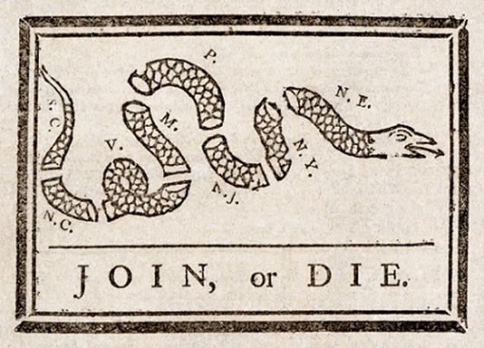
The French and Indian War
Fighting the French and Indian War
The __________________ __________was an attempt to unite the colonies against the French; colonists, afraid of being governed by a central government, rejected the plan.
Britain and the colonists lost several battles early in the war.
Later, Britain gained the upper hand and defeated France. William Pitt (British Prime Minister) raised _________and borrowed huge amounts of $ to pay for this ______________ war.

Slide 5
The French and Indian War

Slide 6
The French and Indian War
The Effects of the War
The _____________________ ended the war. Britain got Canada and all land east of the Mississippi River.
The war caused tensions between Britain and the colonies:
The colonists were shocked and disappointed with Britain’s strategy and fighting style
The British felt the colonies did not provide enough support and were ungrateful
Britain was in ___________after the war. They began to look to the colonies as a source of _____________ ($).

