Slide 1
The Stirrings of Rebellion

Slide 2
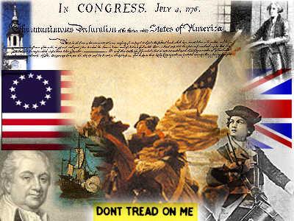
Main Idea
Conflict between Great Britain and American colonies grew over issues of taxation, representation, and liberty

Slide 3
Vocabulary: Boycott
Organized refusal to buy certain products or use certain services.

Slide 4
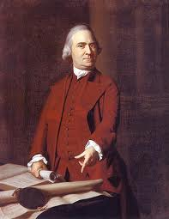
Key People: Sam Adams
One of the founders of the Sons of Liberty
A powerful and influential political activist
(He stirred things up)

Slide 5
Key People: King George III
King of England during the American Revolution

Slide 6
Vocabulary: Boston Massacre
March 5, 1770 – conflict between Colonists and British soldiers in which five colonists are killed

Slide 7
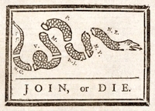
Vocabulary: Committee of Correspondence
A network of communication set up in Massachusetts and Virginia to inform other colonies of ways that Britain threatened colonial rights

Slide 8
Vocabulary: Boston Tea Party
December 16, 1773 – Protest against increased tea prices in which colonists dumped British tea into Boston Harbor
114 chests were thrown into the harbor. (over $1 million worth of tea)

Slide 9
The Stamp Act
The British Parliament passed the Stamp Act in 1765 in order to…
increase revenue from the colonies to pay debts from the French and Indian War
Colonists responded to the act by…
demonstrating, protesting, and boycotting British goods; holding the Stamp Act Congress; and writing the Declaration of Rights and Grievances

Slide 10
The Stamp Act
Britain responded to the colonists by…
Repealing the Stamp Act and issuing the Declaratory Act.

Slide 11
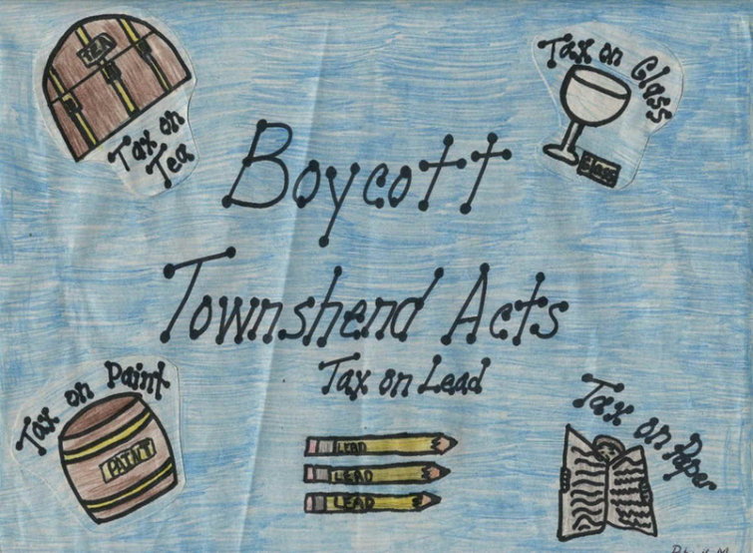
The Townshend Act
The British Parliament passed the Townshend Act (1767) in order to…
increase revenue from the colonies
Colonists responded to the act by…
demonstrating, protesting and boycotting British goods

Slide 12
The Townshend Act
Britain responded to the colonists by…
Enforcing the act and stationing troops in Boston

Slide 14
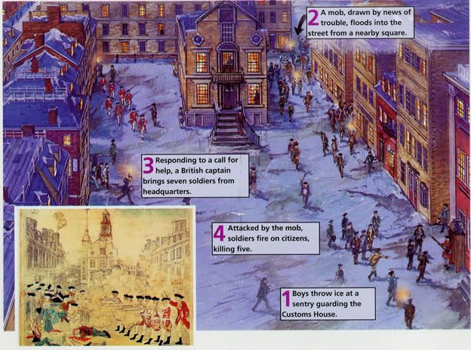
The Boston Massacre, 1770

Slide 15
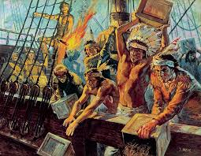
The Tea Act
The British Parliament passed the Tea Act (1773) in order to…
save the East India Company from bankruptcy
Colonists responded to the Act by…
Holding the Boston Tea Party and dumping 18,000 pounds of East India tea into the harbor

Slide 16
The Tea Act
Britain responded to the colonists by…
Passing the Intolerable Acts

Slide 17
The Intolerable Acts
The British Parliament passed the Intolerable Acts (1774) in order…
to punish the colonists for the Boston Tea Party and tighten control over Massachusetts.
Colonists responded to the act by…
holding the First Continental Congress and preparing the military.

Slide 18
The Intolerable Acts
Britain responded to the colonists by…
marching troops to Concord to seize illegal weapons and engaging in battle

Slide 19
Paul Revere

