Slide 1
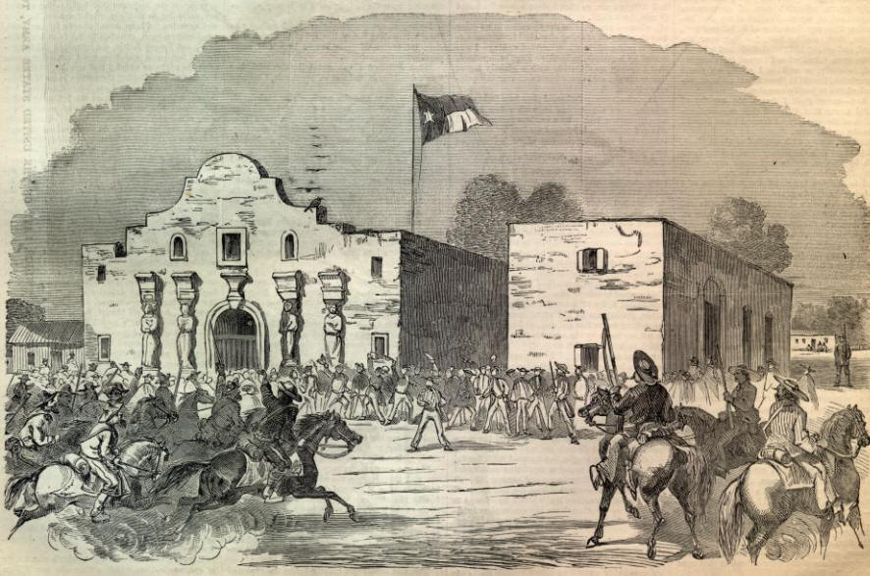
The Texas War for Independence

Slide 2
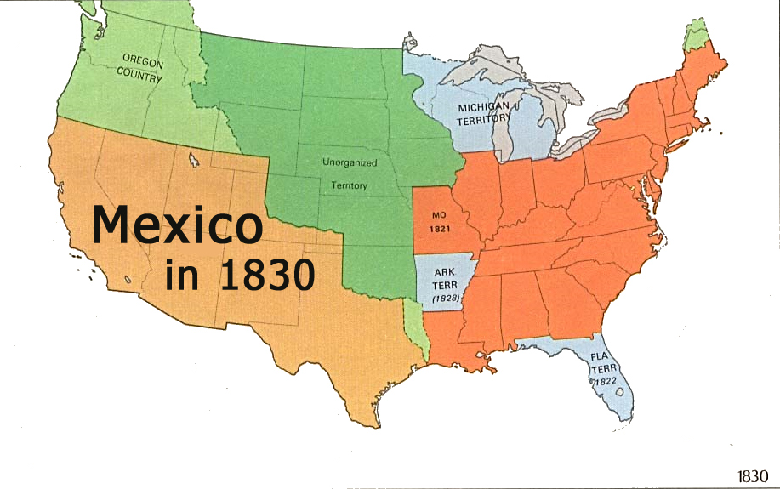
Hispanic North America
In the late 1700s, Mexico was a Spanish colony and included what is now Texas, New Mexico, and California.
Missions and presidios (forts) thrived in California but remained small in New Mexico and Texas due to harsh conditions and Native American attacks.

Slide 3
The Texas War for Independence
In 1821 Mexico won its independence from Spain; Mexico’s northern areas traded more with the US than with Mexico.
In 1822 Stephen Austin got permission from Mexico to found a colony in Texas; the colony grew quickly
By 1835, 35,000 Americans lived in Texas and began demanding political control.

Slide 4
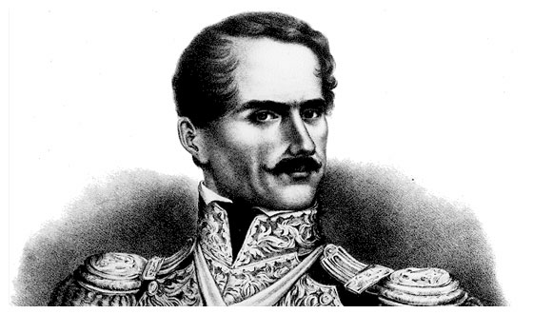
The Texas War for Independence
In 1833, General Santa Anna declared himself dictator of Mexico and stripped the Texians of their independence.

Slide 5
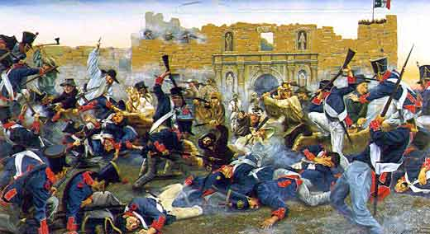
The Texas War for Independence
In March 1836, the Texians made a brave stand against Santa Anna at the Alamo (a fortress) and were slaughtered.
“Remember the Alamo” became a battle cry later in the war.

Slide 6
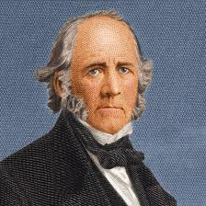
The Texas War for Independence
After the Alamo, Santa Anna had the Texians on the run; when the end seemed near, Texian troops regrouped and defeated Santa Anna at San Jacinto.
The Texians won their independence and Sam Houston became their first president.
Americans continued to push west and this led to tension between the US and Mexico.

