Slide 1
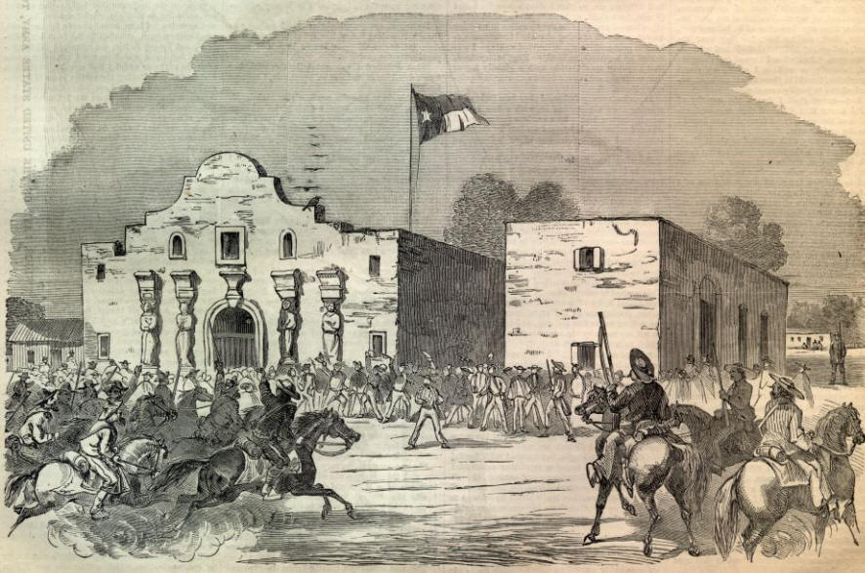
The Texas War for Independence

Slide 2
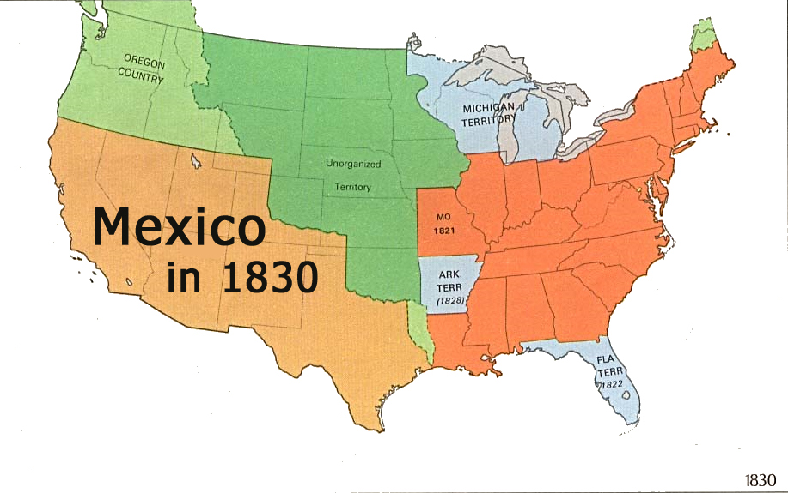
Hispanic North America
In the late 1700s, Mexico was a ___________colony and included what is now Texas, New Mexico, and California.
___________ and presidios (forts) thrived in California but remained small in New Mexico and Texas due to harsh conditions and Native American attacks.

Slide 3
The Texas War for Independence
In 1821 Mexico won its ____________ from Spain; Mexico’s northern areas traded more with the US than with Mexico.
In 1822 _______________________got permission from Mexico to found a colony in Texas; the colony grew quickly
By 1835, ____________ Americans lived in Texas and began demanding political control.

Slide 4
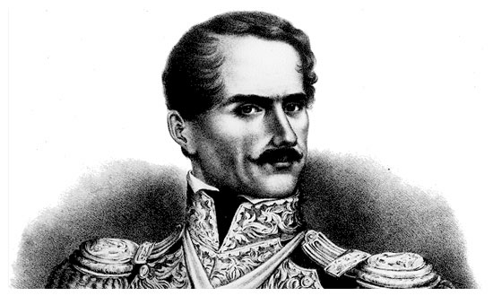
The Texas War for Independence
In 1833, ______________________ declared himself dictator of Mexico and stripped the Texians of their independence.

Slide 5
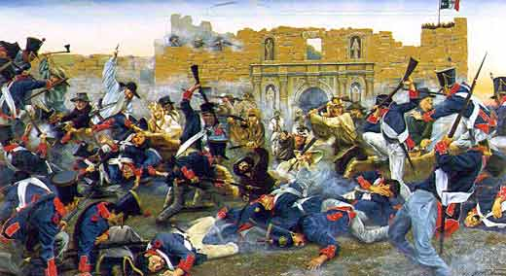
The Texas War for Independence
In March 1836, the Texians made a brave stand against Santa Anna at the _________ (a fortress) and were slaughtered.
“___________________” became a battle cry later in the war.

Slide 6
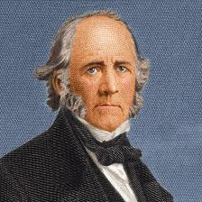
The Texas War for Independence
After the Alamo, Santa Anna had the Texians on the run; when the end seemed near, Texian troops regrouped and ____________ Santa Anna at San Jacinto.
The Texians won their ________________ and Sam Houston became their first president.
Americans continued to push west and this led to ______________ between the US and Mexico.

