Slide 1
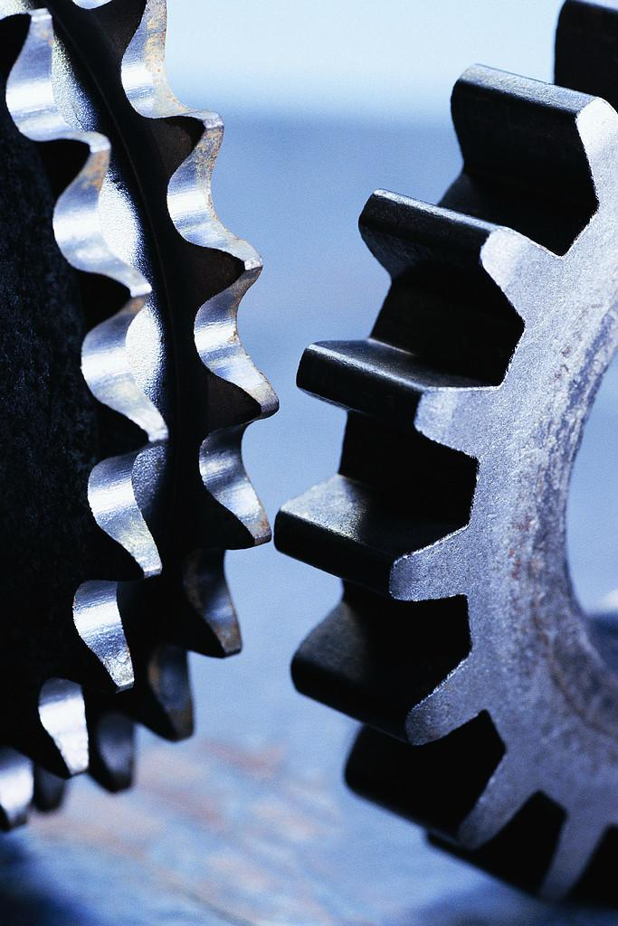
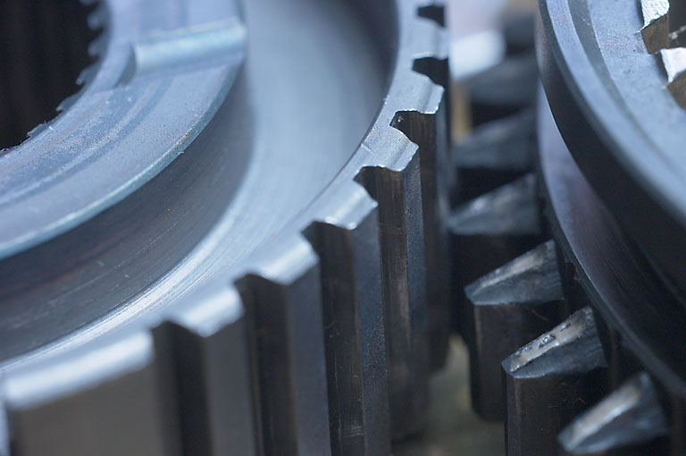
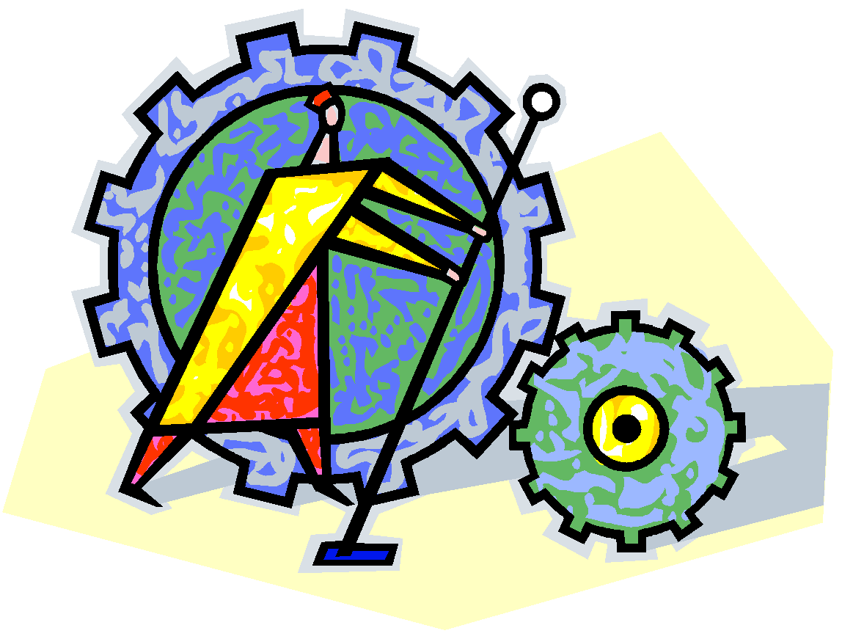
“Cognitive” or “Cognition”
mnemonic:
picture the
“cogs” clicking
in your brain as you
think

Slide 2
COGNITION Part II

Slide 3
Thought and Language

Slide 4
Examples of not carefully thinking things through

Slide 5
Sign at a second hand store: “We exchange anything: bicycles,
washing machines, etc. - Why not bring your wife along and get
a wonderful bargain!!”
On Sears hair dryer: “Do Not Use While Sleeping”
On a bar of ‘Dial’ soap: “Use like regular soap”
On the box containing a shower cap provided by hotels: “Fits
One Head”
On a child’s “Superman” costume: “Wearing of this garment
does not enable you to fly”

Slide 6
Pitt Univ. basketball player: “I’m going to graduate on time,
no matter how long it takes”
Commentator Joe Theismann: “Nobody in football should be called a genius; a genius is a guy like Norman Einstein”
Sign on baby changing table in public restroom:
“WARNING – Remove baby before closing”

Slide 7
Examples of not carefully thinking things through

Slide 8
Darwin Award winners:
*Juggling live hand grenades
*Lawyer crashing through window and
falling 24 stories to his death in
attempt to show the window
was unbreakable

Slide 9
Darwin Award
OF THE YEAR for 2007:
Man dies of alcohol poisoning after
having two 1.5 liter bottles of wine
injected into his anus

Slide 10
“Darwin Award” examples:
Honorable Mention: “at risk”
“Lawnchair Larry”

Slide 11
Divergent vs. Convergent Thinking
Incubation
Metacognition

Slide 12
PROBLEM SOLVING

Slide 13
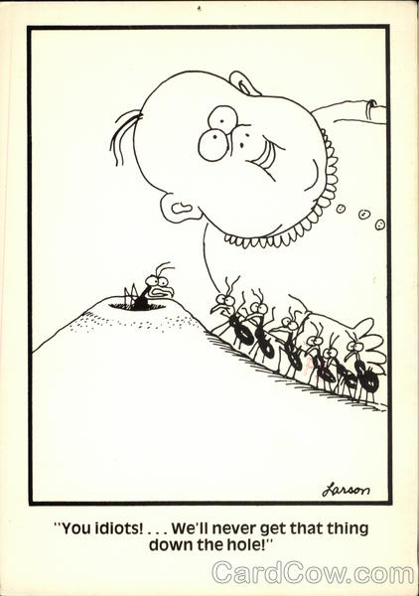

Slide 14
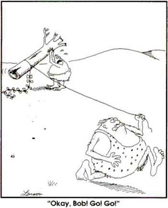

Slide 15
In problem solving,
there’s a tendency to get
trapped in mental sets
(fixating on one way to approach a problem because
it has worked in the past)
Sometimes people assume rules
and restrictions that don’t
actually exist:
“implicit assumptions”
Notes:
15

Slide 16
O O O
O O O
O O O

Slide 17
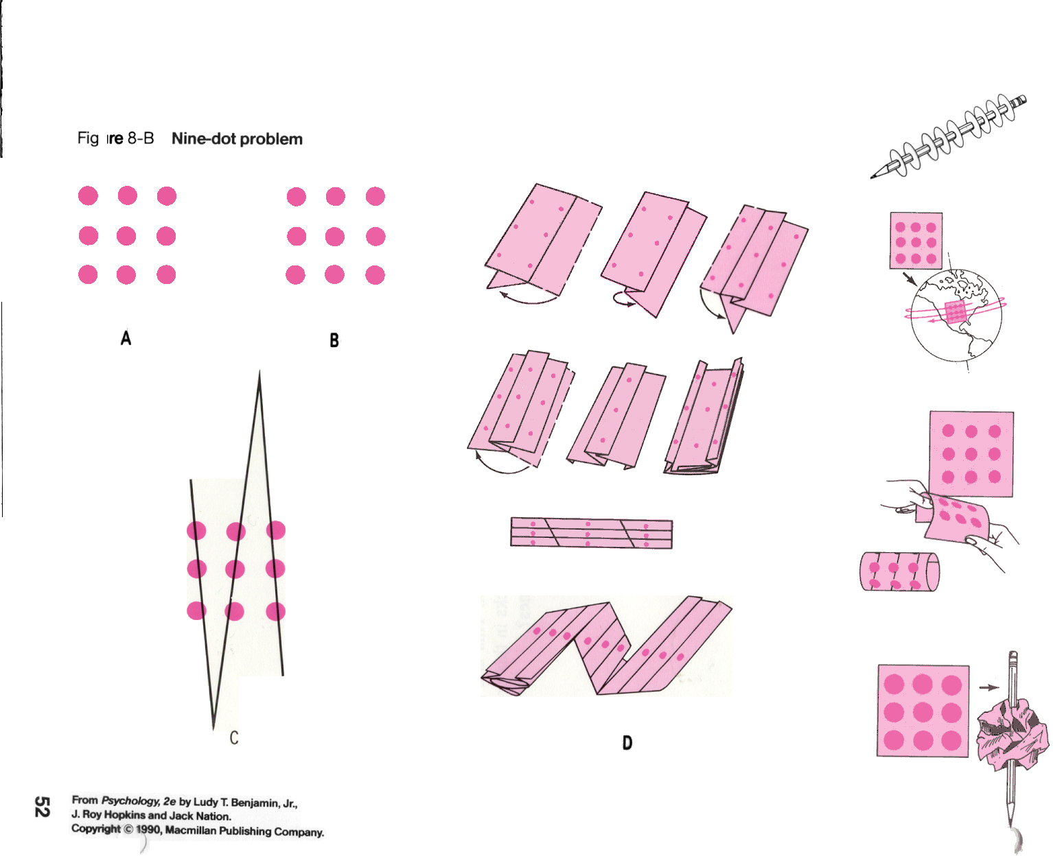

Slide 18
Mental Sets
Explain the pattern for this set of numbers
8, 5, 4, 1, 7, 6, 3, 2, 0

Slide 19
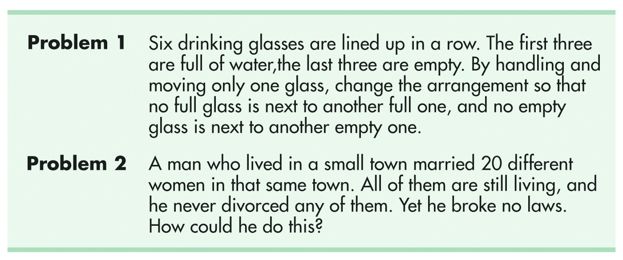

Slide 21
Functional Fixedness is a kind of mental set
-the tendency to perceive an item only in terms of its most common use

Slide 22
How many uses for a potato can you come up with?
…overcoming functional fixedness

Slide 23
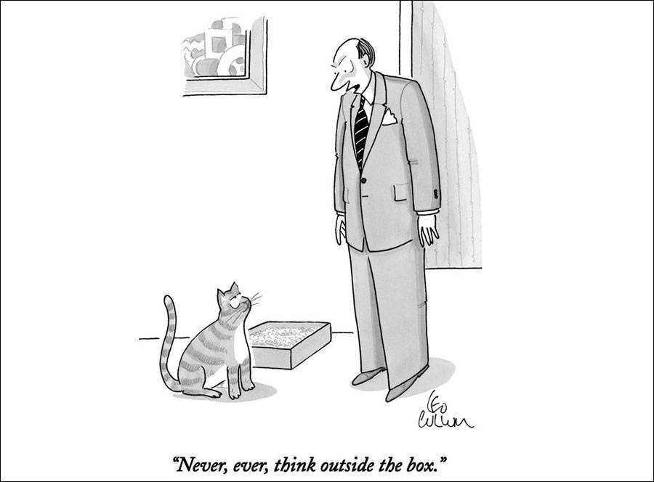

Slide 24
Approaches to Problem Solving

Slide 25
ALGORITHMS AND HEURISTICS
A step by step process that guarantees
a solution, but can be time consuming
Short cuts, or “rules of thumb”,
in problem solving
What’s 17 X 10?
What’s 12 x 12?
What’s 12 x 13?
Letter jumbles:
pandem?
REARPOOT?
SLPOCYHYOG?
diagnosing
disorders?
shopping example OR fixing a car

Slide 26
Heuristics allow for fast thinking/decision making to keep up w/fast paced lives- we need to instantly assess threats/dangers

Slide 27
HEURISTICS
1. Which is more common?
‘k’ as the first letter of words,
or ‘k’ as the 3rd letter of words?
2. A man is 5’4”, slim, wears glasses, likes to
attend poetry readings; is he more likely to
be a truck driver or an Ivy League psychology
professor?

Slide 28
3- Which is further north: Philadelphia
or Rome?
4- Which is further west:
Reno, NV or
Los Angeles, CA?
5- Which is further north, Montreal or Seattle?

Slide 29
Steve is very shy and withdrawn. He is very helpful, but has little interest in people. A meek and tidy soul, he has a need for order and structure and a passion for detail. Is Steve more likely to be a salesperson or librarian?

Slide 30
Heuristic Errors:
Identified by Daniel Kahneman and Amos Tversky
The representativeness heuristic: we base decisions on the
prototype or schema that comes into our head; in essence, relying
on stereotypical pictures of what is “most representative”
of the thing we’ve been asked to think about
(example: doctors misdiagnosing)
The availability heuristic: we rely on the first
thing that comes into our mind; what is
most readily available to us
(example: more likely to die in terror attack or from
the flu?)

Slide 31
You’re 170 times more likely to die in a
car than you are in a plane
You’re 400 times more likely to die in your
bathtub than in a shark attack
You’re 16 times more likely to be killed in a dog attack
than a shark attack (2010)

Slide 32
Daniel Kahneman and Amos Tversky (1982)
Ask a group of randomly selected physicians if
they would recommend a medical procedure
that would result in a 7% mortality rate over five years
They also ask a second, randomly selected group
of physicians if they’d be willing to recommend
a medical procedure that would result in a 93%
survival rate over five years
The second group was much more likely
to recommend the procedure

Slide 33
Bias and other thinking issues

Slide 34
Recall these?
confirmation bias →belief perseverance
illusion of control
self-fulfilling prophecy
self-serving bias
self-handicapping
hindsight bias

Slide 35
Confirmation Bias
We seek evidence that is consistent
with our existing beliefs
Politics
Coaches and tryouts
Teachers talking about class lists (also a self-fulfilling prophecy?)

Slide 36
Belief Perseverance A tendency to cling to our original beliefs even in the face of contradictory evidence
(Global warming? Obama Citizenship? Racist views? Belief in Jim Jones?)

Slide 37
Hindsight Bias?
“I knew it all along!”
We like to reframe our understanding
of the past in terms of
what we know now!

Slide 38
Self-Fulfilling Prophecy (our expectations about others or ourselves can actually make those “predictions” come true)
Reading groups
Leveling
Having an older sibling that attended the same school
Knowing your IQ
Being diagnosed with ADHD at a young age

Slide 39
The Self-Serving Bias
Tendency to attribute success to
our internal characteristics while
blaming failures on external causes
(“If I succeed, it was me;
if I fail, it was the situation”)
Also linked to the “better than average effect”

Slide 40
Self-Handicapping
(creating conditions for failure beforehand to protect
self-esteem against the possibility of later failure)
“I didn’t study for the test…”
Sporting performances
Teacher doing artwork on the board?
A double payoff?

Slide 41
End of
“Thinking”
in “Thought and Language” unit

