Slide 1
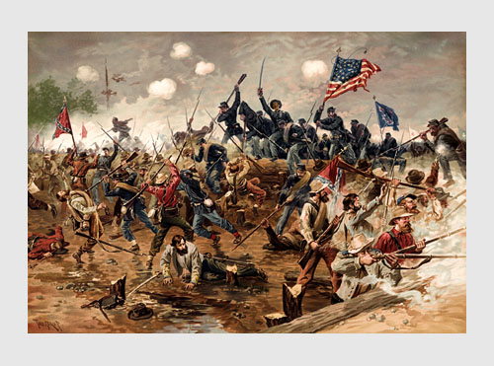
Timeline of Events Leading to the Civil War

Slide 2
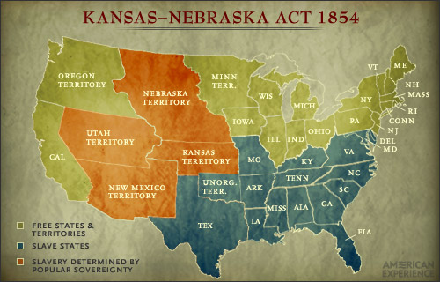

Slide 3
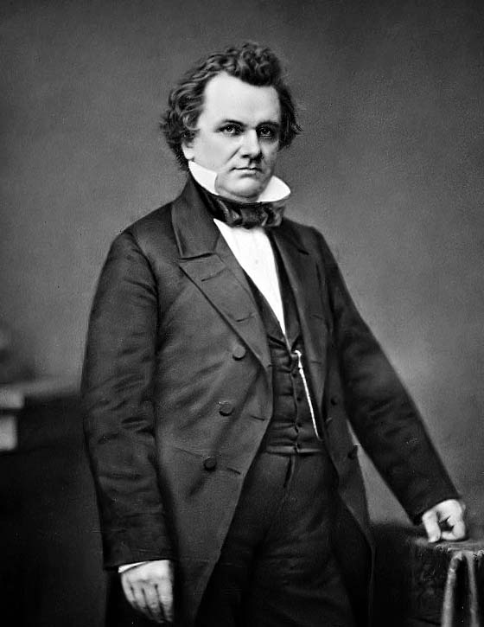
Kansas Nebraska Act 1854
Stephen Douglas (Senator from Illinois) proposed an act that would make Kansas and Nebraska states. The sooner this happened, the sooner railroads connecting Chicago to the west could be built.
This would help Douglas in his bid to become President.
He supported the idea of popular sovereignty which would allow residents of each territory decided whether or not to allow slavery in their land.

Slide 4
Bleeding Kansas 1856
Proslavery and anti-slavery groups began moving to Kansas to vote on the slavery issue.
Tensions escalated between the groups.
Led by John Brown, several free-soilers murdered proslavery men with swords.

Slide 5
Bleeding Sumner 1856
Senator Charles Sumner of Massachusetts, an abolitionist, made a fiery speech titled “The Crimes Against Kansas” in which he insulted a southern senator.
Two days later, the nephew of the senator attacked Sumner, beating him with his cane.

Slide 6
Dred Scott Decision 1857
Dred Scott, a slave, filed a lawsuit against his owner stating that because he had lived in free states with his owner, he should be free.
The Supreme Court ruled that because he was a slave, he had no right to sue in court.
The Court also ruled that slaves are property and Congress could not deprive people of their property.

Slide 7
Lincoln Douglas Debates 1858
Stephen Douglas and Abraham Lincoln ran for Senator of Illinois in 1858.
They debated each other; these debates highlighted the differences between the two candidates
The debates exposed the fundamental arguments between popular sovereignty and minority rights.
Douglas won the election.

Slide 8
The John Brown Raid 1859
John Brown and 21 followers attacked an arsenal at Harper’s Ferry Virginia.
They wanted to lead an uprising of slaves that would overthrow southern governments
Brown was defeated, captured, and executed for his crime.
This raid deepened the division, distrust, and anger between the North and South

Slide 9
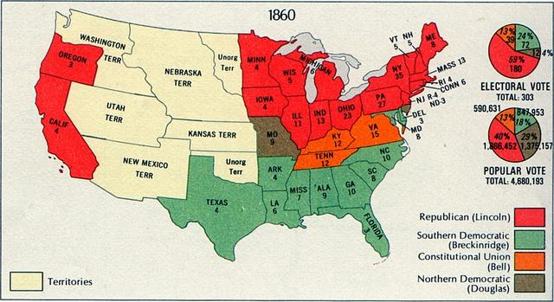
Election of 1860
Four candidates ran for President in 1860; each one represented a different party or region.
Ultimately, Abraham Lincoln won the election making states in the South furious. He won without a single southern electoral vote.

Slide 10
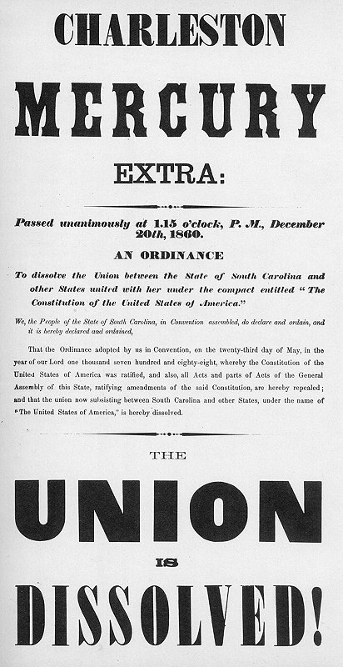
The Lower South Secedes 1860-1861
Southerners outraged over the election results began seceding from the United States.

Slide 11
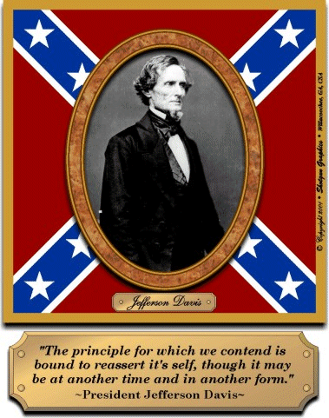
The Confederate States of America 1861
In 1861 the Confederate States of America were formed.
They chose Jefferson Davis to be their president.

Slide 12
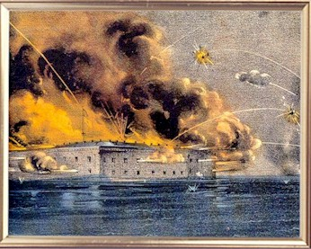
The Bombing of Fort Sumter 1861
After the CSA was formed, Americans turned their attention to Fort Sumter in South Carolina
Lincoln did not acknowledge the CSA and sent a ship to resupply the fort.
The ship was turned away and the fort was bombed into submission. The American Civil War had Begun.

