Slide 6
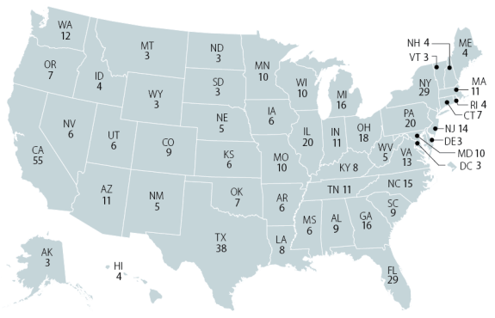

Slide 18
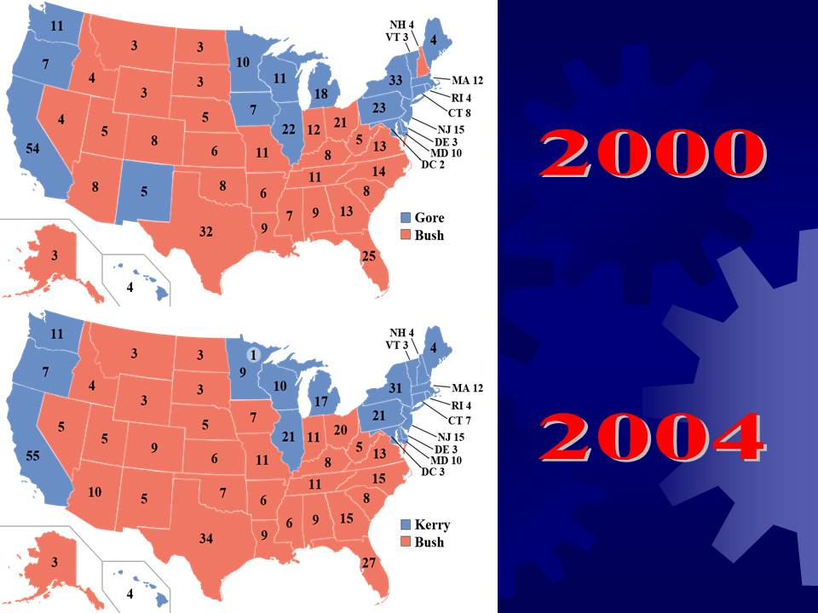

Slide 23
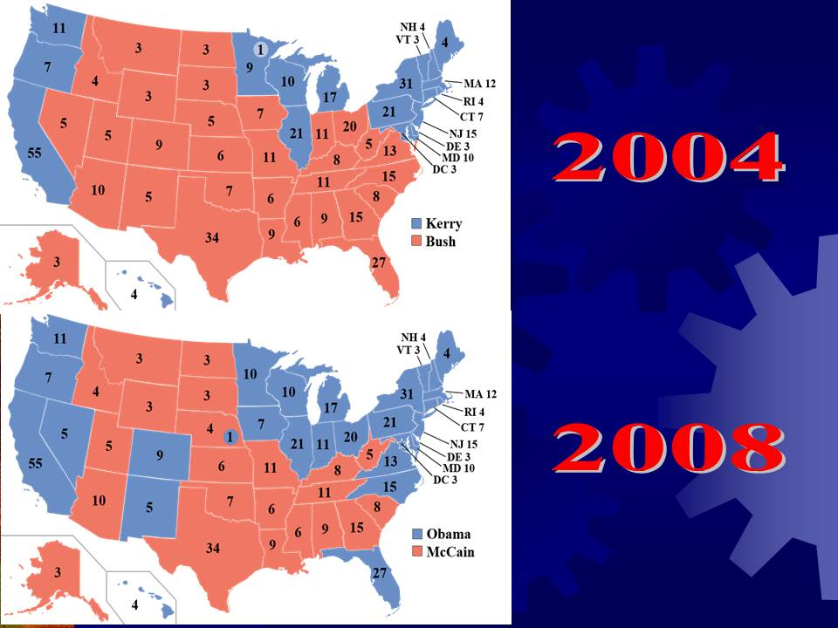

Slide 30
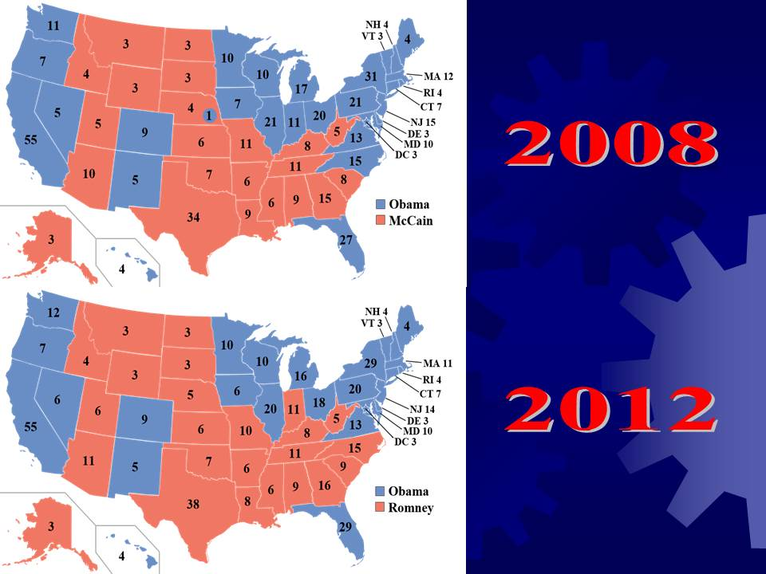

Slide 32
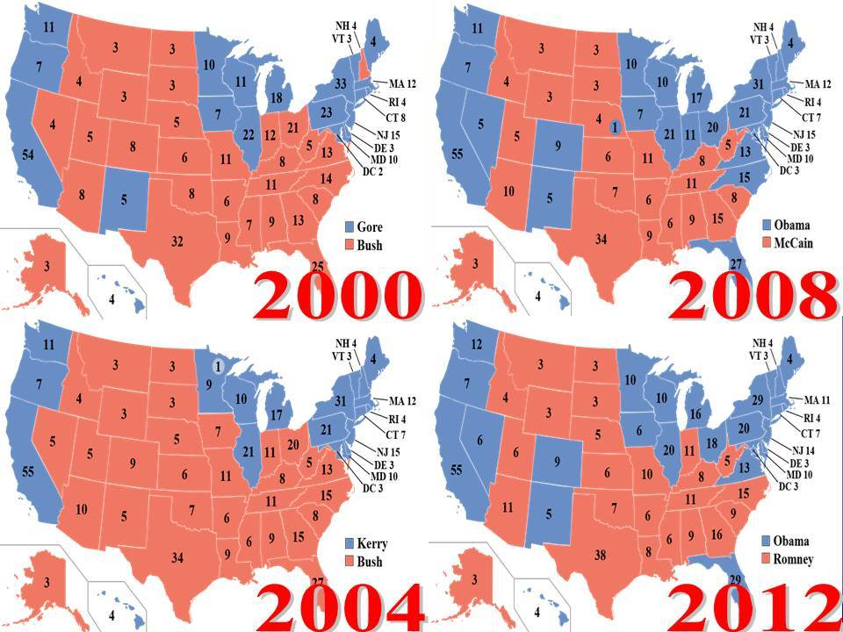

Slide 33
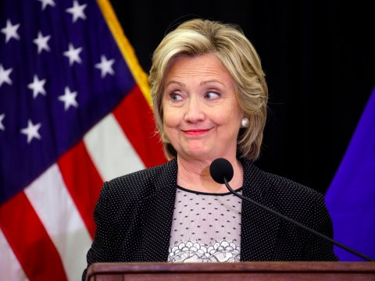
2016 U.S. Presidential Election
Trump: 62,979,636 Votes
Clinton: 65,844,610 Votes
62.9 million > 65.8 million
WON
LOST

Slide 34
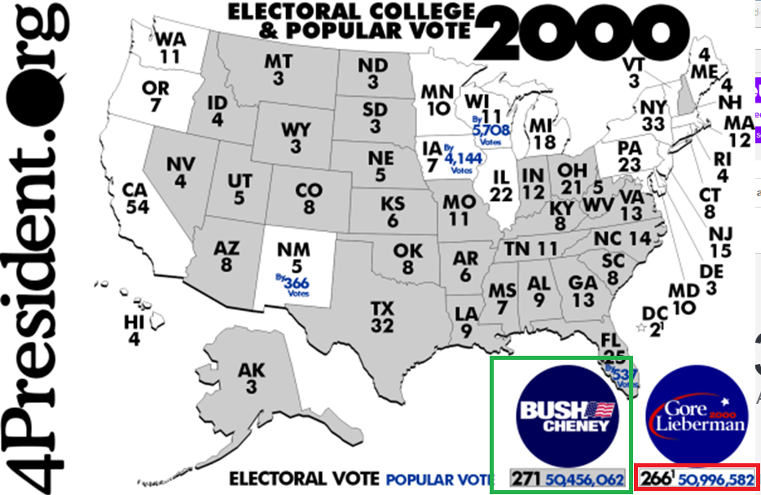
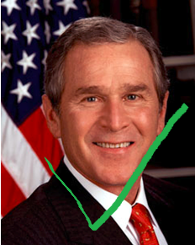

Slide 35
Huh? Why…?
The Electoral College!

Slide 39
You need one partner!
You need one phone → random.org/dice
One partner will be the Democratic Candace, one will be the Republican.
The person that rolled the highest amount first gets to pick which state they are going to find out the results from first.
Example: You and I are going to find out who wins the state of Tennessee. I roll first and roll a three. You roll next and roll a five. I get three popular votes and you get five. You win all 11 electoral votes from Tennessee ad I win zero. We put these numbers on the tally sheet.
• Keep a running total of how many electoral votes they have won as well as how many popular votes (totals from rolls) they have won as they play the game.
• As soon as one player receives 270 electoral votes they are the winner. There are 538 total electoral votes. Half of that is 269, therefore 270 is the majority.

